Slide 1
EE 508 housekeeping
Syllabus
  Any questions?
Survey:
  Fill out by Monday, Sep 8, 6pm (so far: 17/27 responses)
Software & environment
  Any issues? Have it ready by Tuesday.
Study groups:
  If you would like to be matched with 1-3 other students to work on the problem sets together, send me an email (chrnolte@bu.edu) by Monday, Sep 8, 6pm

Slide 2
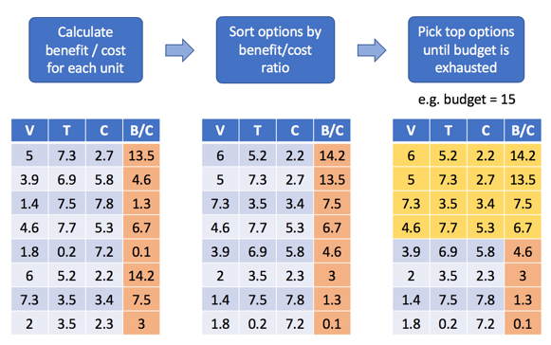
EE 508 / DS 537 – Data Science for Conservation Decisions
Problems & Methods
Day 2

Slide 3

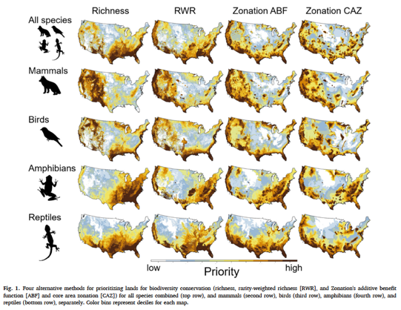
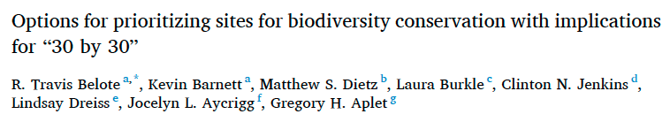

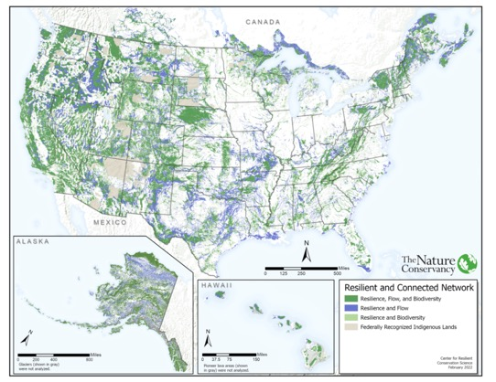

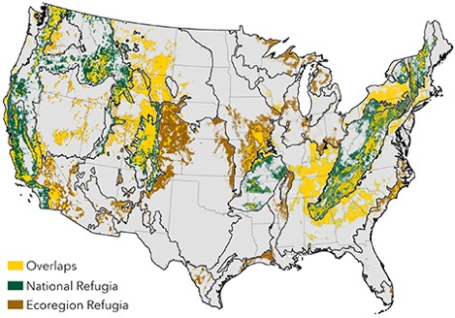
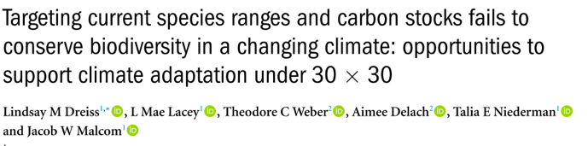
”30 by 30”: a proliferation of priority maps
Resilient and Connected Landscapes
Mark Anderson, Director of Conservation Science, The Nature Conservancy, Boston

Slide 4
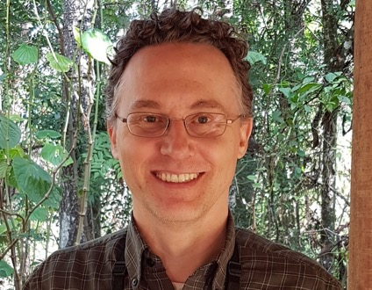



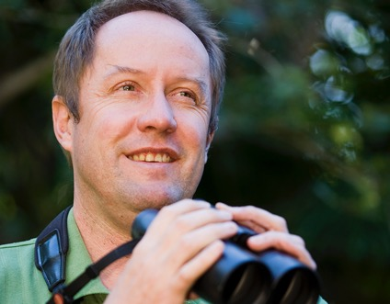

Clinton Jenkins
Florida Int’l U
Citations: 21,010
h-index: 51
Christopher Brown
Griffith University
Citations: 17,797
h-index: 53
Stuart Pimm
Duke University
Citations: 62,736
h-index: 110
Hugh Possingham
U of Queensland
Citations: 109,002
h-index: 175
“World leader in the study of present day extinctions”
Centre of Excellence for Environmental Decisions
Former Chief Scientist, The Nature Conservancy

Slide 5
Jenkins et al. (2015) PNAS
Could you do this?
Data
  Species
    Which ones? Why?
    What source?
    What is the format of the data? What does it look like?
  Protection
Processing
  Geoprocessing
  Definition of priority index
Conclusions drawn

Slide 6
1. Blue Ridge Mountains – Amphibians, mainly due to salamanders, as well as for fish and trees. Much of the area is Federal land.
2. Sierra Nevada Mountains – Amphibians and trees. Much of the area is Federal land.
3. California Coast Ranges – Trees, amphibians, and mammals. Substantial portions are Federal land.
4. Tennessee, Alabama, northern Georgia watersheds – Exceptional fish diversity, substantial reptile and amphibian diversity. Most of the region is privately owned.
5. Florida panhandle – Trees, fish, and reptiles. Almost none is protected areas. Mostly privately owned, but some Federal and State lands.
6. Florida Keys – Mostly due to trees. A moderate amount of the Keys is protected or public lands.
7. Klamath Mountains – Mainly due to trees, and somewhat to amphibians, and fish. Much of the area is Federal.
8. South-Central Texas around Austin and San Antonio – Mainly due to amphibians, but also fish and reptiles. This is nearly all privately owned.
9. Channel Islands of California – Mainly trees, reptiles, and mammals. Significant portions protected or Federal.

Slide 7
Brown et al. vs. Jenkins et al.
Brown et al.: conservation planning needs
Explicit and defensible objectives.
Prioritization of actions
(not species or places).
Consideration of social
constraints, such as cost.
Consideration of complementarity
Jenkins et al.:
”Brown et al formulate a mindset that produced a system of protected areas with nearly the opposite pattern of biodiversity priorities”.
“Those who save species by conserving land must decide the local tactics”

Slide 8
Benefit: What difference will it make to remove the threat?
Value
Threat
x
Benefit-Cost ratio
Cost
+ Spatial Dependencies
+ Dynamics Across Time

Slide 9
The Simple Approach
(ignoring any dependencies between actions)
Calculate benefit / cost ratio for each action (or unit)
Sort options by benefit/cost ratio
Pick top options until budget is exhausted
Value Threat Cost
V | T | C | B/C
5 | 7.3 | 2.7 | 13.5
3.9 | 6.9 | 5.8 | 4.6
1.4 | 7.5 | 7.8 | 1.3
4.6 | 7.7 | 5.3 | 6.7
1.8 | 0.2 | 7.2 | 0.1
6 | 5.2 | 2.2 | 14.2
7.3 | 3.5 | 3.4 | 7.5
2 | 3.5 | 2.3 | 3
V | T | C | B/C
6 | 5.2 | 2.2 | 14.2
5 | 7.3 | 2.7 | 13.5
7.3 | 3.5 | 3.4 | 7.5
4.6 | 7.7 | 5.3 | 6.7
3.9 | 6.9 | 5.8 | 4.6
2 | 3.5 | 2.3 | 3
1.4 | 7.5 | 7.8 | 1.3
1.8 | 0.2 | 7.2 | 0.1
V | T | C | B/C
6 | 5.2 | 2.2 | 14.2
5 | 7.3 | 2.7 | 13.5
7.3 | 3.5 | 3.4 | 7.5
4.6 | 7.7 | 5.3 | 6.7
3.9 | 6.9 | 5.8 | 4.6
2 | 3.5 | 2.3 | 3
1.4 | 7.5 | 7.8 | 1.3
1.8 | 0.2 | 7.2 | 0.1
Example:
Budget = 15
Spent: 13.6, Benefit: 128.6

Slide 10
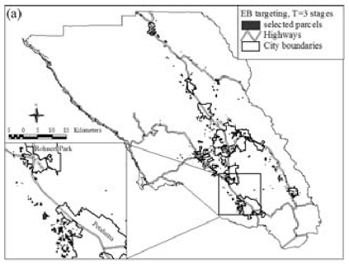
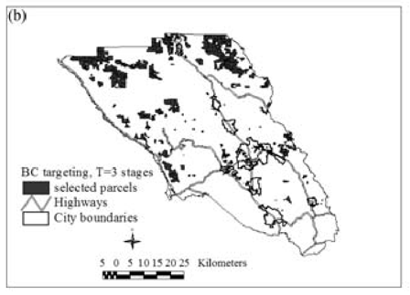
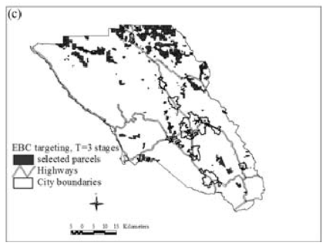
Maximize Value x Threat
Total Benefit: 0.6
Maximize Value / Cost
Total Benefit: 9.7
Newburn et al. (2006) Habitat and open space at risk of land-use conversation […] Am J of Agric Econ
Maximize Value x Threat / Cost
Total Benefit: 14.3
Sonoma County, CA: how to best allocate a fixed budget?
+ Benefits, threat, cost
+ Parcel level, empirically grounded
– Simplified benefits (“1" if priority)
– No complementarity

Slide 11
Tasks for Tuesday
Finish Exercise 1 in Lab 1 (QGIS)
Make sure your Python environment works.
Read “A Byte of Python”: https://python.swaroopch.com
  Basics
  Operators and expressions
  Control flow
  Functions
  Data structures
    (Know the difference between tuples, lists, sets, and dictionaries.)
Suggested: start readings for Thursday (pandas), as we might skip ahead

