Slide 1
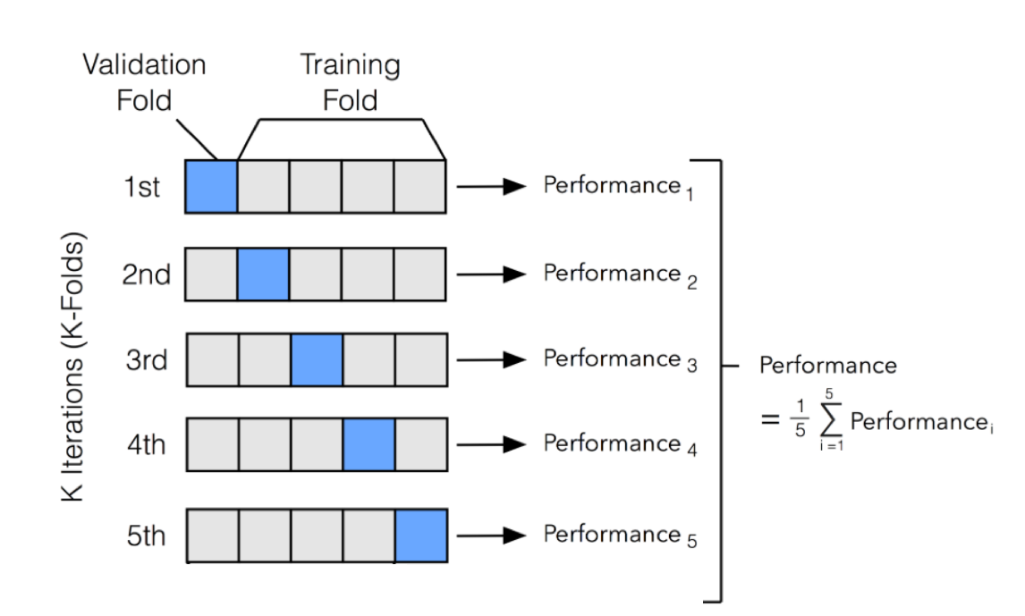
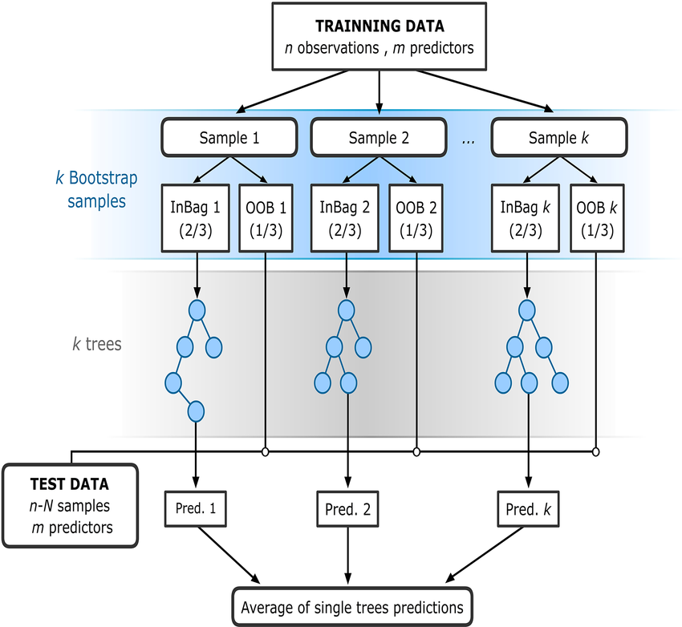
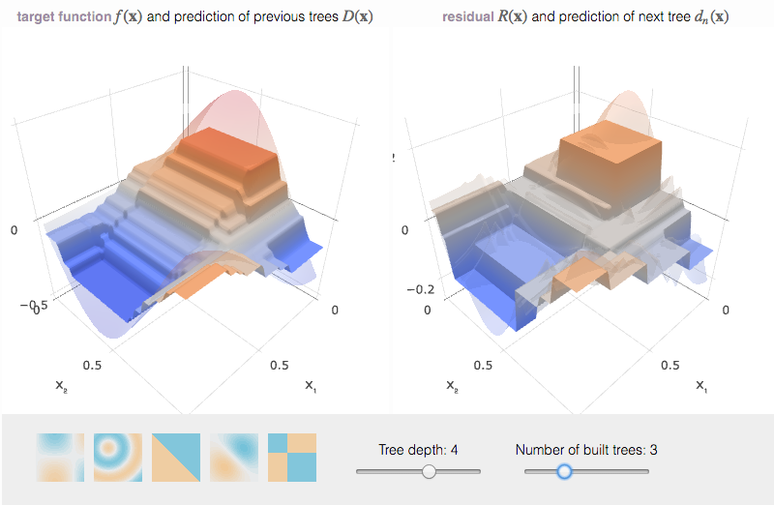
EE 508 / DS 537 – Data Science for Conservation Decisions
Cross-validation & tree ensembles

Slide 2
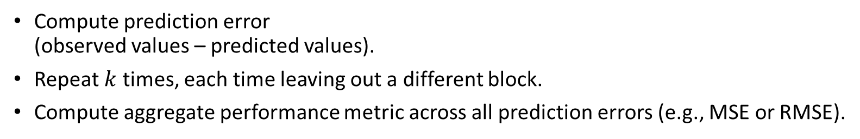
Cross-validation
Break data into folds (groups).
  How the folds are split depends on the structure of your prediction problem (random, spatially blocked, temporally blocked, hierarchically blocked, etc).
Train the model on data from all folds except one (training data)
Make prediction for observations from the fold that wasn’t used in training (test data).
Compute prediction error
(observed values – predicted values).
Repeat $k$ times, each time leaving out a different block.
Compute aggregate performance metric across all prediction errors (e.g., MSE or RMSE).

Slide 3
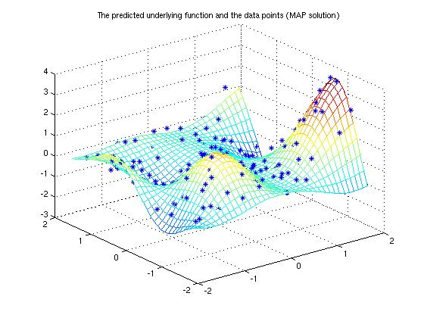
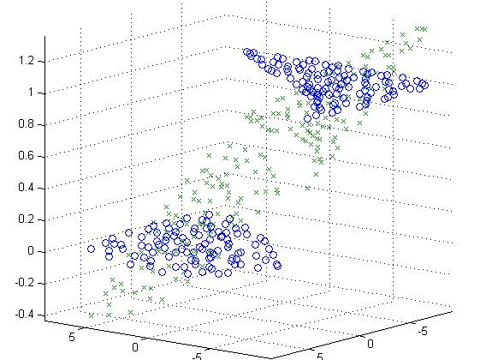
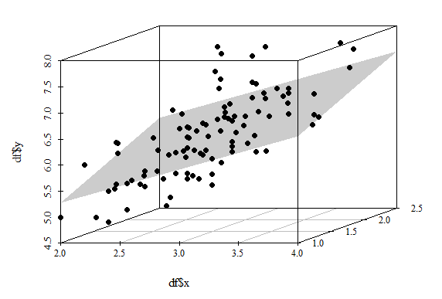

Regressions with predefined functional forms
$$y= ∝+β_{1}x_{1}+β_{2}x_{2}+ε$$
Can do well if you specify the functional form correctly.
Can do poorly if you don’t know the correct functional form.
  For instance, because relationships are complex and/or unknown.

Slide 4
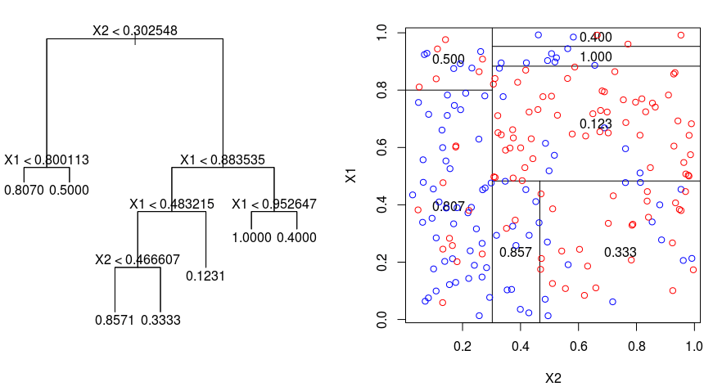
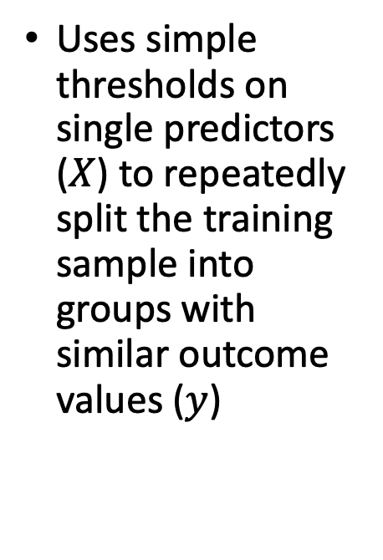
Regression Tree
Uses simple thresholds on single predictors ($X$) to repeatedly split the training sample into groups with similar outcome values ($y$)

Slide 5
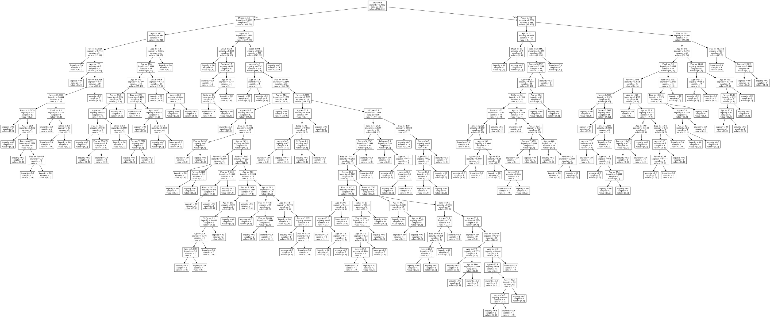
A single regression tree can be large
... and is usually vulnerable to overfitting

Slide 6
Random Forest Regressor
Many regression trees, each based on different randomly selected features and subsamples.
Averaging across trees
  ”Bagging” (parallelized)
Hyperparameter tuning:
  number of estimators
  minimum samples per leaf
  ...

Slide 7
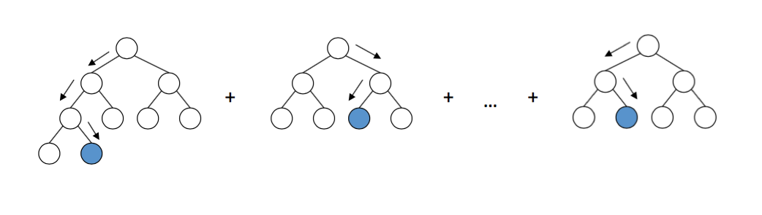
Gradient Boosting Regressor
Sequential improvements of regression tree predictions
Each new tree is built on the residuals of the previous ensemble.
Cannot be parallelized: slower (usually has max. tree depth).
Needs more tuning, more prone to overfitting.
If well-tuned, often beats random forests.
Hyperparameters: number of estimators, maximum tree depth, learning rate, ...

Slide 8
Demonstration

Slide 9
RandomForestRegressor vs. ExtraTreesRegressor
 | RandomForestRegressor defaults | ExtraTreesRegressor defaults
Features considered | All features: max_features=1.0 | All features: max_features=1.0
Finding splits in decision trees | Computes the locally optimal (most discriminative) combination of feature and threshold. | Generates random thresholds for each feature under consideration and picks the most discriminative one. Faster. Can reduce overfitting.
Bootstrapping (random sample) | Random sample: bootstrap=True | Full sample: bootstrap=False Set to True for out-of-bag estimates

