Slide 1
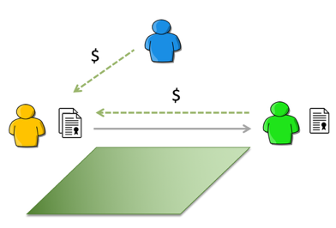
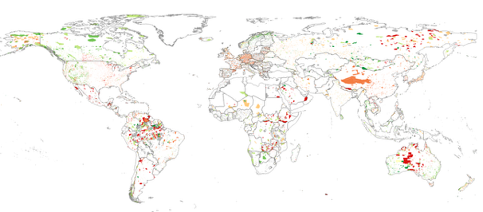
EE 508 / DS 537 – Data Science for Conservation Decisions
Conservation instruments
An overview of common strategies
Day 14

Slide 2
Analytical framework
Property or Land
Conflict of Interest
Rights
(Ex)change
of Rights
1
Between people and their desired resource uses and benefits
2
Definition: Which right(s)?
Allocation: Who has it?
Who decides?
Enforcement:
Who guarantees it?
Trade / Purchase: Who wants it?
5
3
4
If there’s no conflict of interest, you don’t need rights (or conservation).
Definition, allocation, and enforcement of rights are preconditions for their trade
Rights only exist if someone is ready and able to enforce them

Slide 3







A Simple Baseline Scenario
Government
Ownership:
a bundle of rights that varies across geographies
Landowner
Conservation Organization

Slide 4


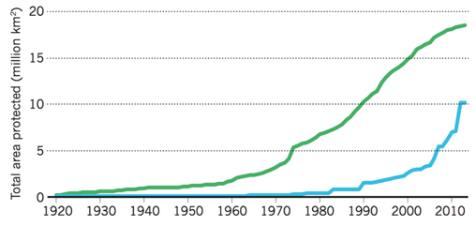
Public Protected Areas
Strict
Wild
National Park
Monument
Managed Habitat Protected Landscape
Managed Resource

Slide 5
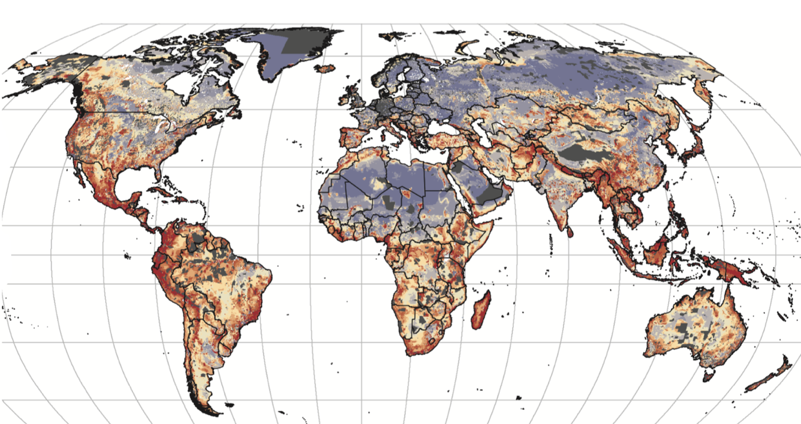
Private Land Use Regulations
A key driver of ”protection” globally.
U.S.: State and Municipal Laws
Some examples:
EU: Natura 2000
Brazil: Forest Code
Argentina: Forest Law

Slide 6
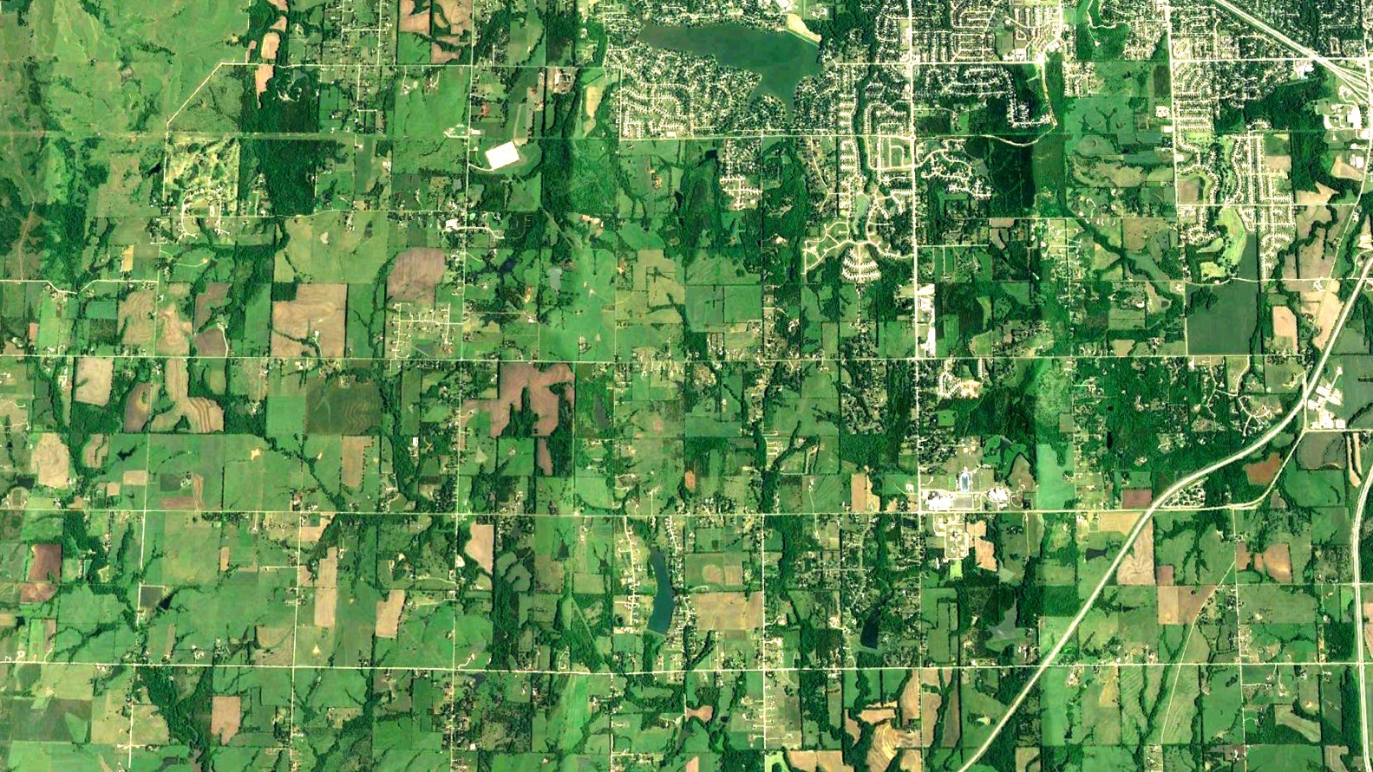
Iowa, USA

Slide 7
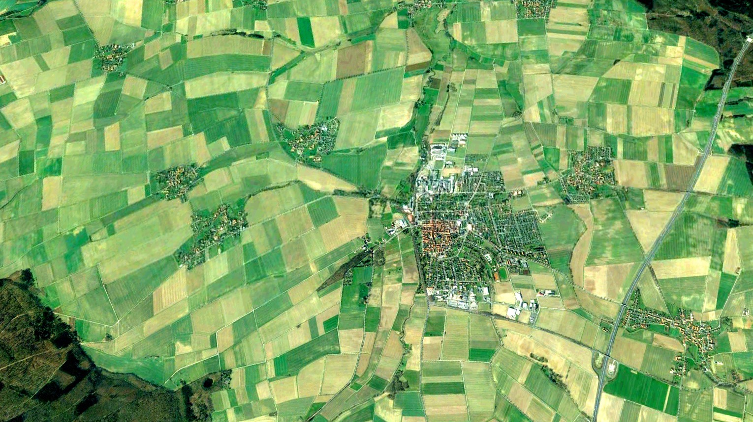
Bavaria, Germany

Slide 8
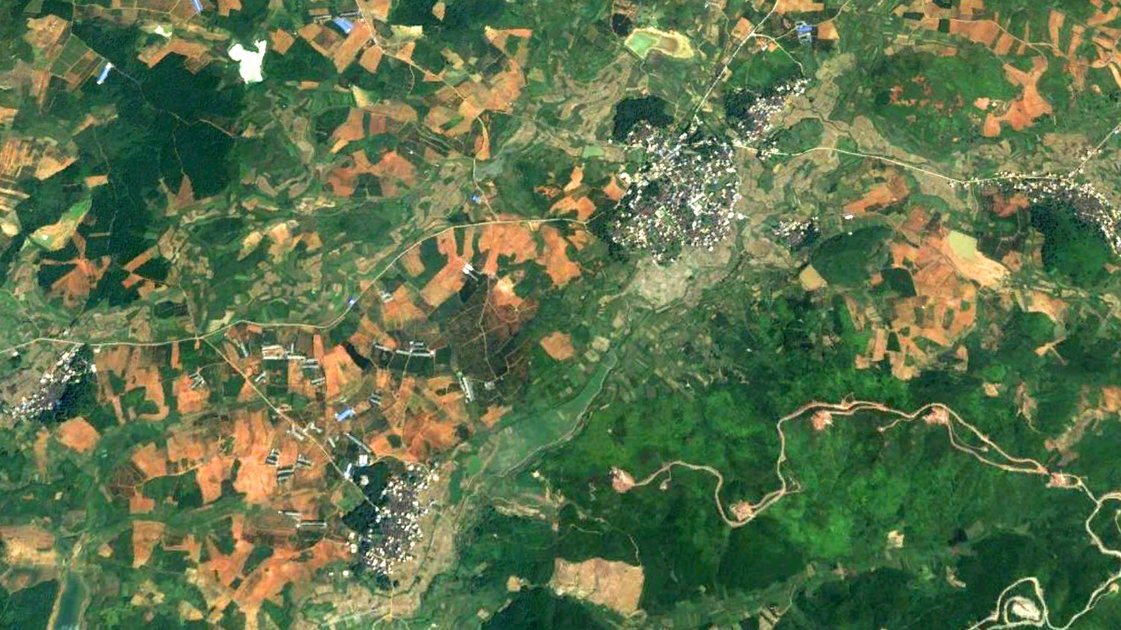
Hunan, China

Slide 9
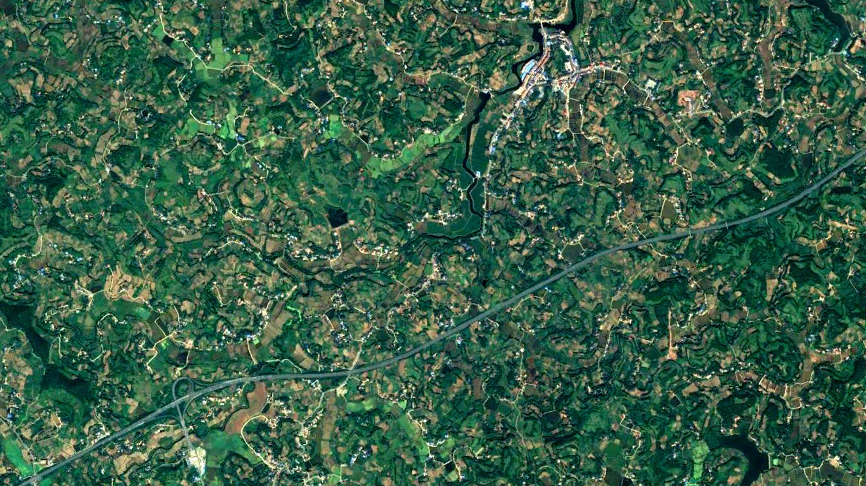
Sichuan, China

Slide 10
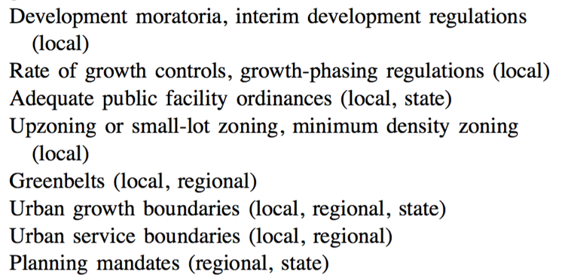
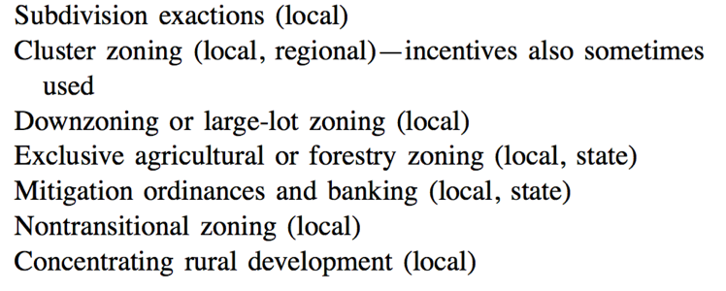
Local zoning: considerable diversity
“Lack of empirical evaluations of growth management policies” (Bengston et al. 2004)
“Does zoning follow the market?”
Wallace (1998) The market effects of zoning undeveloped land […]
Bengston et al. (2004) Public policies for managing urban growth and protecting open space […]

Slide 11
Regulatory taking
Compensation might occur, commonly at estimated fair market value (EFMV) of the transacted rights
Conservation organizations might attempt to advocate / lobby for regulation
$

Slide 12

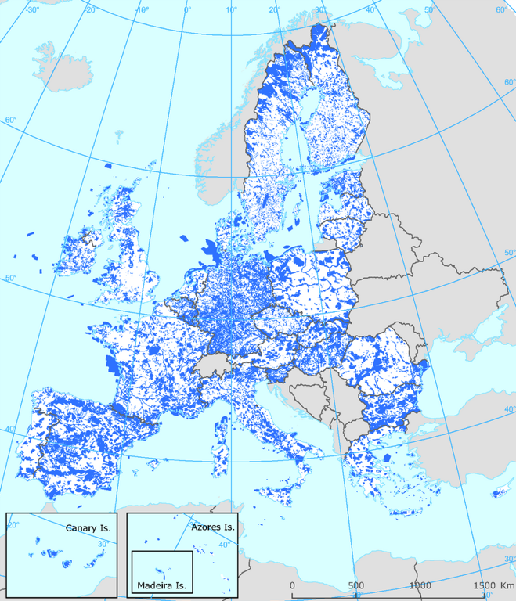
Natura 2000
Mandatory reporting of threatened habitats & species to the EU.
“Member states must […] take all the measures necessary to avoid interventions which incur the risk of seriously compromising the ecological characteristics of the sites.”

Slide 13
Eminent domain
Expropriation
& compensation, commonly at EFMV
$

Slide 14
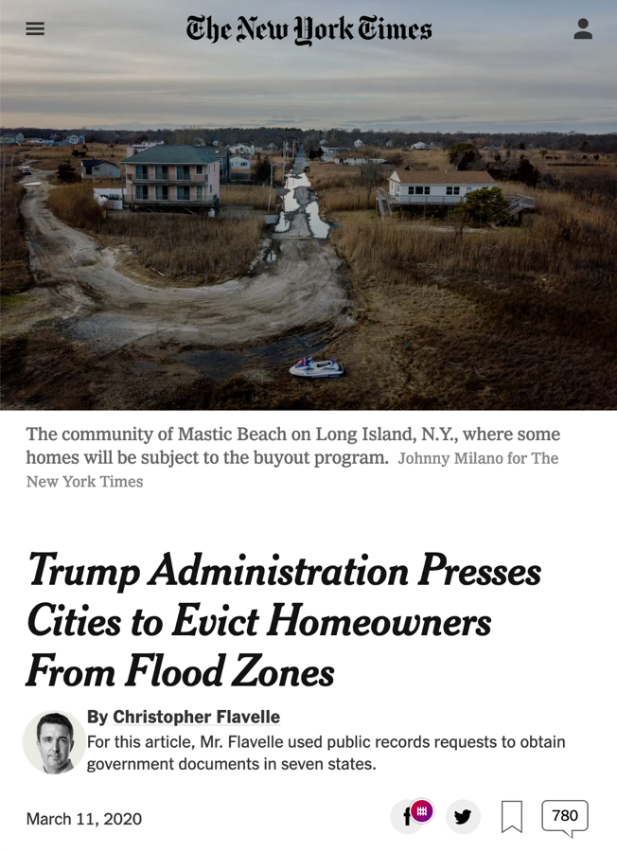
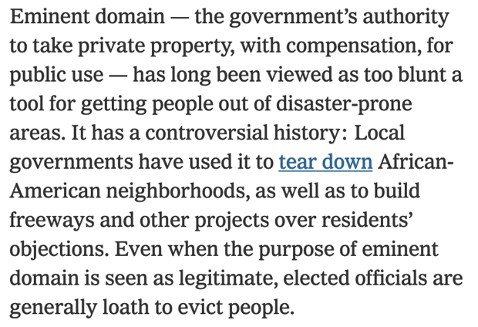
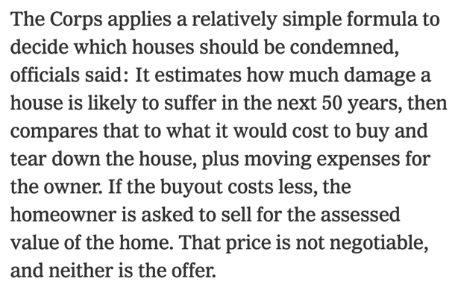

Slide 15
Eminent domain with “fair” value compensation
Willingness To Accept (WTA)
Value of the property to its current owner.
“At what price would the landowner be willing to sell?”
Nobody knows that value better than the landowner.
If WTA > EFMV:
Landowners lose the difference
(if forced to sell)
Policy targeting might not be optimal.
However, government usually can’t use personal WTA as basis for compensation (asymmetric information)
Estimated Fair Market Value
Expected sales price of a property in a competitive market, with well-informed sellers and buyers not under pressure to buy or sell.
Based on market analysis & comparable property sales.

Slide 16
Eminent domain with “fair” value compensation
Willingness To Accept (WTA)
Value of the property to its current owner.
“At what price would the landowner be willing to sell?”
Nobody knows that value better than the landowner.
If WTA < EFMV:
Landowner is willing to sell (puts the property on the market).
Estimated Fair Market Value
Expected sales price of a property in a competitive market, with well-informed sellers and buyers not under pressure to buy or sell.
Based on market analysis & comparable property sales.

Slide 17
Land acquisitions: voluntary ownership transfer
Direct payments or income tax break (for charitable donations)
Option 1: Government becomes landowner
$

Slide 18
Land acquisitions: voluntary ownership transfer
Income tax break (for charitable donations)
Option 2: Land trust becomes landowner
$
$
Direct payments

Slide 19
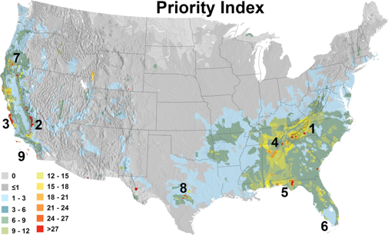
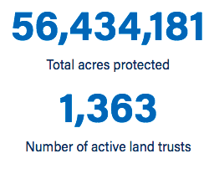
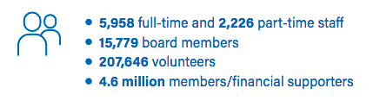
Land Acquisitions: A Big Deal in the U.S.
Direct public funding | ≈$2.5 B/yr. | 1998- 2016
Tax deductions | $1 B/yr. | 2010- 2012
Private philanthropy | ≈$1 B/yr. | 2011
Direct Public Funding 1998-2016

Slide 20
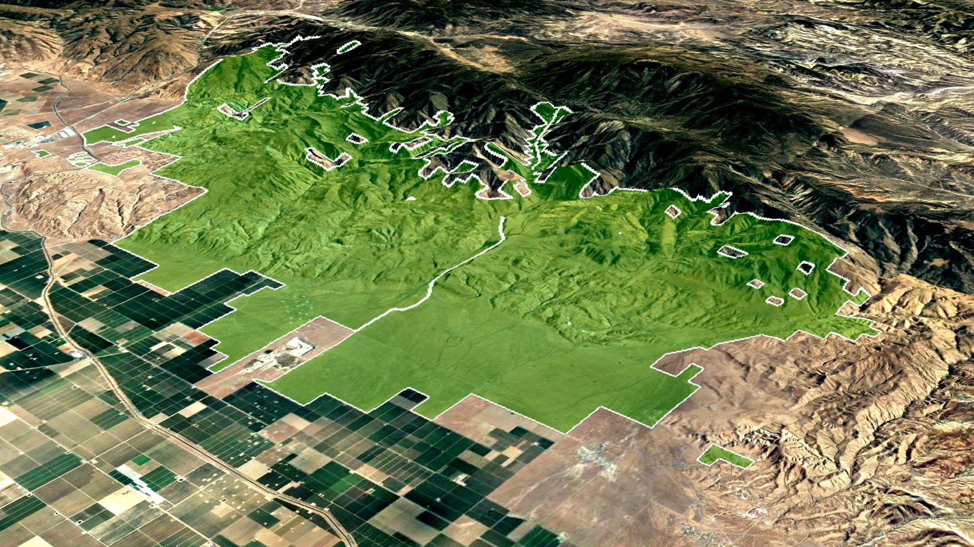
Wind Wolves Preserve, ~28,000 ha
1996, The Wildlands Conservancy

Slide 21
Conservation easement: partial right transfer
Direct payments, reduced property taxes, and/or income tax break (for charitable donations)
Option 1: Government receives the easement
$

Slide 22
Conservation easement: partial right transfer
Reduced property taxes, and/or income tax break (for charitable donations)
Option 2: Land trust receives the easement
$
$
Direct payments

Slide 23
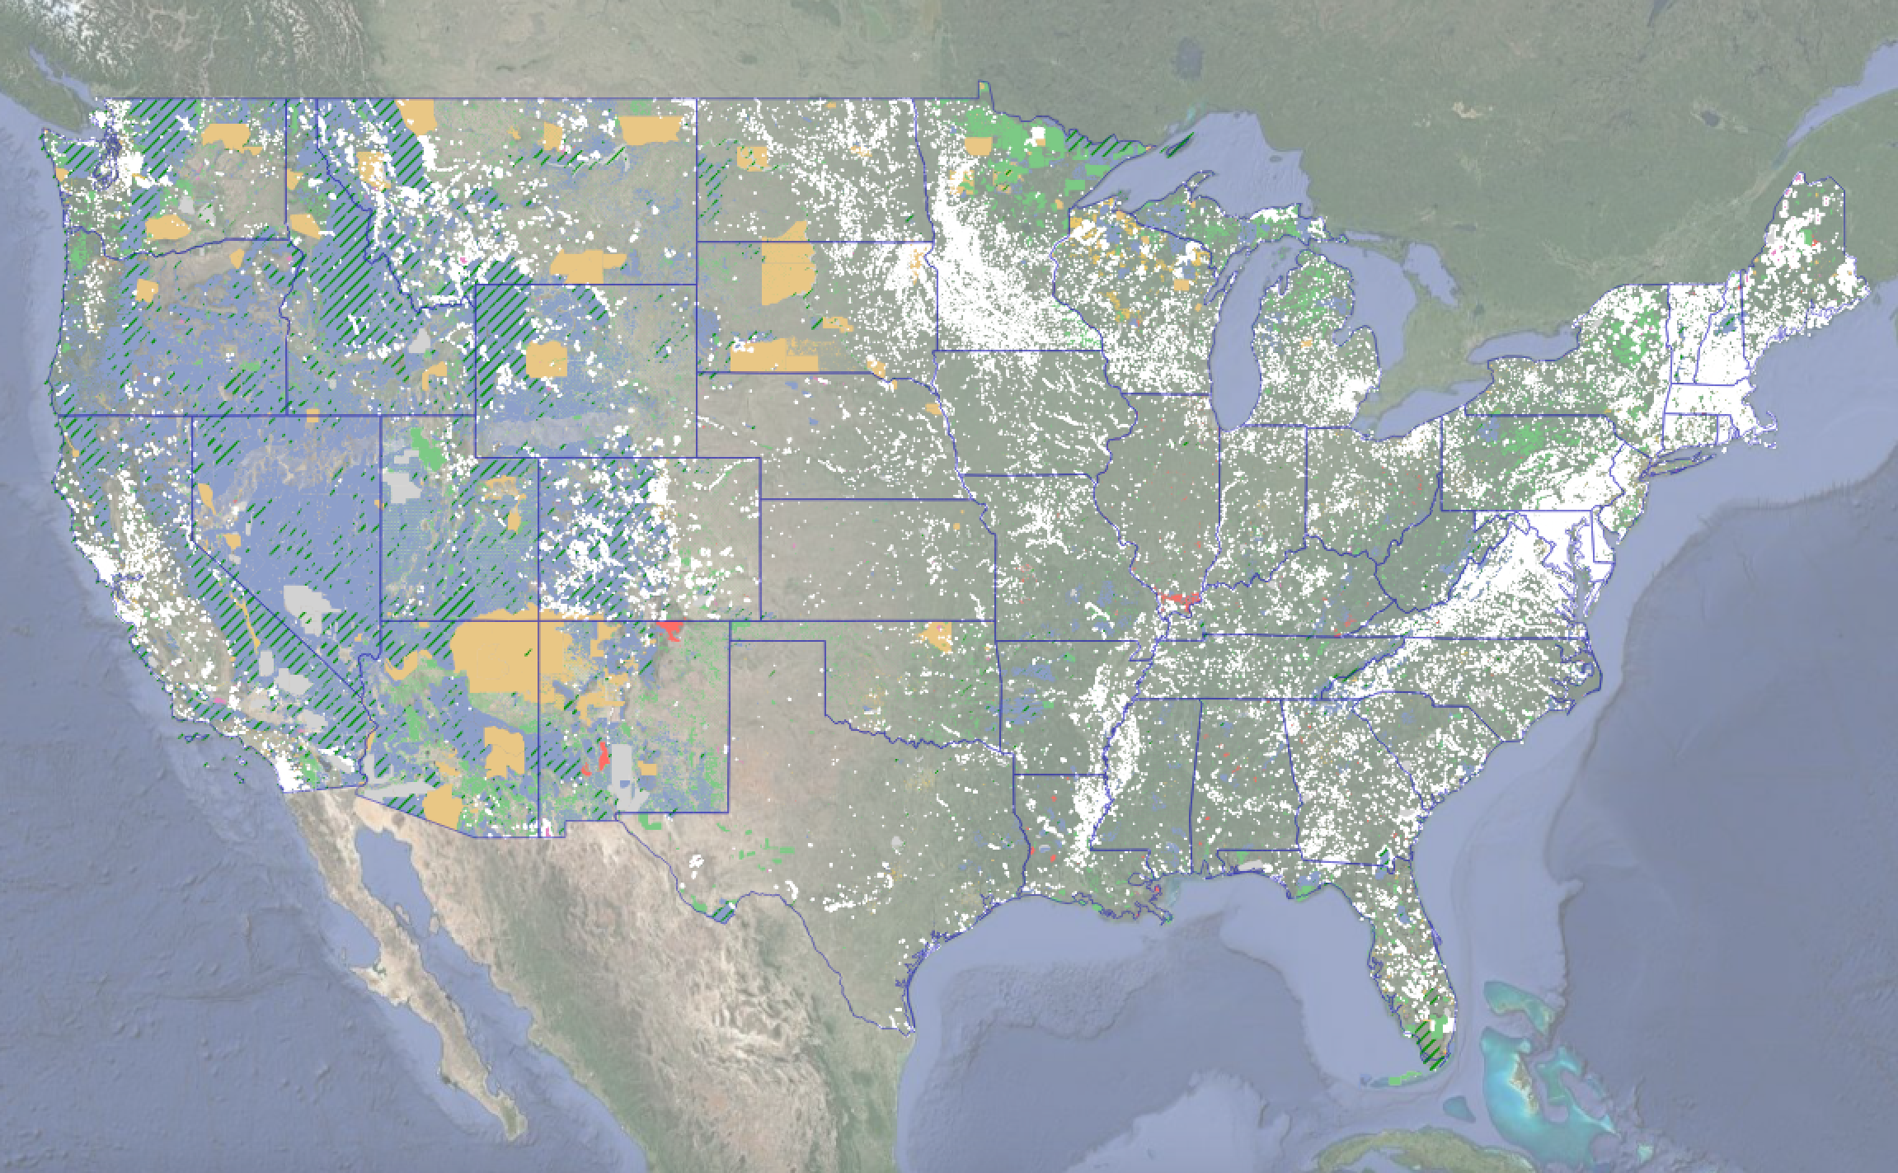
National Conservation Easement Database (NCED)
201,525 conservation easements, 33,527,688 acres (Oct 2022)

Slide 24
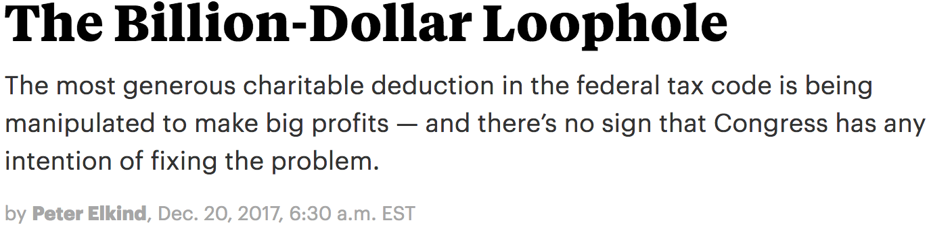
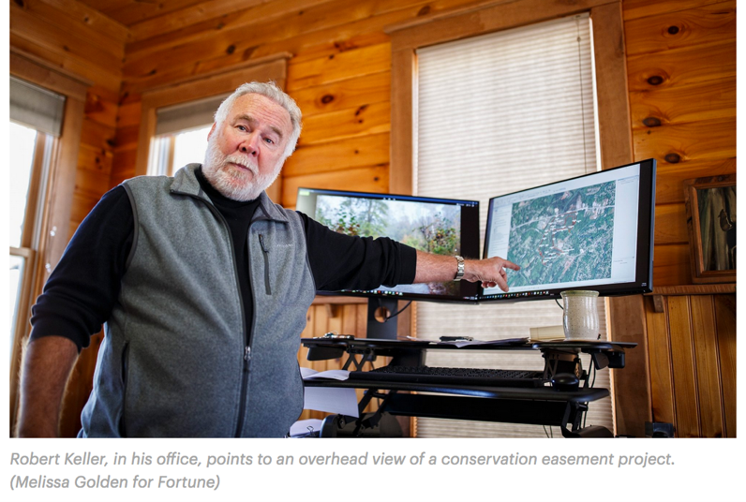
https://www.propublica.org/article/conservation-easements-the-billion-dollar-loophole

Slide 25
Appraising conservation easements
= estimating its fair market value
Comparable sales without easements
$
CE Value
Comparable sales with easements
$
Fair market value without restriction
Fair market value with restriction

Slide 26

Payments for Environmental Services
usually a temporary transfer of partial rights (e.g., the right to harvest timber)
Multiple options: PES can be offered by governments, land trusts, companies, etc.
$
or
$

Slide 27
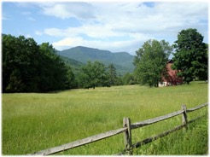
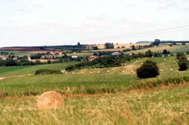

PES: Flagship Examples
Paying farmers for watershed protection
  City of New York pays farmers in the Catskills watershed for improved farming practices – and saved costs for new filtration plant.
  Mineral water company Vittel (Nestlé Waters) pays 27 dairy farmers for low-impact (and/or organic) management practice (5100 ha).
Paying landowners for forest conservation in Costa Rica
  1 Mha enrolled (2013), 5-15 year contracts, payments from government, water suppliers, agribusinesses, hydropower.

Slide 28

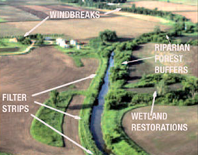
PES: Flagship Examples
China: paying farmers for afforestation (“Grain for Green”)
  33.8 Mha of degraded / barren land converted to forestland (1999-2010).
  Government funded.
  “Largest known PES in history.”
Agri-environmental measures (EU)
  Input reduction, organic farming, rotation schemes, water use reduction, landscape maintenance, set-aside, buffer strips, hedgerows, mowing, grass species, …
  2013: 47 Mha under some measure.

Slide 29

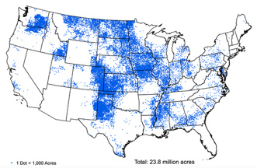
PES: Flagship Examples
US: Conservation Reserve Program
  Contracts with farmers to retire highly erodible and env. sensitive cropland and pasture, 10-15 years
  1985: beginning; 2007: 14.9 Mha; 2015: 9.8 MHa, $1.8B/yr
  Auction mechanism based on Environmental Benefit Index and local average rental rates:
  Wildlife, water quality, erosion, enduring benefits, air quality, costs

Slide 30
The Asymmetric Information Problem
Imagine you are a government agency that wants to maximize carbon sequestration through avoided deforestation using a voluntary incentive program with a predefined, finite budget.
You know that the likelihood of losing forests, and the costs of conserving them, varies across properties. What are some possible reasons for this variation?
  Some properties might be more suitable for alternative uses (development, agriculture, solar panels, etc.).
  Some properties might already be subject to regulations.
  Some landowners are more environmentally motivated.
  Some landowners might need money more than others.
How can you design the program to maximize impact?
Ferraro (2008) Asymmetric information and contract design for payments for environmental services. Ecol Econ
Notes:
Bad information on opportunity cost may lead to excess supply or excess demand for contracts.

Slide 31
The Asymmetric Information Problem
Information asymmetry: Landowners know opportunity costs much better than PES buyers and thus have an incentive to overstate costs → “informational rents”.
How may PES buyers reduce informational rents (and thus improve cost-effectiveness)?
  Costly-to-fake proxies: Estimate opportunity costs based on e.g. soil type, distance to roads/markets, forest type, etc.
  Screening contracts: Offering different kinds of PES contracts that reveal the types of land users (powerful, but no examples).
  Auctions: Inviting contract offers from land owners and buy the contracts with the lowest bids (e.g. US Conservation Reserve Program, Australian EcoTender).
Ferraro (2008) Asymmetric information and contract design for payments for environmental services. Ecol Econ
Notes:
Bad information on opportunity cost may lead to excess supply or excess demand for contracts.

Slide 32
Asymmetric Information:
How much do you end up paying?
Price
Auction Prices
(potential)
Supply of Forest
Uniform Price
Uniform
Budget
Minimum
Budget
Ecosystem Service
(e.g. amount of forest)

Slide 33
Mandatory vs. voluntary
Under which circumstances can one be better than the other?
Scenario: creating a protection program in a landscape with thousands of landowners and a fixed budget
Option 1: Regulatory taking with compensation at fair market rate
Factor 1: Ecosystem services with strong interdependencies (e.g. habitat connectivity, scenic views, water purification)
Option 2: Voluntary incentive program (PES)
Factor 2: High heterogeneity in unobservable costs to landowners (e.g. family situations, preferences)

Slide 34
Conservation Banking: Cap-and-Trade
Price
MC_{high}
MC_{low}
Ecosystem Service

Slide 35
Conservation Banking: Cap-and-Trade
Price
MC_{high}
MC_{low}
p_{Perm}
Ecosystem Service
ES₁
ES_{init}
ES₂

Slide 36
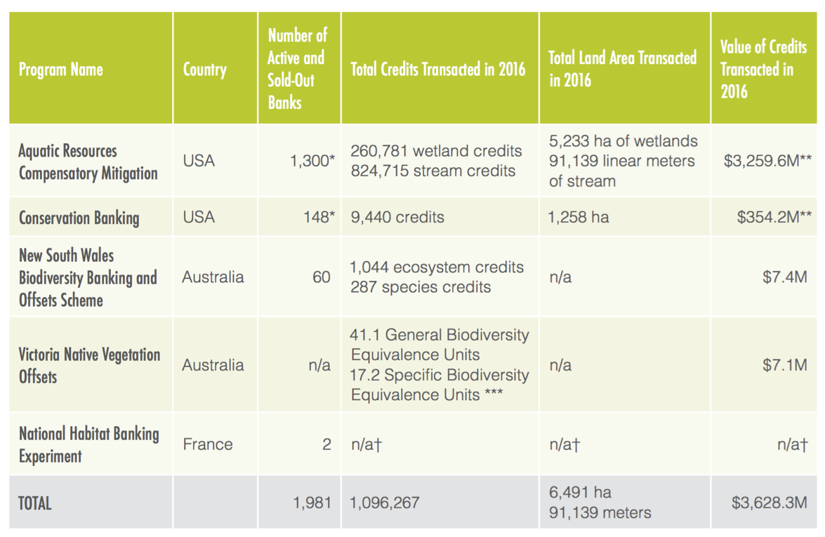
Major Mitigation Banking Programs
Bennett et al. (2017) State of Biodiversity Mitigation 2017. Forest Trends

Slide 37




Enforcement can be an important cost factor for all these programs

Slide 38



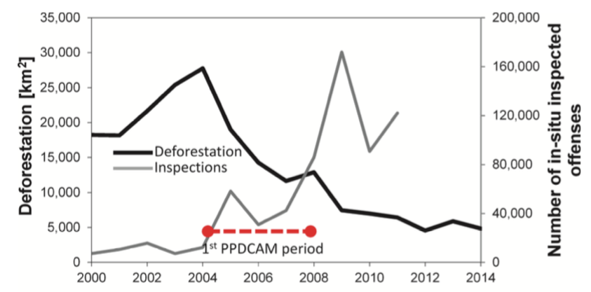
Amazon forest: regulatory enforcement
Börner et al. (2015) Post-Crackdown Effectiveness of Field-Based Forest Law Enforcement […]

Slide 39
Optimal enforcement is rarely ”perfect”
Even if many conservationists would like to see more of the latter
Marginal (unit) cost / benefit
Cost of a one-unit increase in enforcement disincentive (e.g. gas & salaries)
Benefit (e.g. lower poaching) of a one-unit increase in enforcement disincentive
Enforcement disincentive: p(detection) * sanction

