Slide 1
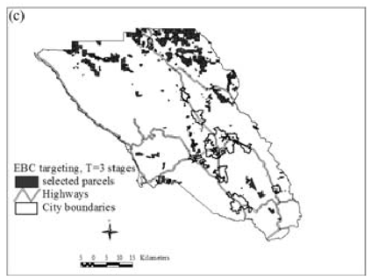
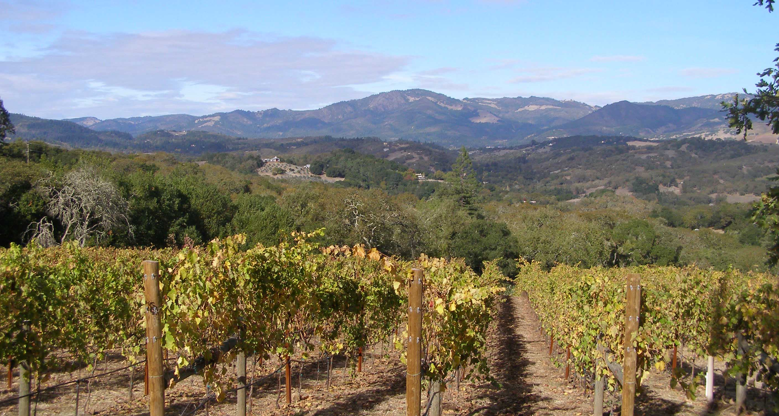
EE 508 / DS 537 – Data Science for Conservation Decisions
Habitat and Open Space at Risk of Land-Use Conversion: Targeting Strategies for Land Conservation
Newburn et al. (2006)
Day 14

Slide 2
Sonoma County, CA: how to best allocate a fixed budget to protect lands from conversion?
Sonoma county’s budget: $10M/year
https://commons.wikimedia.org/wiki/File:Sonomamtnvineyard.jpg

Slide 3




Conservation easements in Sonoma
Direct payments
Option 1: Government receives the easement
$

Slide 4
“Expected Benefit”
Newburn et al. 2006
Here: conversion to residential or vineyard
Value
Threat
“Benefit”
Newburn et al. 2006
x
Cost
Here: total value - existing use value
Easement cost
Newburn et al. 2006

Slide 5
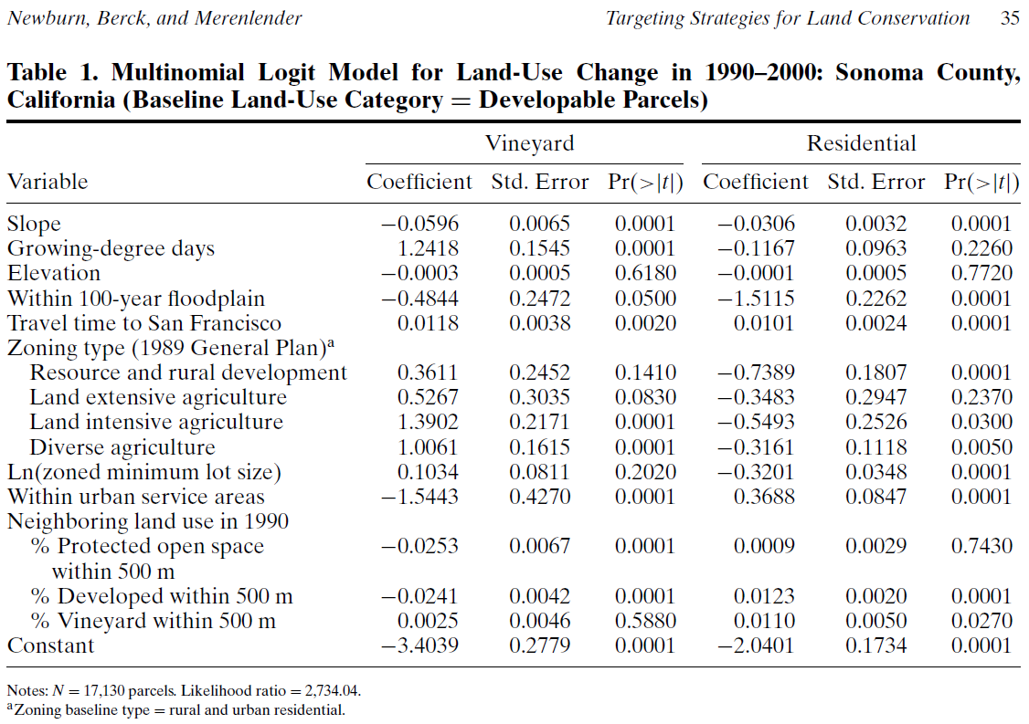

Slide 6
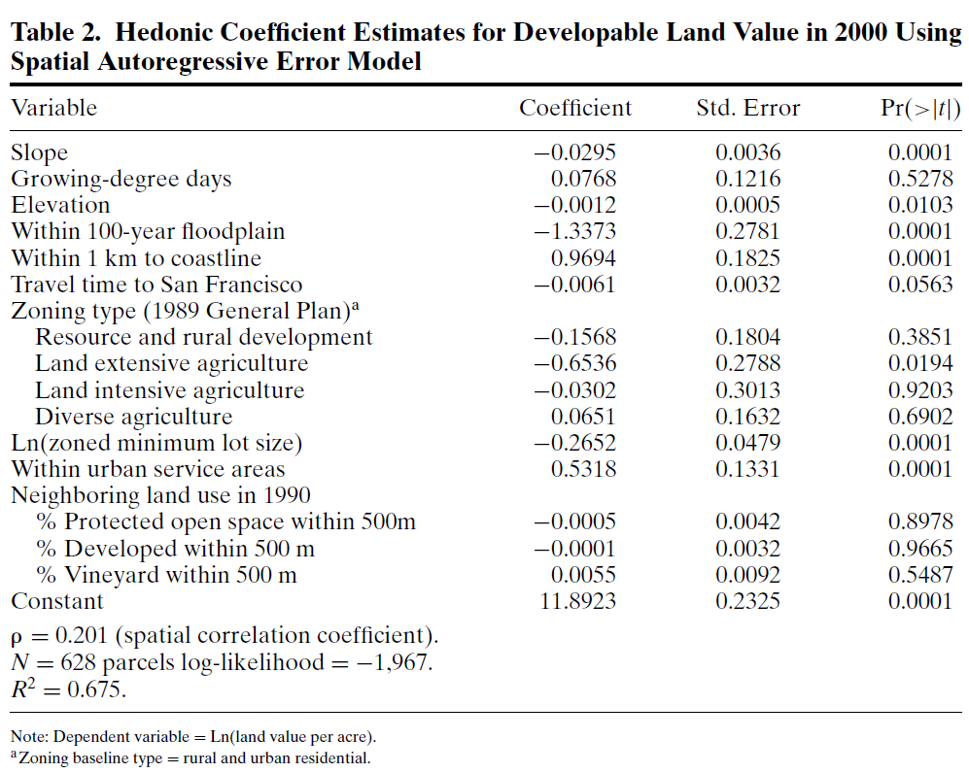

Slide 7
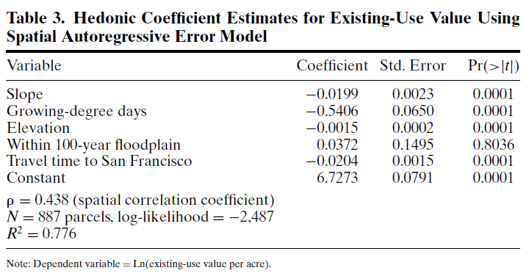

Slide 8
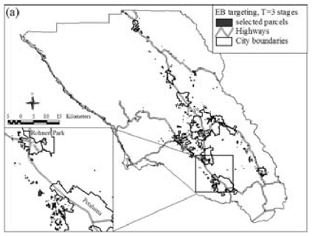
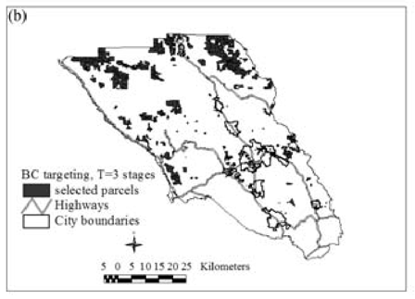
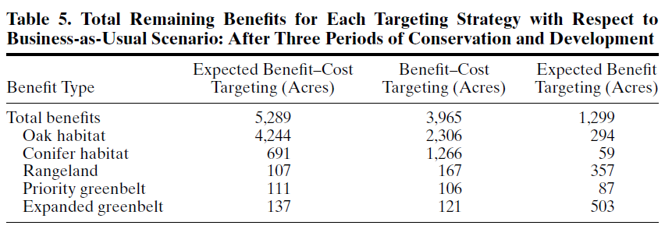
Maximize Value x Threat
Total Benefit: 0.6
Maximize Value / Cost
Total Benefit: 9.7
Maximize (Value x Threat) / Cost
Total Benefit: 14.3
Newburn et al. (2006) Habitat and open space at risk of land-use conversation […] Am J of Agric Econ

Slide 9
