Slide 1
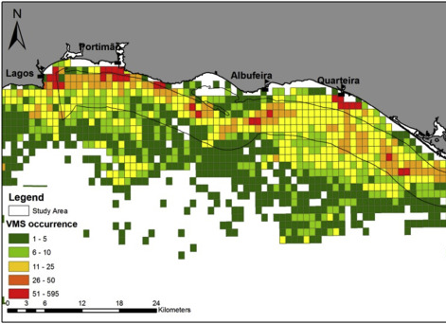

EE 508 / DS 537 – Data Science for Conservation Decisions
Systematic Conservation
Planning in Marxan

Slide 2
Difference in social benefit (as defined by objective function)
In conservation, we often want to avoid loss (of carbon, species, etc.), and can formulate this ratio as:
△ Benefit
Value
x
△ Threat
Difference in social cost (e.g., public spending)
△ Cost
△ Cost
Benefits and costs are defined broadly as “what we want and do not want”. They do not have to be expressed in monetary terms.
+ Spatial dependencies
+ Dynamics across time

Slide 3
The Simple Approach
(ignoring any dependencies between actions)
Calculate benefit / cost ratio for each action (or unit)
Sort options by benefit/cost ratio
Pick top options until budget is exhausted
Value Threat Cost
V | T | C | B/C
5 | 7.3 | 2.7 | 13.5
3.9 | 6.9 | 5.8 | 4.6
1.4 | 7.5 | 7.8 | 1.3
4.6 | 7.7 | 5.3 | 6.7
1.8 | 0.2 | 7.2 | 0.1
6 | 5.2 | 2.2 | 14.2
7.3 | 3.5 | 3.4 | 7.5
2 | 3.5 | 2.3 | 3
V | T | C | B/C
6 | 5.2 | 2.2 | 14.2
5 | 7.3 | 2.7 | 13.5
7.3 | 3.5 | 3.4 | 7.5
4.6 | 7.7 | 5.3 | 6.7
3.9 | 6.9 | 5.8 | 4.6
2 | 3.5 | 2.3 | 3
1.4 | 7.5 | 7.8 | 1.3
1.8 | 0.2 | 7.2 | 0.1
V | T | C | B/C
6 | 5.2 | 2.2 | 14.2
5 | 7.3 | 2.7 | 13.5
7.3 | 3.5 | 3.4 | 7.5
4.6 | 7.7 | 5.3 | 6.7
3.9 | 6.9 | 5.8 | 4.6
2 | 3.5 | 2.3 | 3
1.4 | 7.5 | 7.8 | 1.3
1.8 | 0.2 | 7.2 | 0.1
Example:
Budget = 15
Spent: 13.6, Benefit: 128.6

Slide 4
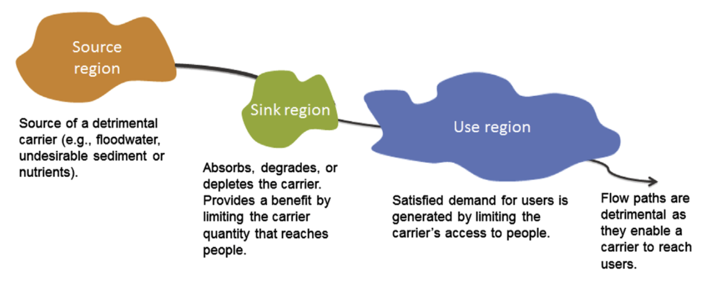
Spatial dependencies
… creating a sink region (e.g., a wetland) between the source and the use region will have benefits for people in the use region …
If a source region emits a ”carrier” (e.g. a toxic pollutant) that is bad for the people in the use region…
However: if we completely remove the source of the “bad”, the value of adding a sink region changes as well (its “sink function” is not needed anymore)
Therefore, the benefits of the two actions “clean up the source” and “create a new sink” are not independent.
Bagstad et al. (2013) Spatial dynamics of ecosystem service flows […] Ecosystem Services

Slide 5

Combinations of actions: “brute force” approach
(allowing for dependencies between the costs or benefits of actions)
Input scenario (a combination of locations & actions)
Model response of ecological system
Measure change in objective function
CO₂ Sequestration
Hydrological Flows
Species Persistence
Viewshed Modeling
Cost
Benefit
Repeat for all possible combinations
of locations and actions
Pick the solution with the highest
benefit for the given budget
n = $2^{n_{Locations}∗n_{Actions}}$
10 locations, 5 actions → 1,125,899,906,842,620 scenarios
(if actions are not
mutually exclusive)

Slide 6
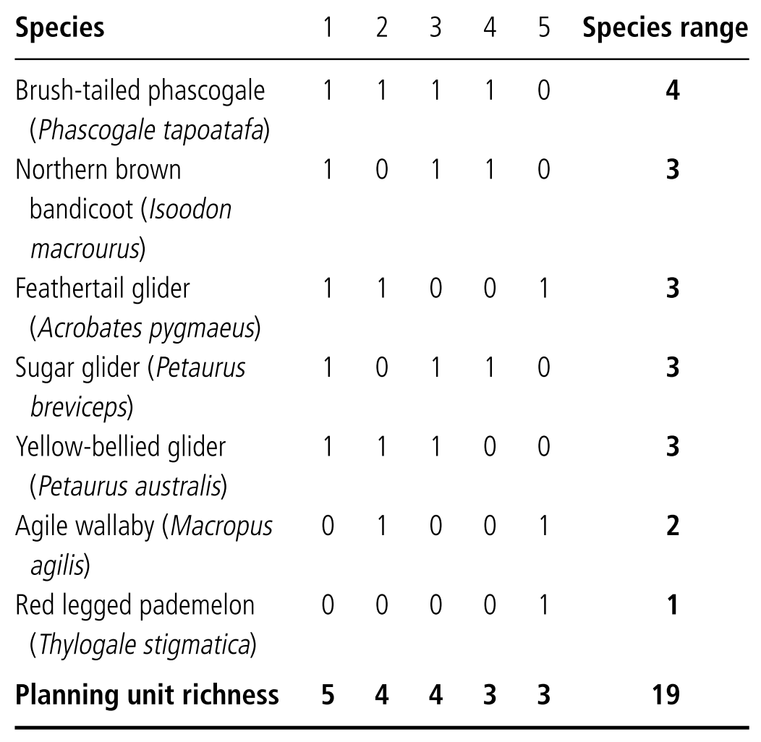
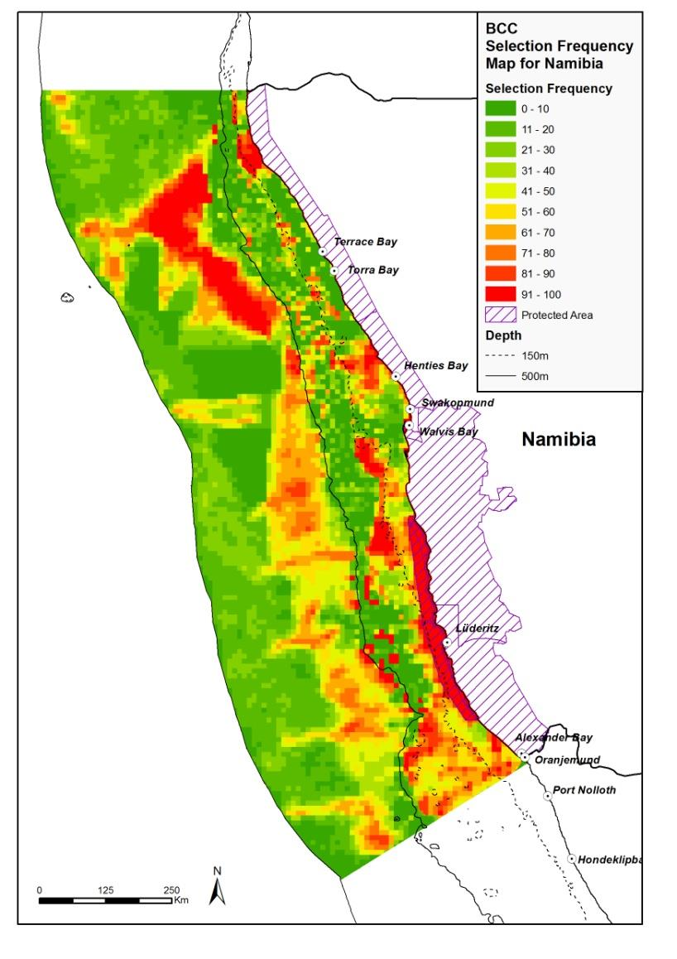
Complementarity
Illustrative example with 5 planning units and 7 species. Protecting the three most species-rich locations will not protect all species listed here.
Marxan finds reserve
networks that achieve
predefined comple-
mentarity targets at
the lowest cost.
It uses an algorithm
called “simulated
annealing”

Slide 7
The Conservation Planning Problem
How can we create protected area networks
that represent all species at the lowest cost?
or, more precisely
Which locations should we protect
to achieve a (potentially large) number
of species-specific protection targets
at the lowest overall cost?

Slide 8

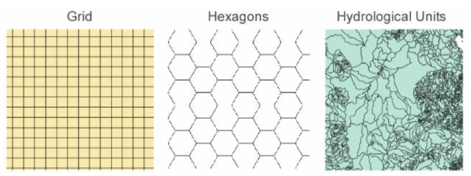

Marxan: the “minimum set” problem
Problem: Find the set of planning units (PU) that reaches all species protection targets at the lowest overall cost.
Decision variable: selection of protected PUs
  Planning units can be: pixels, hexagons,
  parcels, watersheds, political boundaries, …
Objective: minimize cost (of acquiring PUs, and of protecting their boundaries)
Constraint: all species targets have to be reached (e.g. 30% of every species)
Ian Ball
Hugh
Possingham

Slide 9
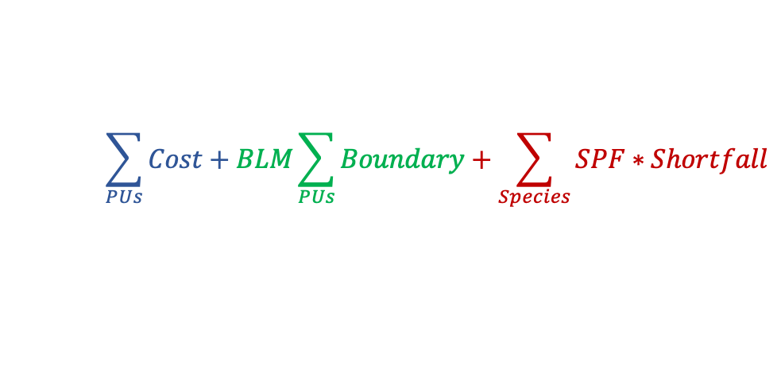
Marxan’s objective function
Because simulated annealing does not formally incorporate constraints, Marxan’s objective function includes this penalty for missed targets. This means that you don’t get a strong guarantee that all targets will be met, and usually still need to double-check whether all targets have been met.
Cost to protect all selected planning units (PUs)
Sum of length of all outer boundaries of selected PUs
Difference between species target and species amount in selected PUs
minimize:
$$\sum_{PUs}{Cost+BLM\sum_{PUs}{Boundary+\sum_{Species}{SPF∗Shortfall}}}$$
Boundary Length Modifier: relative weight of one unit of outer boundary vs. one unit of PU protection cost
Species Penalty Factor: relative weight of missing one unit of a species-specific target vs. one unit of PU protection cost

Slide 10
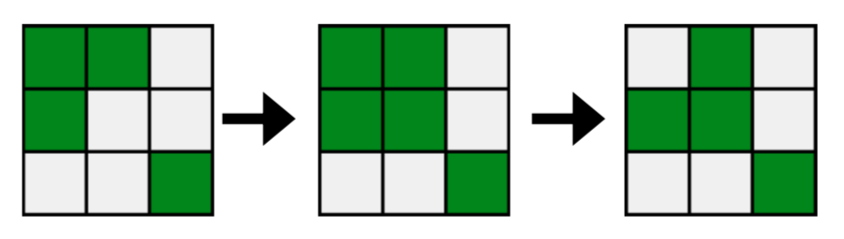
How Marxan works: step by step
“Simulated annealing” algorithm
Start with a random set of selected planning units.
Consider switching the selection status of a random planning unit.
  Evaluate the network with vs. without the change against Marxan’s objective function to verify whether the switch will move you closer or further away from the objective.
  If it gets you closer to
  the objective, accept
  the switch.
Repeat Step 2 a million times to find a good network.
Repeat Steps 1-3 several times (10-100 times) to find multiple near-optimal networks.

Slide 11
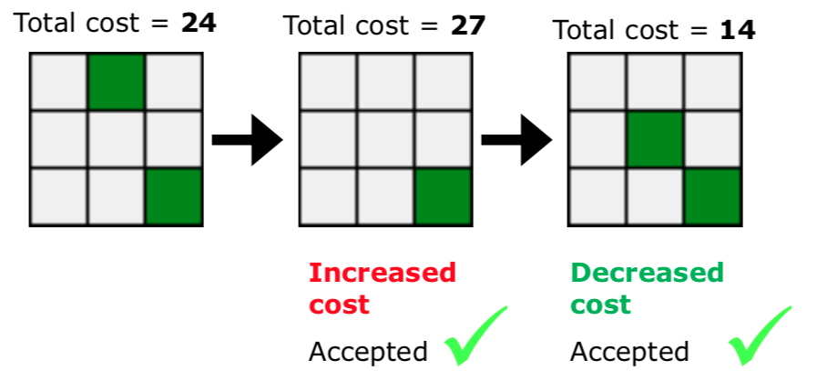
Accepting ”bad” decisions early on
At the beginning of any Marxan run, the algorithm will randomly accept some backwards steps, i.e. steps that will temporarily lead to a worse objective function. This avoids getting stuck too early in local optima.
Later in the run, the probability of accepting backwards steps decreases (”lowering the temperature”).

Slide 12
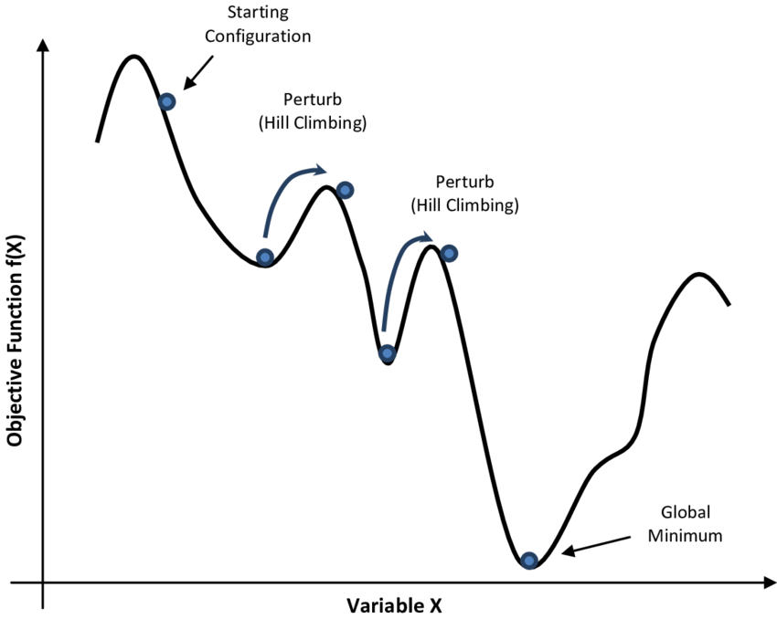
How can we avoid getting stuck in local optima?

Slide 13
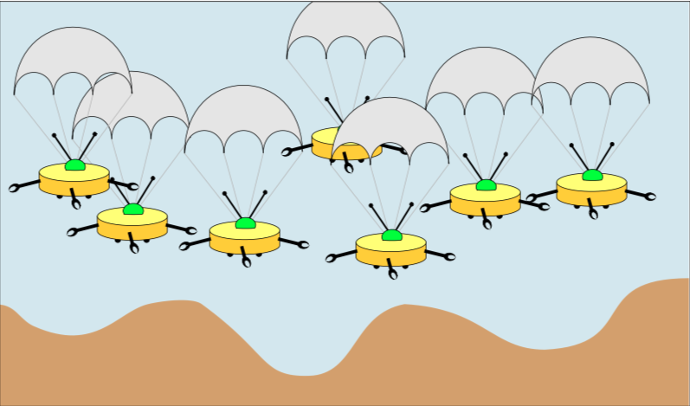
Repeated simulated annealing
At the end of each run, Marxan will have found “a” good solution. However, the solution is not guaranteed to be optimal, as it depends on the initial randomized set.
Repeating the entire process
multiple times with different
initial random sets of planning unit
returns several “near-optimal”
protected area networks to choose
from (and one that will perform
“best” among this set).

Slide 14
Selection frequency map
Green shading: selection frequency
Grey: already protected (locked in)
A common way to summarize Marxan results. A selection frequency (SF) map shows the number of times that a planning unit is selected into a final solution.
Planning units with high SF are more “irreplaceable” for achieving the targets.
  But: selecting only PUs with the highest SF will not give you an “optimal solution”! Why?
Only the individual solutions of Marxan runs are optimized against Marxan’s objective function

Slide 15
Examples from our work

Slide 16
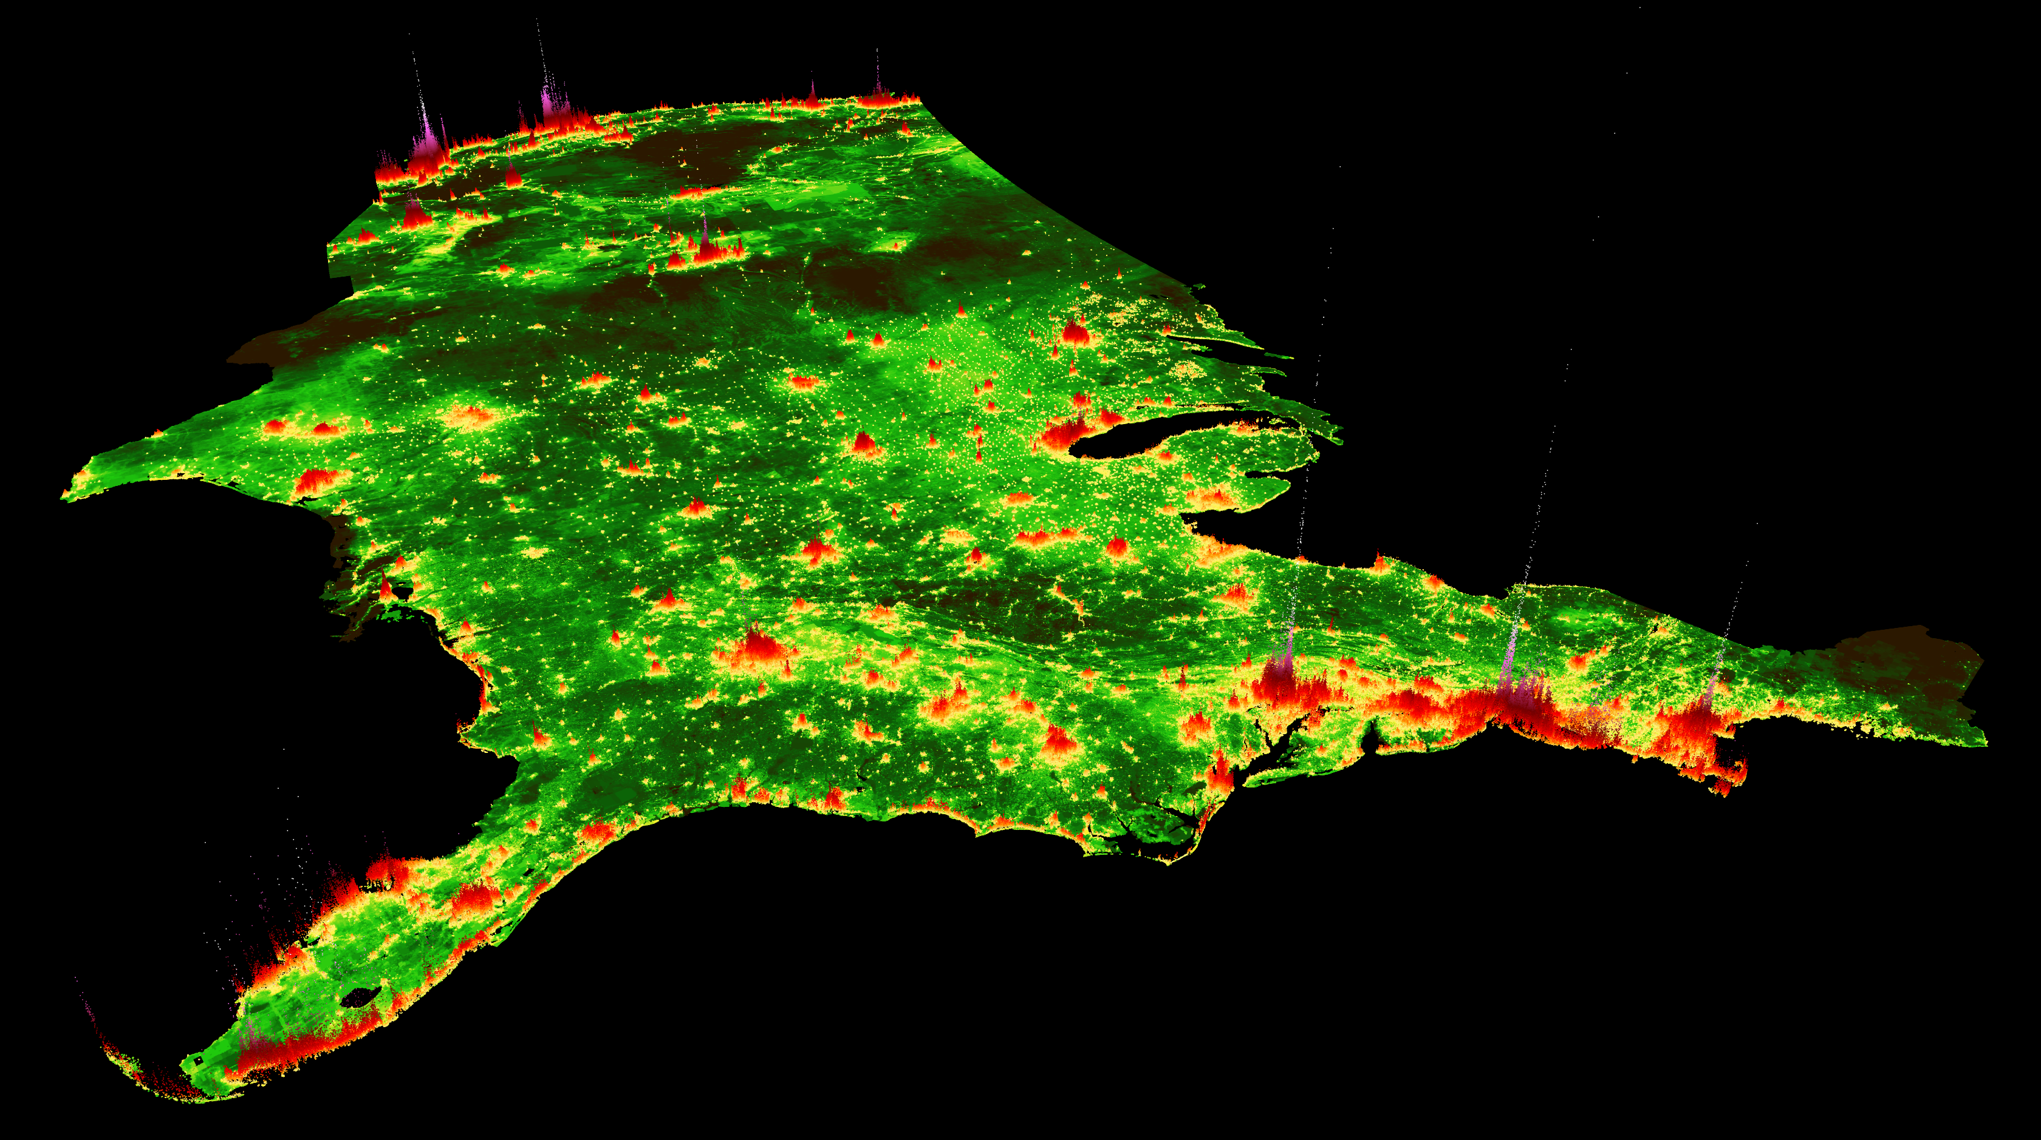

www.placeslab.org/fmv_usa
Notes:
http://www.placeslab.org/fmv_usa

Slide 17
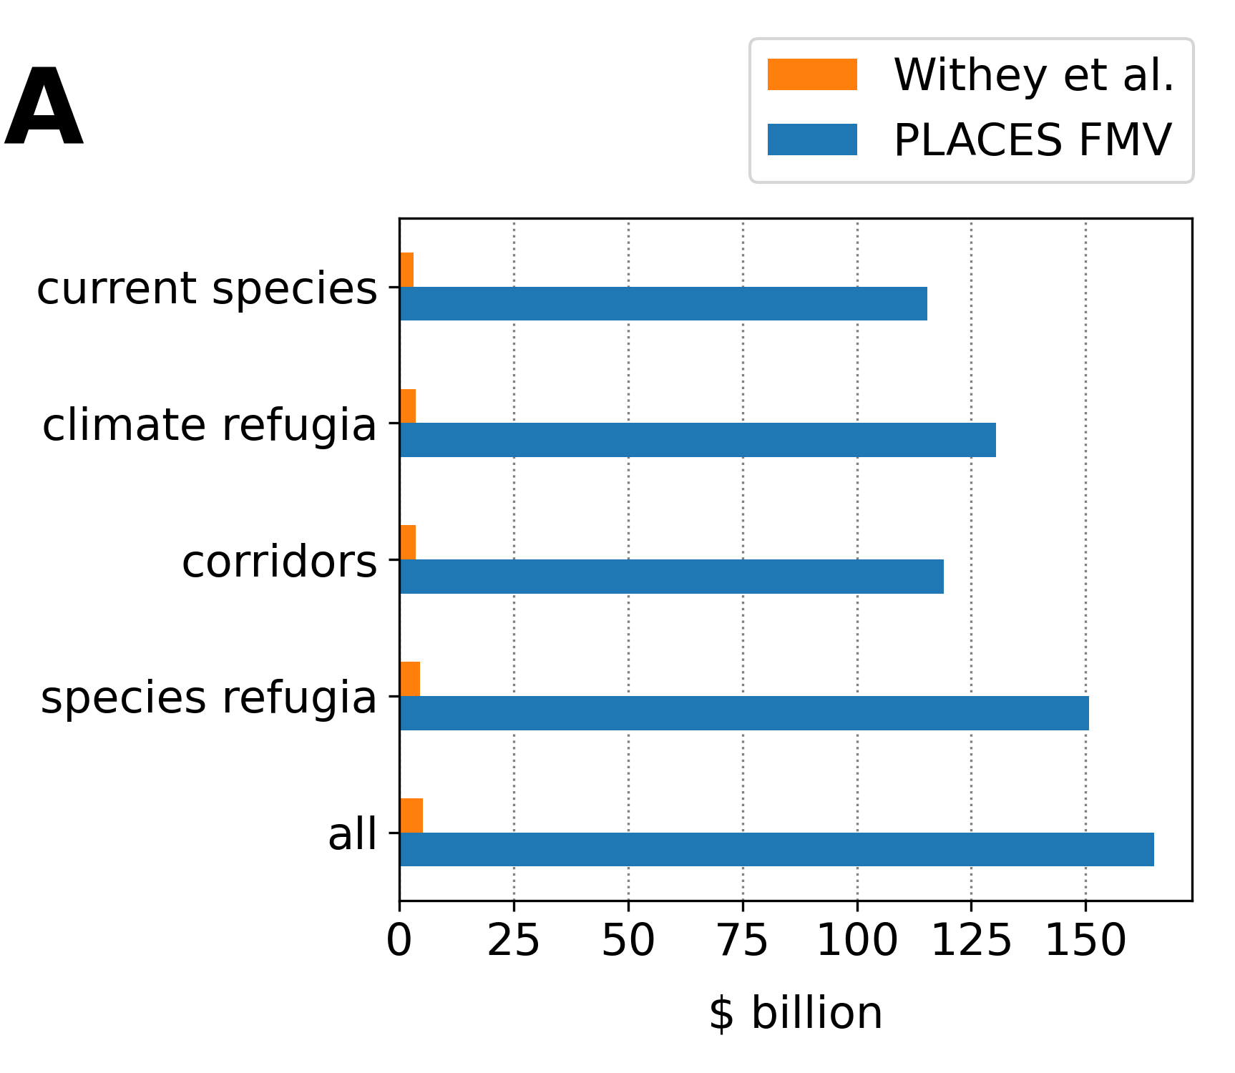
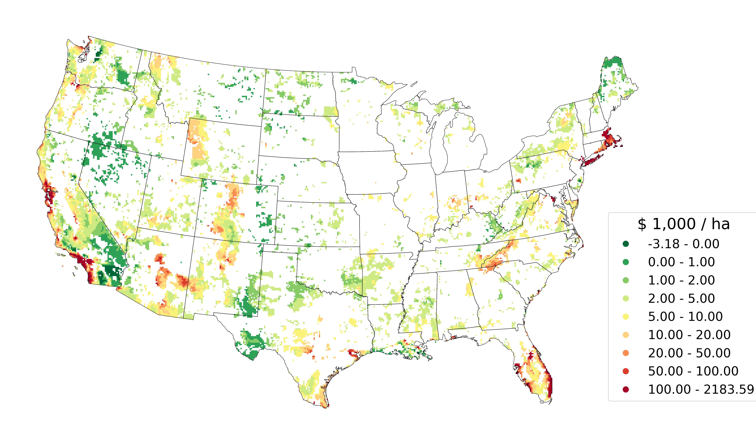
Estimated cost of protected area networks for
climate-sensitive species conservation in the United States:
37x as high as previously estimated
Differences in cost estimates
“current species” scenario
Great American Outdoors Act ($4.5B)
Nolte (2020) High-resolution land value maps … PNAS

Slide 18
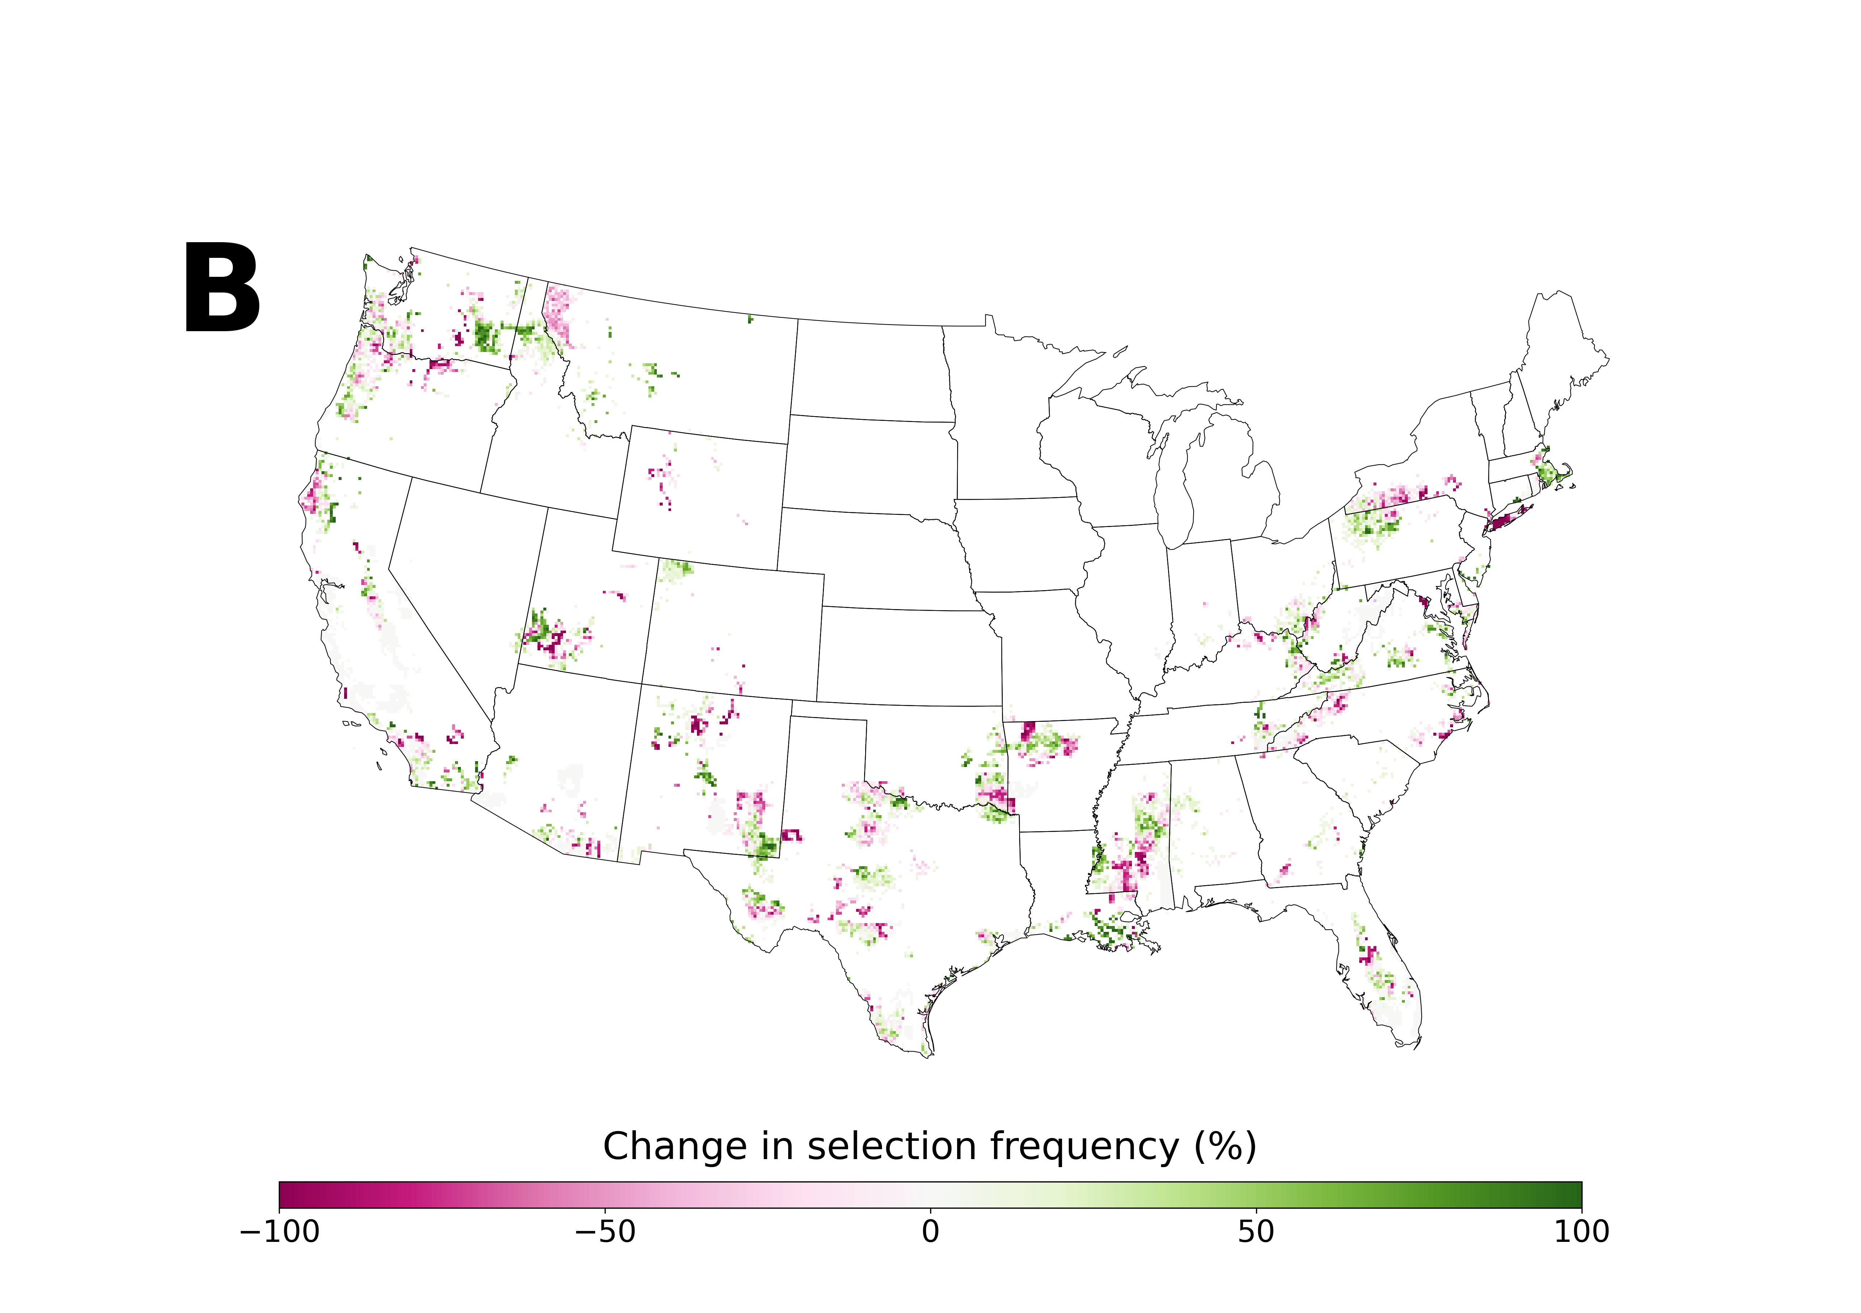
Spatial priorities change if high-resolution cost proxies are used

Slide 19
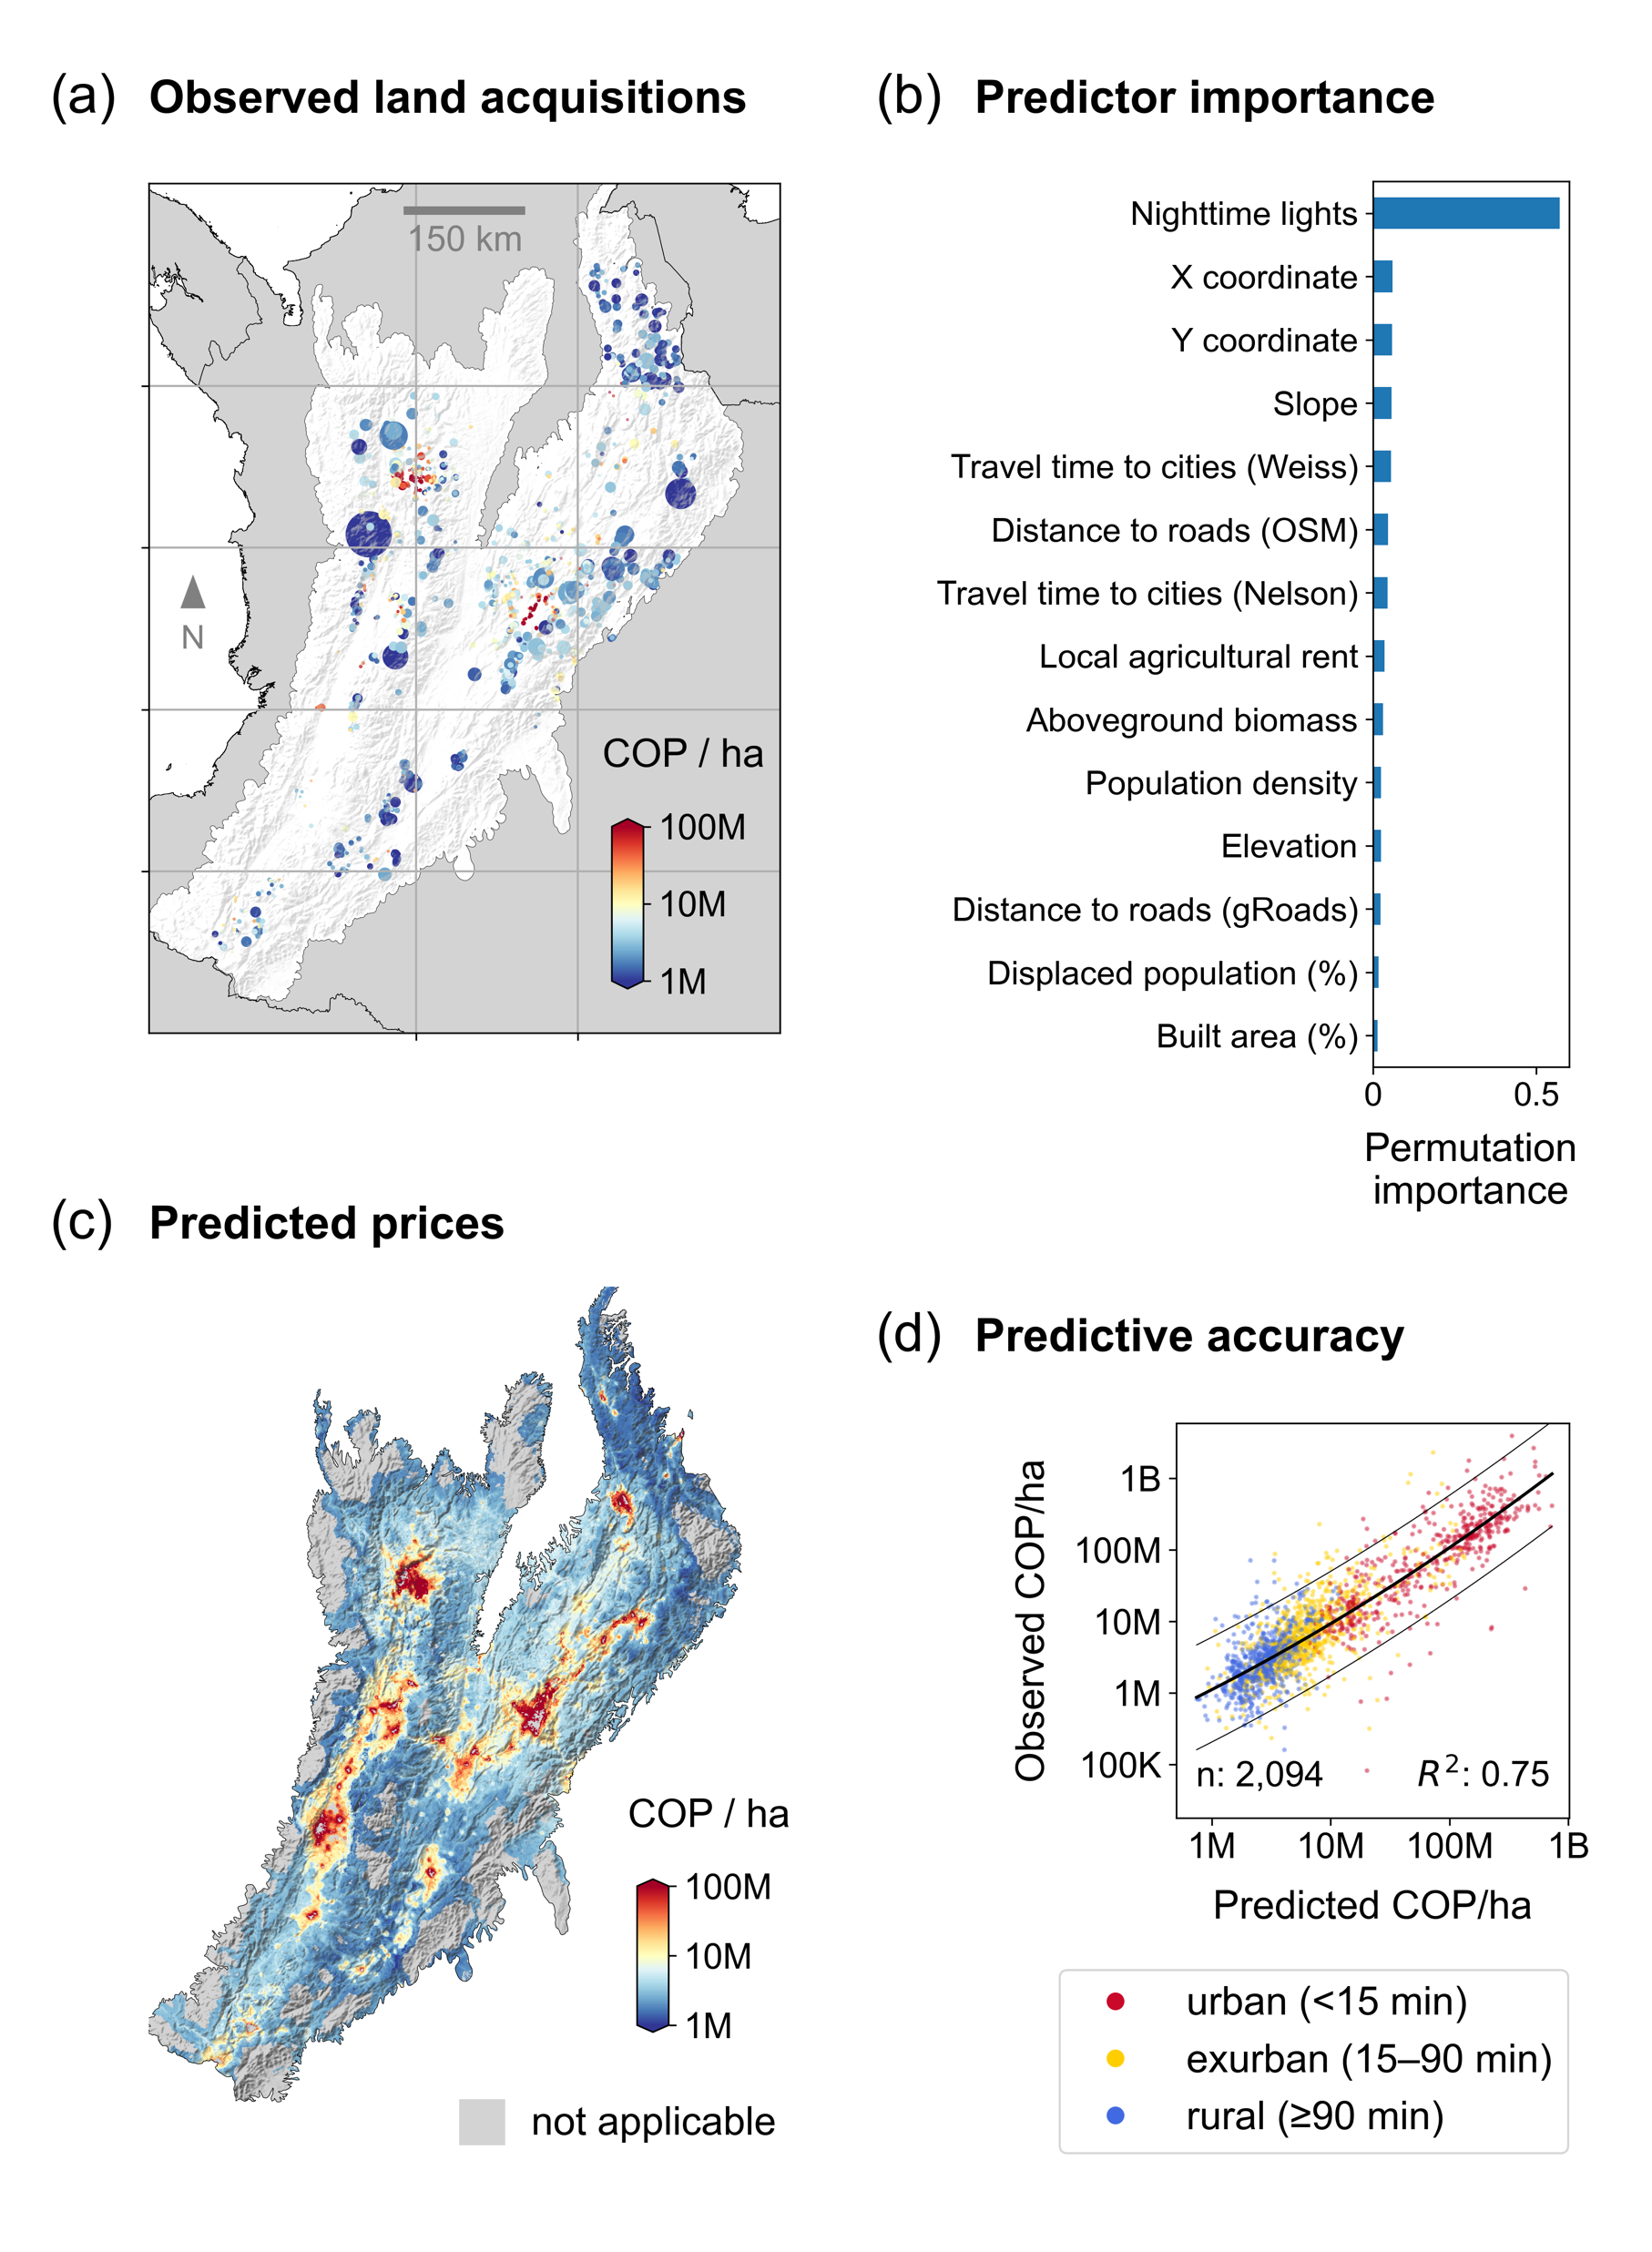
Predicting the cost of land acquisitions
Nolte et al. (2023) Improving estimates of land protection costs in a tropical biodiversity hotspot. Frontiers in Ecology & the Env.

Slide 20
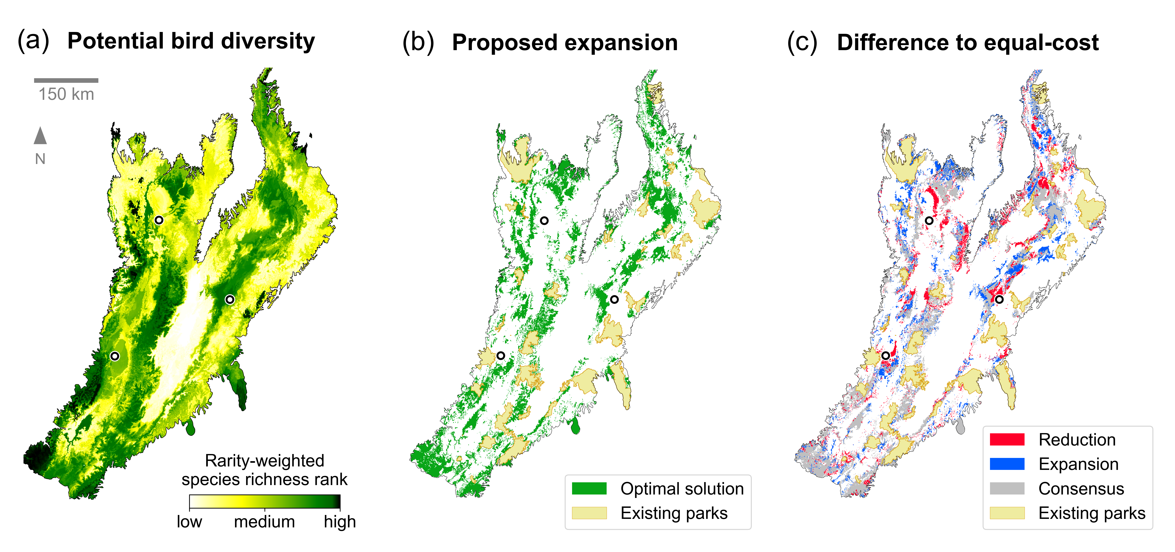
Nolte et al. (2023) Improving estimates of land protection costs in a tropical biodiversity hotspot. Frontiers in Ecology & the Env.

