Slide 1
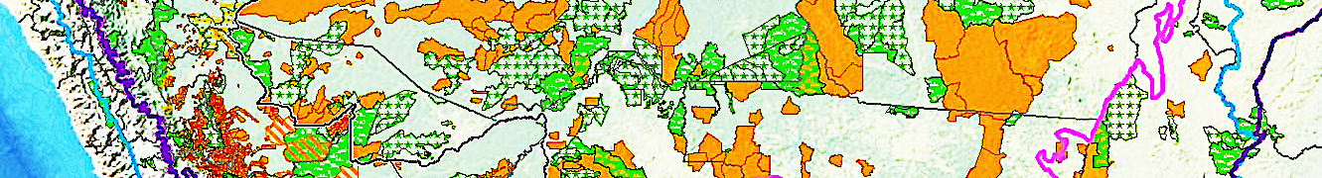




EE 508 / DS 537
Data Science for Conservation Decisions
Fall 2025

Slide 2
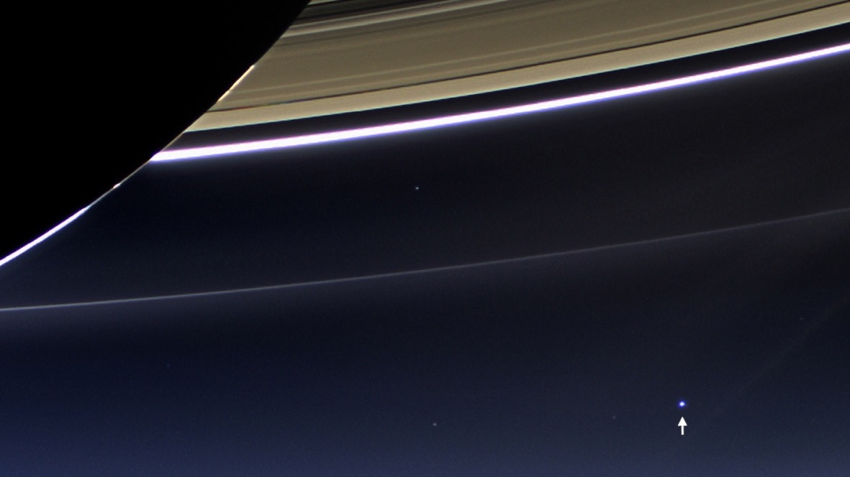

Slide 3
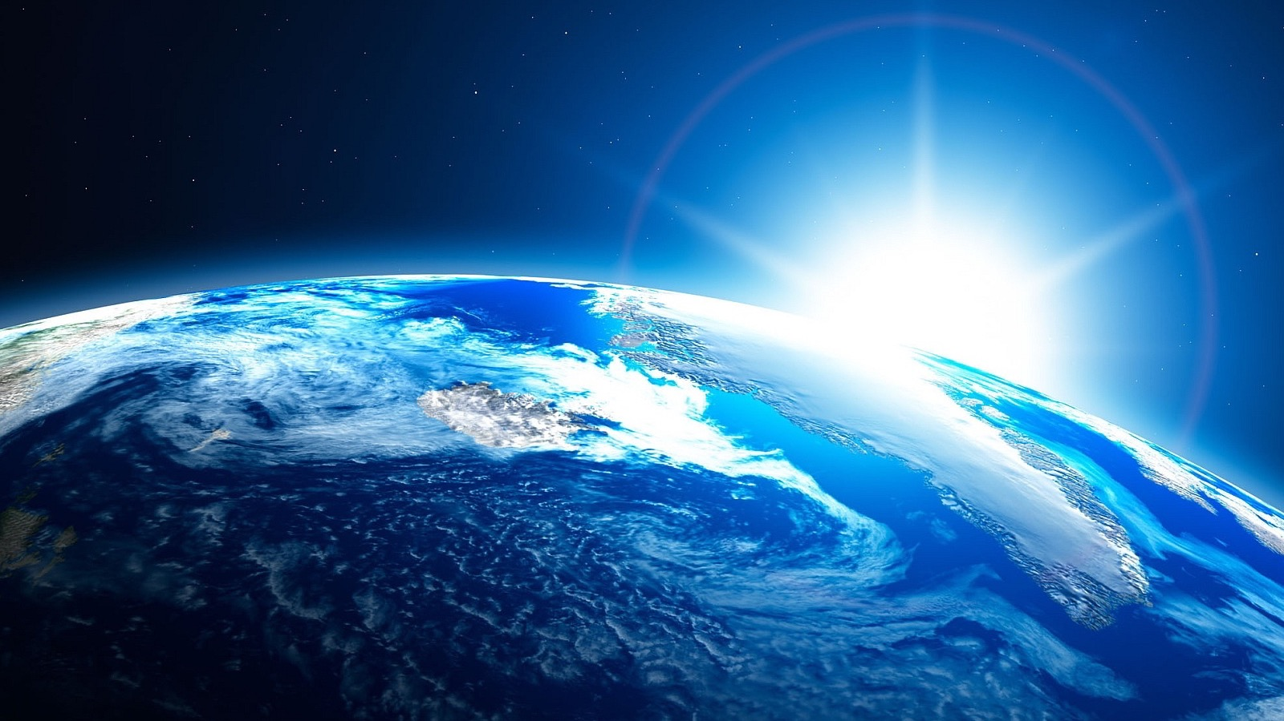

Slide 4
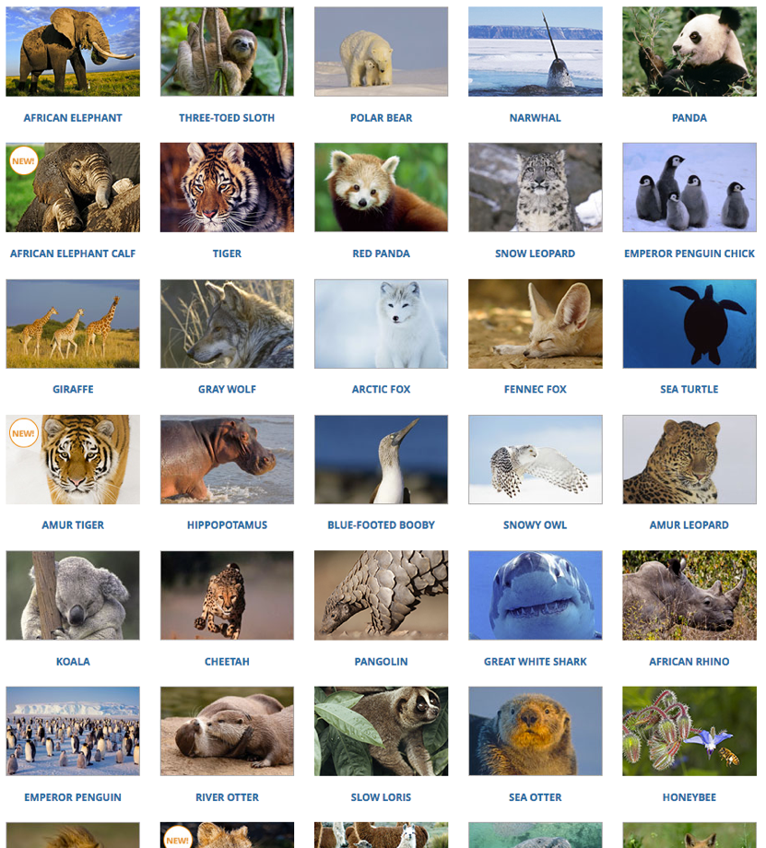
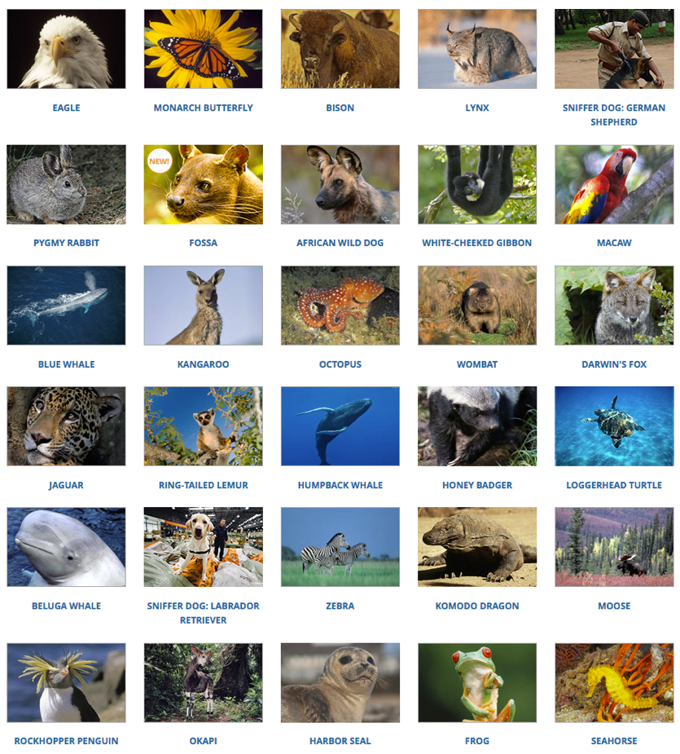
WWF Symbolic Species Adoptions
https://gifts.worldwildlife.org/gift-center/gifts/species-adoptions.aspx
This slide contains approximately 0.1% of vertebrate species (60K) and
0.003% of all named plant and animal species (2.1M, IUCN Red List).
How should we allocate limited conservation funds to so many species?
Notes:
https://gifts.worldwildlife.org/gift-center/gifts/species-adoptions.aspx

Slide 5


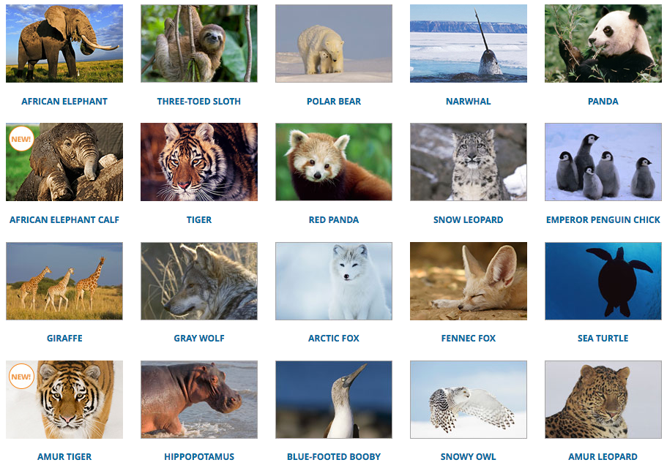
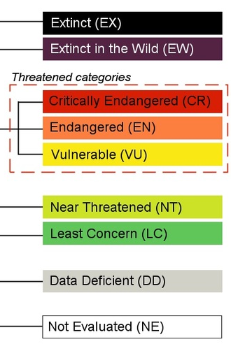
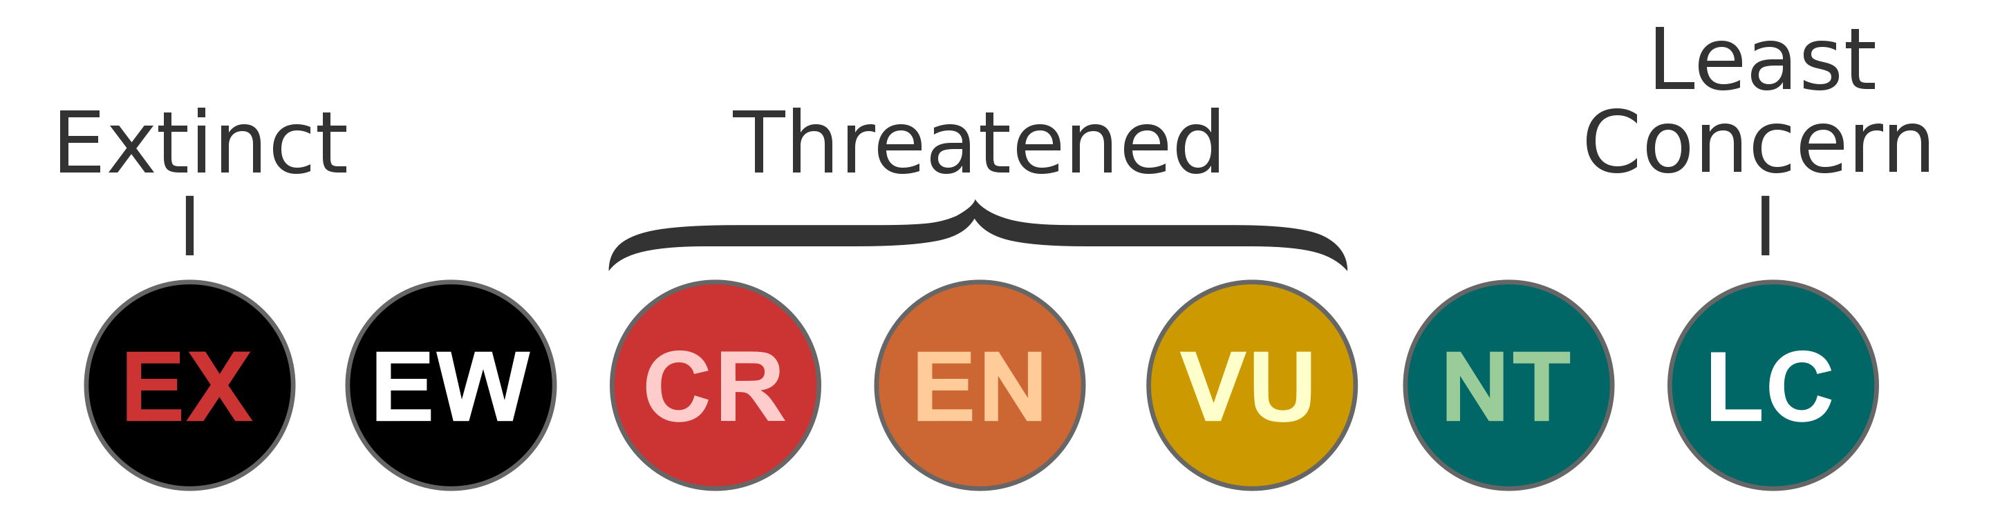
Flagship species = threatened with extinction?
2
VU
4
LC
VU
LC
VU
CR
IUCN Red List categories
www.iucnredlist.org
EN
EN
VU
NT
VU
LC
LC
LC
7
CR
VU
sub
EN
VU
LC
VU
sub
CR

Slide 6
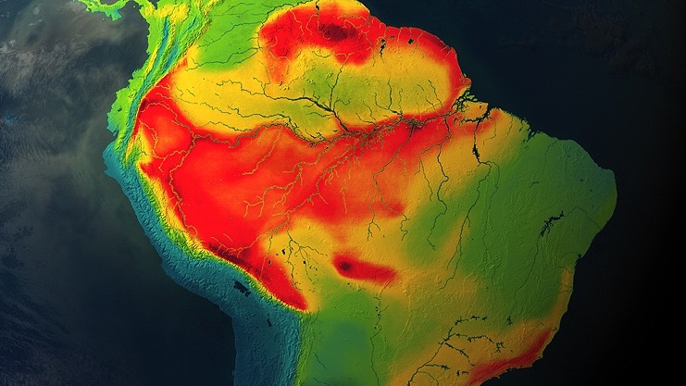
Species Richness: Birds
www.biodiversitymapping.org

Slide 7
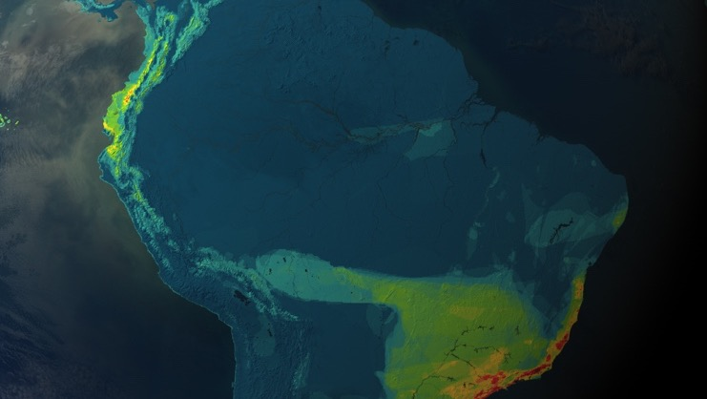
Threatened Species Richness: Birds
www.biodiversitymapping.org

Slide 8
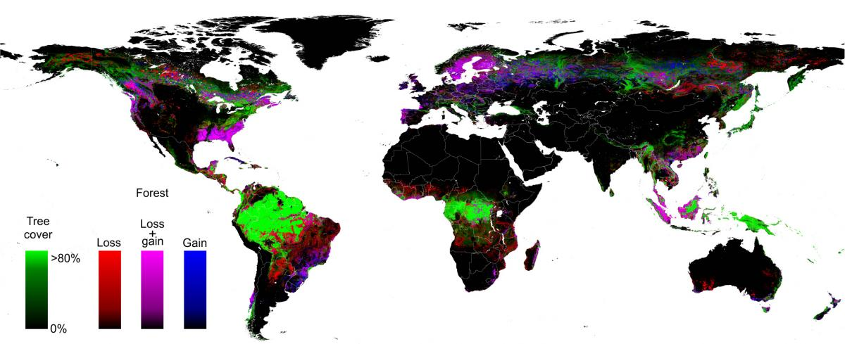
Global habitat loss
(likely the single most important driver of extinction risk)
Global forest loss and gain (Hansen et al. 2013)

Slide 9
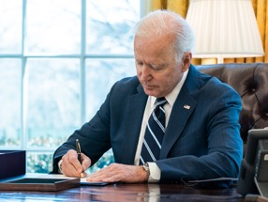
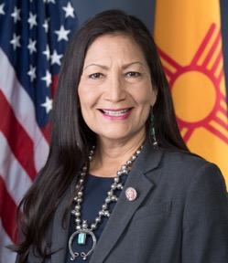
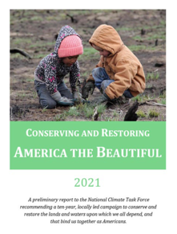
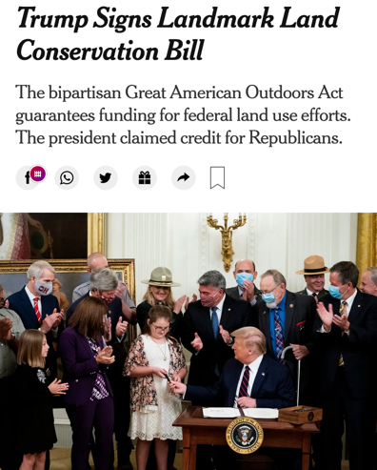

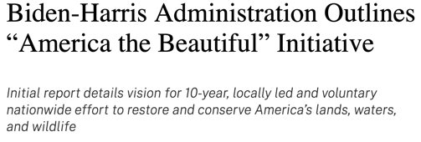

Will humanity protect 30% of the planet by 2030?
Jan 27, 2021
May 6, 2021
Aug 5, 2020
Joe Biden
Deb Haaland
Donald Trump
Montreal, Canada Dec 7-19, 2022
$4.5 billion over 5 years for additional land conservation
Notes:
How are we going to make these decisions?

Slide 10
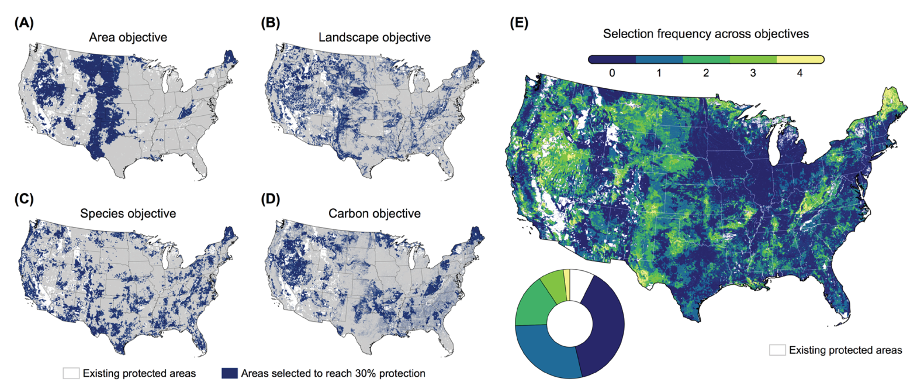
If so, which 30%?
“Cheapest”
Simmons et al. (2021) Delivering on Biden’s 30x30 Conservation Commitment
Notes:
https://www.bu.edu/gdp/files/2021/01/BAS_Biden_EO_30x30_WP.pdf

Slide 11
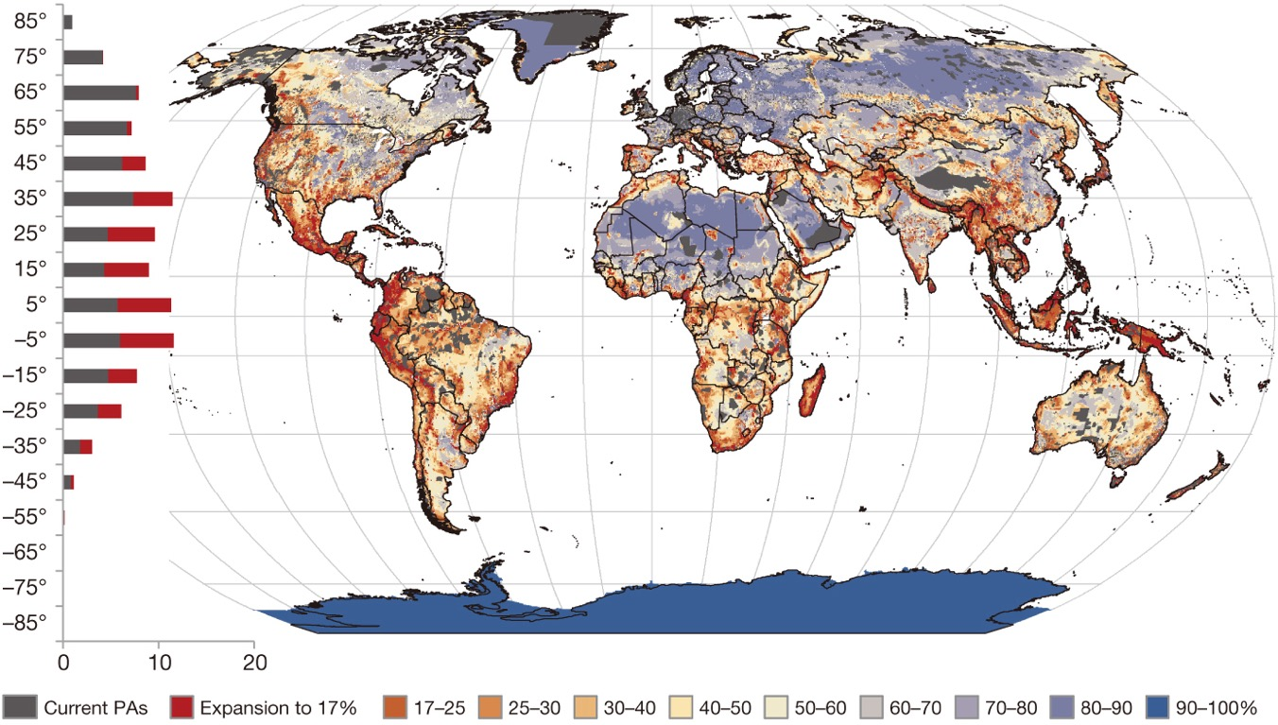
Global Conservation Priorities
Pouzols et al. (2014) Nature

Slide 12
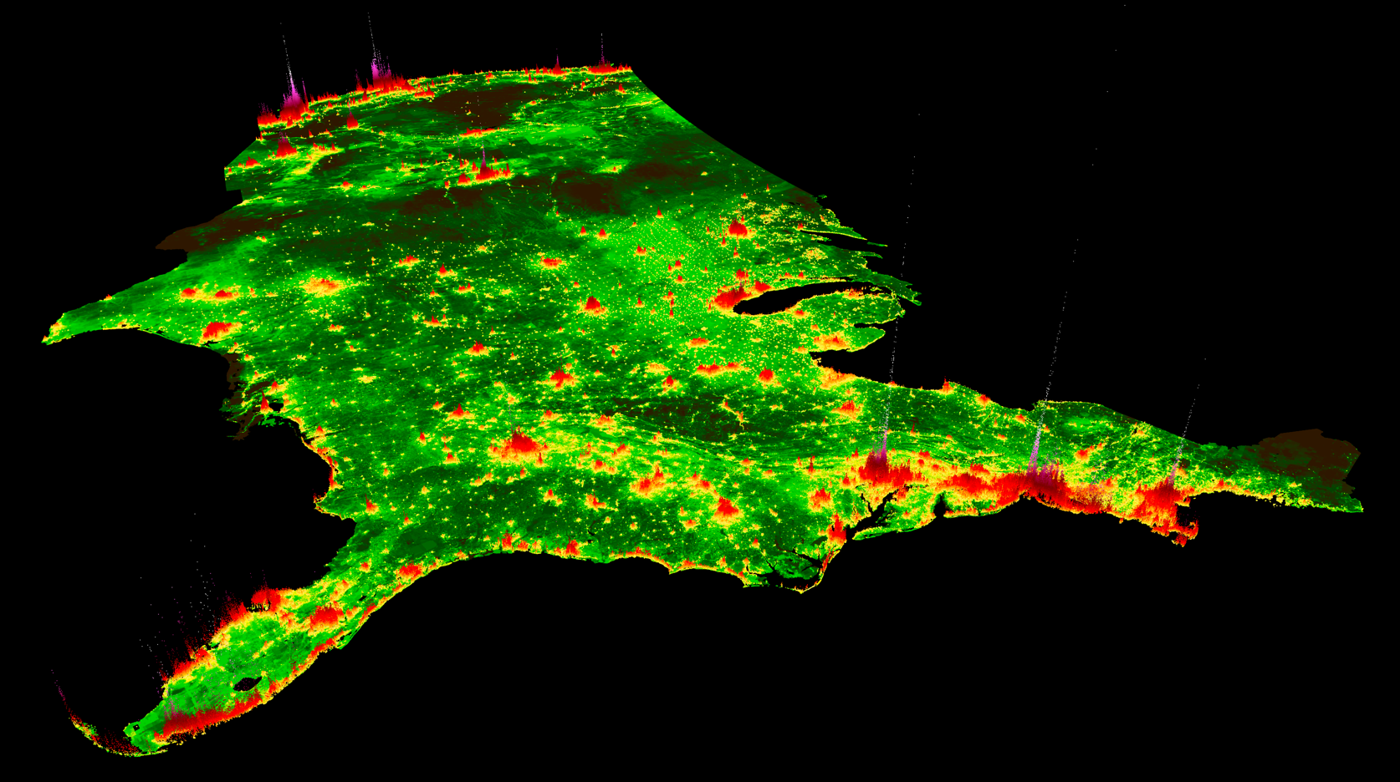

Download: placeslab.org/fmv-usa
Notes:
http://www.placeslab.org/fmv_usa

Slide 13
Policy analysis: evaluating choices
… involves making a lot of choices that affect results and narrative
Choice variables
System model
Good & bads
Personal valuation
Social objective
What choices do we have (or consider in any given analysis)?
How will the world respond to each choice?
What observable good and bad things will happen to each person?
How will this affect every person’s individual utility?
How will we determine which policy is better?
Δ Costs & Benefits
Δ Policy
Δ System
Δ Utility
Δ Welfare
What variables can we directly affect through policy?
New regulations, more enforcement, taxation, subsidies, cap-and-trade, information, moral campaigns, etc.
Social
Change in net income or wealth.
Change in consumption of private and public goods (e.g. clean air)
How does each consumer personally value the net change in the overall bundle (costs and benefits) they obtain?
How does (or should) the policy maker value the overall changes to all people’ utilities in the aggregate?
Natural
Modeling of social economic, and natural systems

Slide 14
Skills & tools
Species
Land Use Change
Public administration
Protection
so much data…
Carbon
Infrastructure
Demographics
Land rights
 | Question we’ll ask | Skills we’ll need | Tools we’ll learn | Cases we’ll study
1 | How can I process and visualize all this data? 15% | Spatial data processing and visualization in open-source software | Python: geopandas, rasterio, matplotlib QGIS | Global and local differences in species richness; student survey.
2 | How can we protect hundreds of species at once at the lowest cost? 20% | Systematic conservation planning | Python (ibid) GDAL Marxan | Protecting threatened bird species in Colombia (#1 globally in birds)
3 | How can we keep carbon on the ground efficiently? 20% | Estimating efficiency (cost / impact), simulating policy | Python: sklearn, statsmodels | Designing forest carbon payments in Massachusetts
 | Question we’ll ask | Skills we’ll need | Tools we’ll learn | Cases we’ll study
1 | How can I process and visualize all this data? 15% | Spatial data processing and visualization in open-source software | Python: geopandas, rasterio, matplotlib QGIS | Global and local differences in species richness; student survey.
2 | How can we protect hundreds of species at once at the lowest cost? 20% | Systematic conservation planning | Python (ibid) GDAL Marxan | Protecting threatened bird species in Colombia (#1 globally in birds)
3 | How can we keep carbon on the ground efficiently? 20% | Estimating efficiency (cost / impact), simulating policy | Python: sklearn, statsmodels | Designing forest carbon payments in Massachusetts
4 | How much carbon emissions did this invention avoid? 10% | Rigorous impact evaluation | R: Matching | Protected areas in the Brazilian Amazon
 | Question we’ll ask | Skills we’ll need | Tools we’ll learn | Cases we’ll study
1 | How can I process and visualize all this data? 15% | Spatial data processing and visualization in open-source software | Python: geopandas, rasterio, matplotlib QGIS | Global and local differences in species richness; student survey.
 | Question we’ll ask | Skills we’ll need | Tools we’ll learn | Cases we’ll study
1 | How can I process and visualize all this data? 15% | Spatial data processing and visualization in open-source software | Python: geopandas, rasterio, matplotlib QGIS | Global and local differences in species richness; student survey.
2 | How can we protect hundreds of species at once at the lowest cost? 20% | Systematic conservation planning | Python (ibid) GDAL Marxan | Protecting threatened bird species in Colombia (#1 globally in birds)
 | Question | Skills | Tools | Cases
1 | How can I process and visualize all this data? 15% | Spatial data processing and visualization in open-source software | Python: geopandas, rasterio, matplotlib QGIS | Global and local differences in species richness; student survey.
2 | How can we protect hundreds of species at once at the lowest cost? 20% | Systematic conservation planning | Python (ibid) GDAL Marxan | Protecting threatened bird species in Colombia (#1 globally in birds)
3 | How can we keep carbon on the ground efficiently? 20% | Estimating efficiency (cost / impact), simulating policy | Python: sklearn, statsmodels | Designing forest carbon payments in Massachusetts
4 | How much carbon emissions did this invention avoid? 10% | Rigorous impact evaluation | R: Matching | Protected areas in the Brazilian Amazon
P | How can I create my own analysis from scratch? 25% | Problem framing (goals, choices), match to data | Your pick! | Your pick!

Slide 15
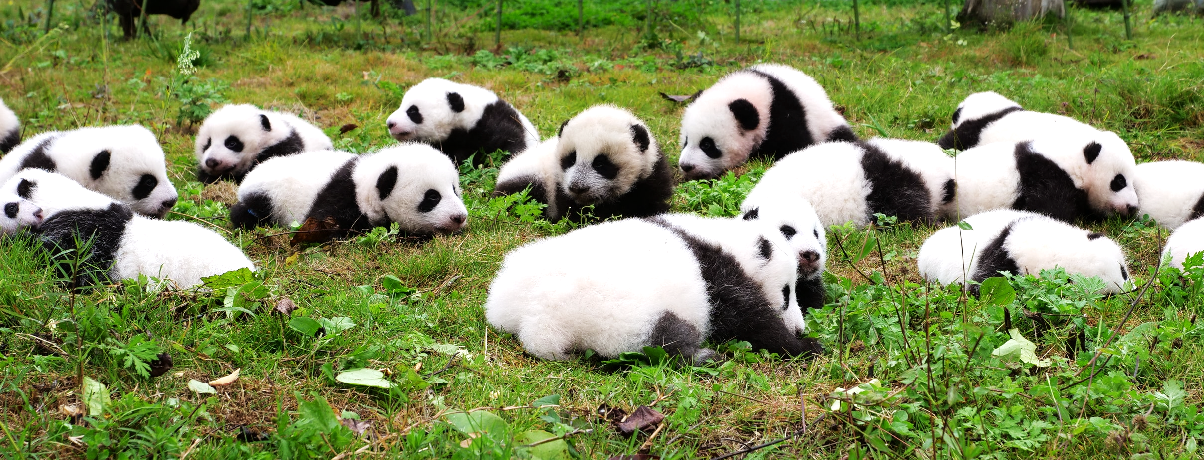
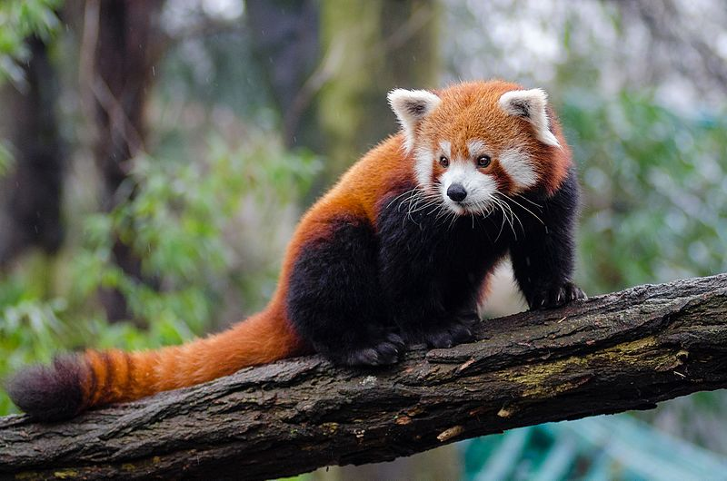
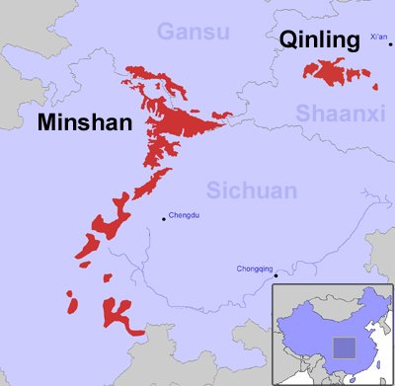
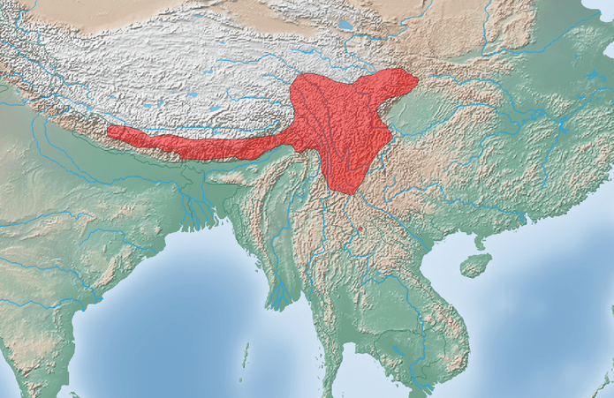
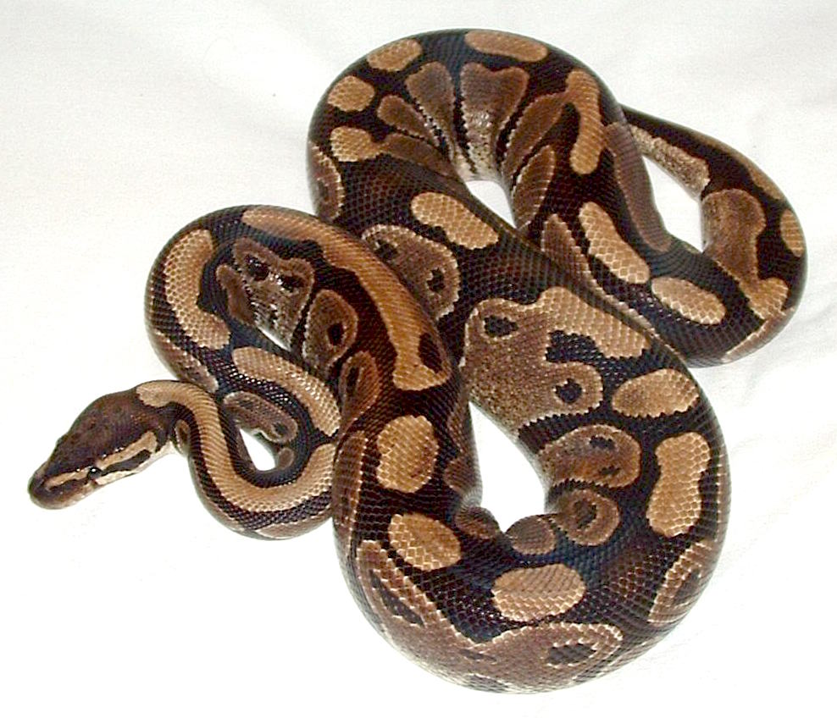
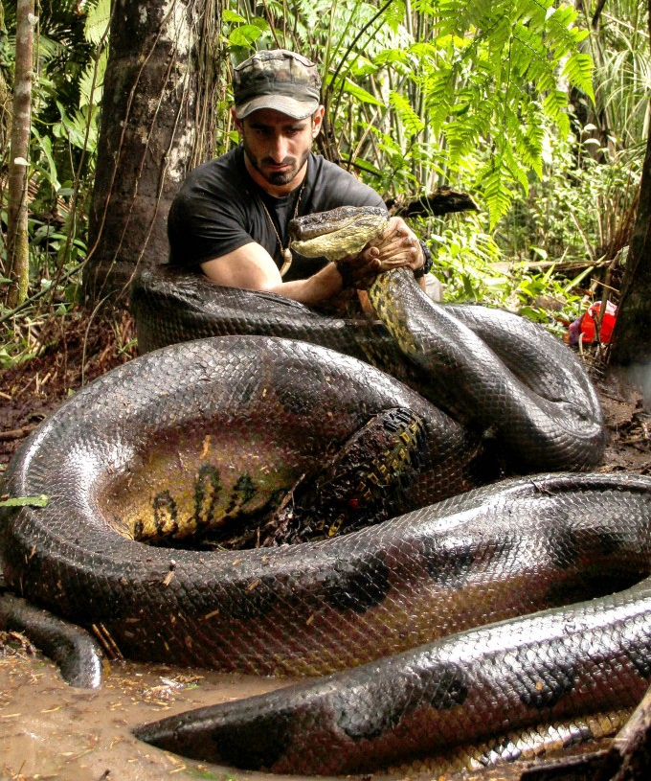
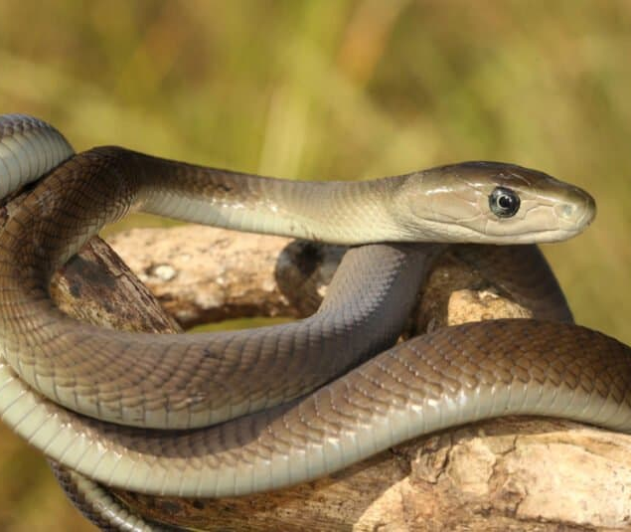
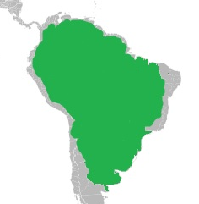
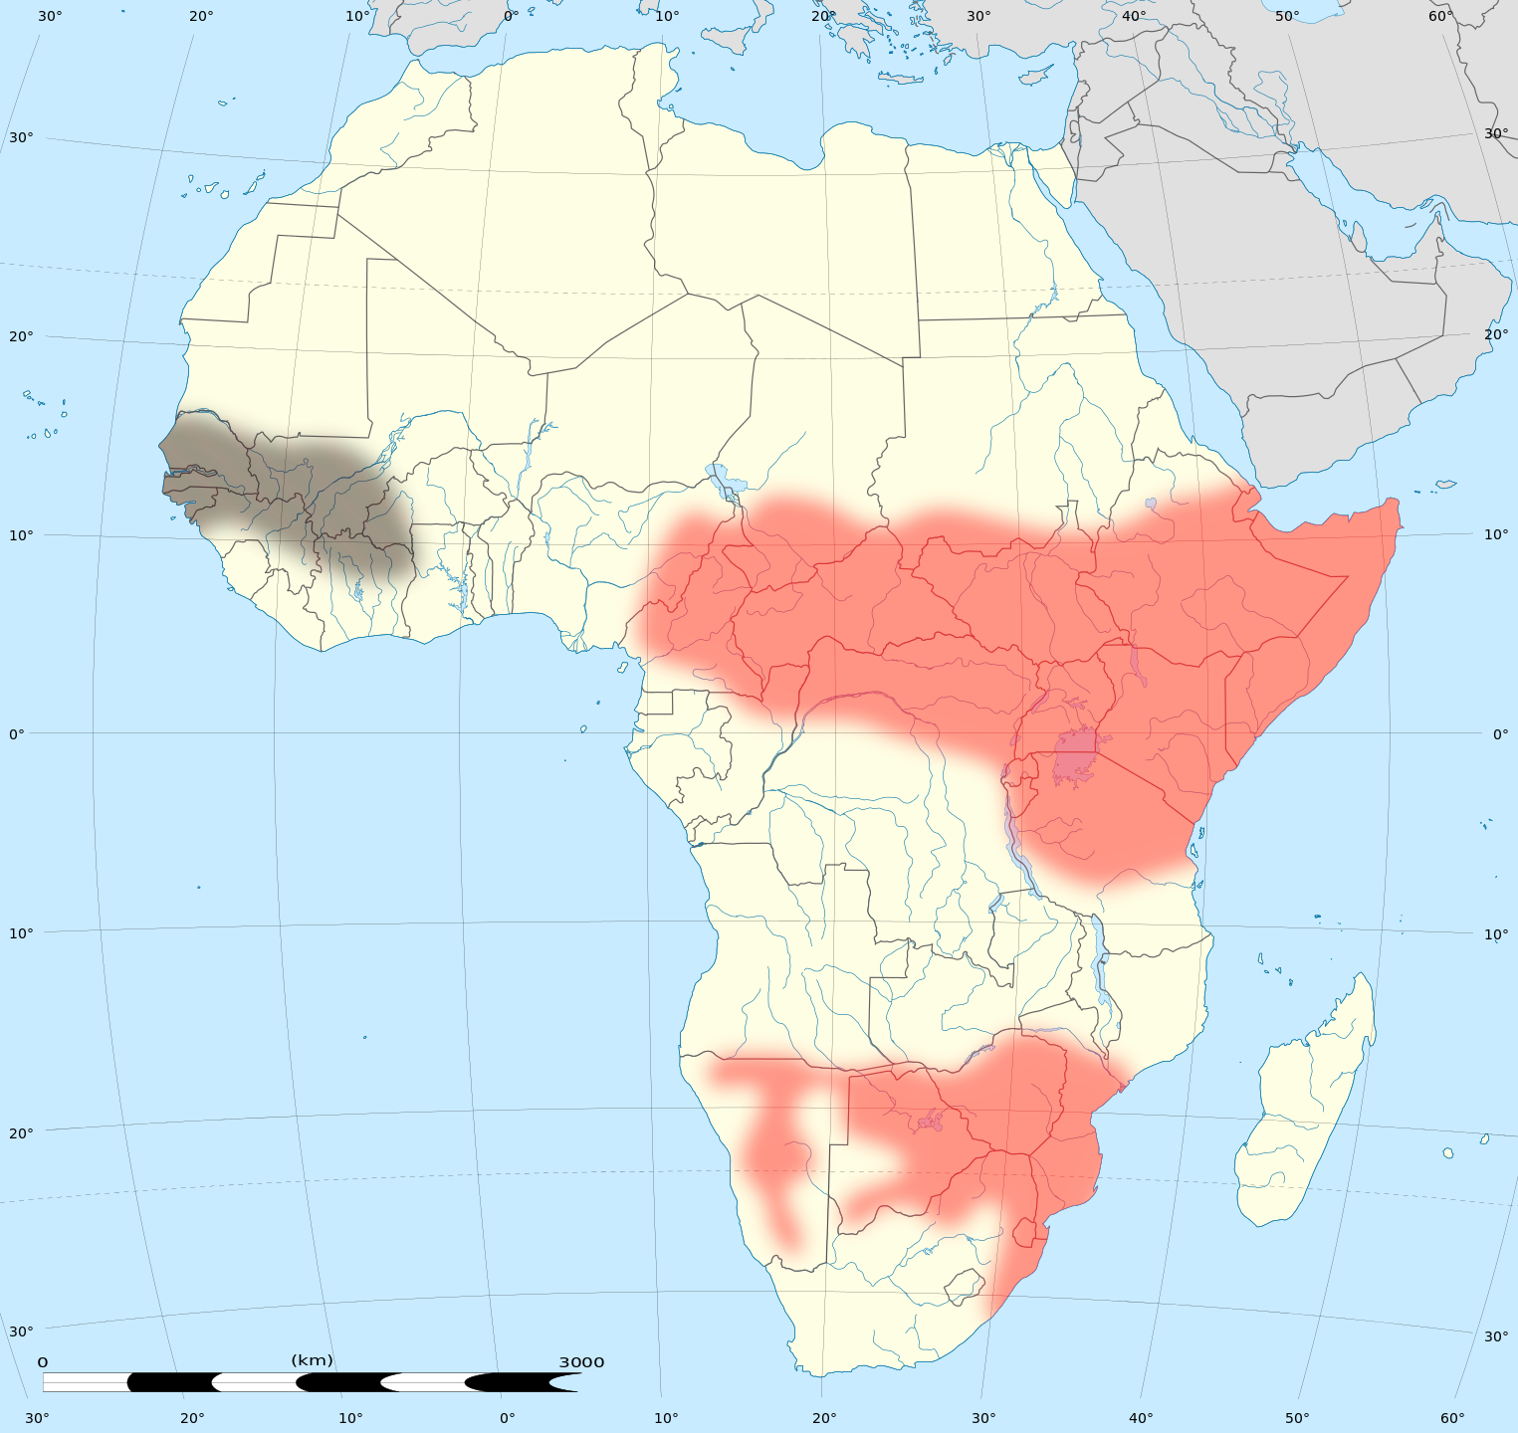


VU
pandas
EN
2
10
black
mamba
4
LC
LC
VU
4
NT
LC

Slide 16





black
mamba
Matching
rasterio
geopandas
fiona
shapely
folium
pandas
numpy

Slide 17
PLACES Lab: currently funded research projects
NSF
High-resolution prediction and uncertainty estimation of land value and conservation cost in the contiguous United States (Human-Environment and Geospatial Sciences, 2022) – Sep 30
First release of a nationwide dataset of parcel-level land value estimates.
Similar to what we do in Lab 3.
Coastal hazards, equity, economic prosperity, and Resilience (CHEER) (Coastlines & People, 2022)
Flood loss prediction.
NASA
Comparing the effectiveness of conservation instruments in the Colombian Andes biodiversity hotspot (Land Cover/Land Use Change, 2019)
Remote sensing of tropical forest types & estimation of the impacts of land acquisitions vs. payments for env. serv.
LakeSense: a portal for nationwide remotely sensed lake water quality indicators to inform benefit-cost analyses for federal and state-level rulemaking (Water Res. Appl., 2022)
Remote sensing/valuation of lake water.
Notes:
http://www.placeslab.org/fmv_usa

Slide 18
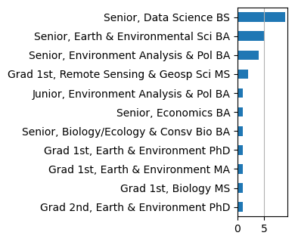
You
Your name
Your background (major, profession, experience)
Your motivation / reason for considering joining this course.
What are you interested in?
Any specific …
…environmental topics?
…types of decisions?
…analytical problems?
…technical skills?
…software / tools?
…geographies?

Slide 19
Tasks for Thursday
Fill out scoping survey: https://forms.gle/LdjhwQcsHoS5JXQc6
Read Jenkins et al. 2015 and the ensuing debate (Brown v. Jenkins)
Install QGIS and Python
QGIS: www.qgis.org
Jupyter Python environment with Anaconda (instructions on Blackboard)
Sign up for Piazza site: piazza.com/bu/fall2023/ee508
Please use Piazza for all questions about syllabus and labs (you can post anonymously)
Start Lab 1-1 – and try to get as far as you can.

