Slide 1
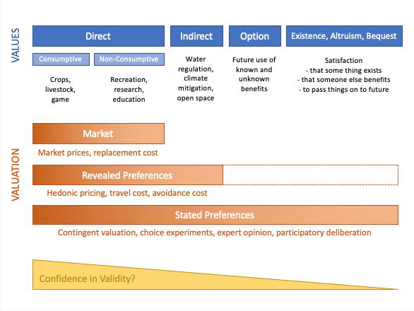
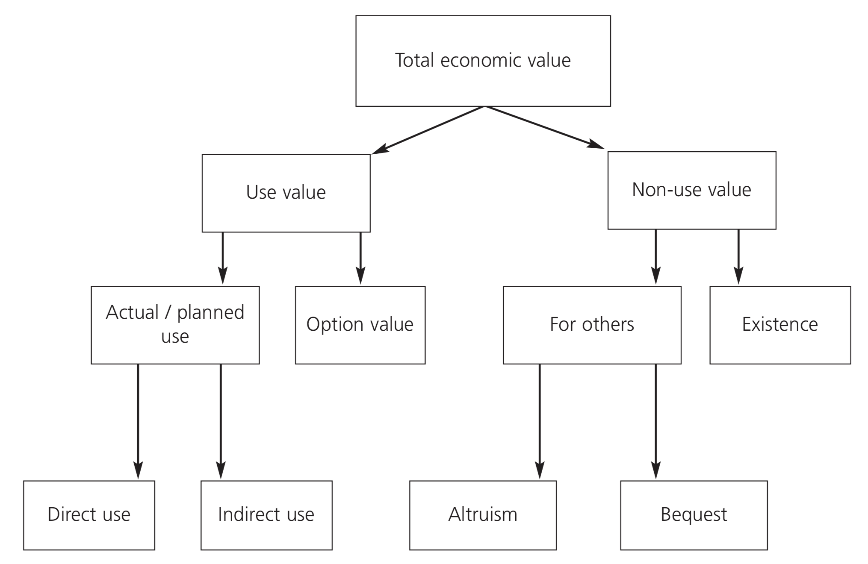
EE 508 / DS 537 – Data Science for Conservation Decisions
Valuing Ecosystem Services
Day 7

Slide 2
Your Final Project
Minimum Criteria
  Do something you have never done before
  Find out something you can’t find out otherwise
  Use some of the tools you learned in this course
  Turn it into policy advice.
  Your contribution needs to stand on its own.
Potential Themes
  Quantifying values, threat, and/or cost
  Identify priorities for a potential intervention
  Model the impact of a potential intervention
  Estimating the impact of an existing intervention

Slide 3
“What should we do?”
Modeling Decisions
Decision Variables
Social Model
Ecological Model
Objective Function
What choices can we make? (actions, budget, constraints)
How will people respond to a given intervention?
How will the ecosystem respond to behavioral change?
How will we judge which outcome is better?
Intervention
Behavioral Change
Ecological Change
Evaluation
Examples:
Creating protected areas
Voluntary incentive programs
Commodity moratoria
Invasive species control
Flood defenses
Example assumptions:
Everyone will accept the dictator’s orders.
Resource users will try to evade new regulations.
Landowners will enroll in a program if benefits exceed the costs.
Examples assumptions:
A species will survive if 30% of its habitat are protected.
An increase in species habitat by X decreases its extinction risk by Y.
Converting primary forest to pasture releases X CO₂eq per hectare.
Examples:
Value ~ quantity of avoided CO₂ emissions
Value ~ habitat size
Value ~ habitat size^{-0.5}
Value = 0.26 if water quality < X and 1 if water quality > X.
Value ~ 1 - probability of extinction, summed across all species, weighted by species appeal

Slide 4
A Major Tension
Environmental valuation
Expert opinion
Participatory processes
Analyst’s preference
Referenda
Need: if you want to claim that one policy is “better” than another, you need to be able to quantify and compare outcomes of different types on the same scale. Put differently: you need an objective function.
Reality: there is no universally accepted way to derive an objective function that represents the shared values of any given human society – especially when it comes to public goods and morals.

Slide 5
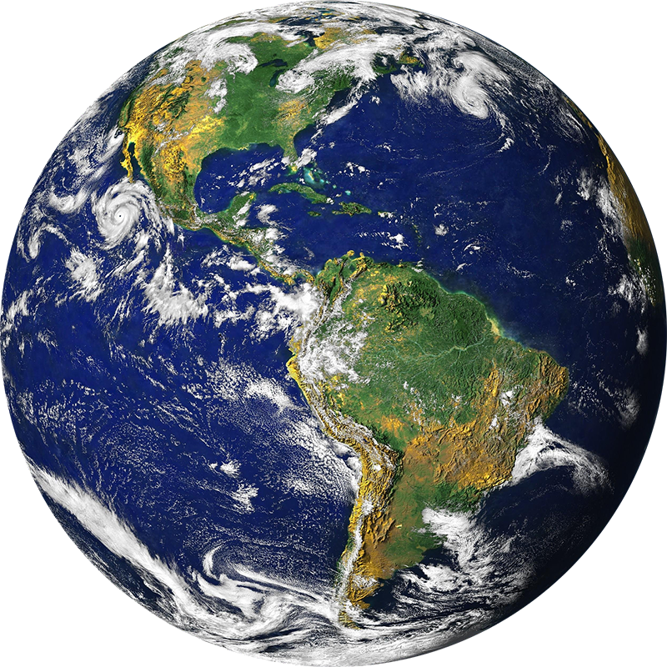



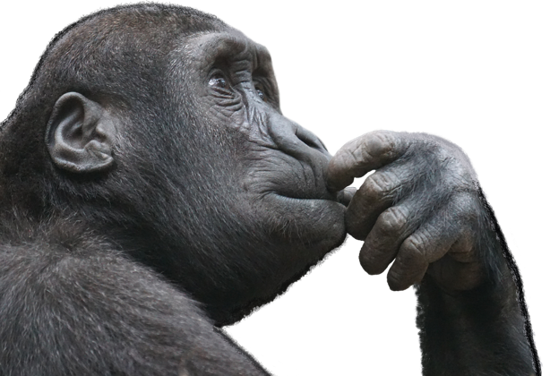
Value: to human beneficiaries
Anthropocentric foundations are most common
  Inference: something has value only if it affects
  someone’s welfare, happiness, or decision.
Who is that someone?
  Identifying beneficiaries is key.
How is that someone affected?
  What if they ”don’t care”?
  What if they “don’t know”?
How can we quantify how
much they are affected?

Slide 6
Ecosystems can create diverse types of benefits
DEFRA (2008) An introductory guide to valuing ecosystem services. DEFRA: London, UK

Slide 7
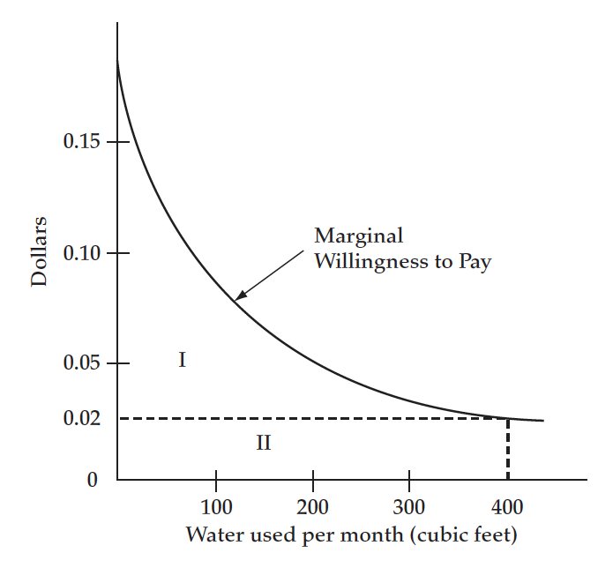
Changes vs. absolutes
Goulder & Kennedy (2011) Interpreting and estimating the value of ecosystem services
To inform policy, you need to be able to value differences in benefits of moving from one state to another (a change).
To value total benefits (area under the curve), you need to know the shape of the entire demand curve.
  For many goods, we know little about the shape of the demand curve, especially at extremes.
    “What would you be willing to pay for the last breath of clean air?”

Slide 8
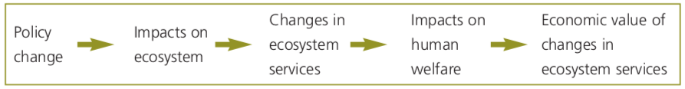
Focus on differences, not absolutes
(marginal values)
(total values)
How much is the atmosphere worth to humans?
  This is not a very meaningful question, at least not for informing a policy decision.
  We don’t make decisions about whether we should have an atmosphere or not.
How much will a specific change in atmospheric composition affect the different things humans care about?
  This question is decision-oriented, and more amenable to economic analysis.
Be wary of studies that state the value of an environmental good without being explicit about what the value is in reference to.
  “The value of virgin rainforest” – as compared to what: a clearcut?

Slide 9
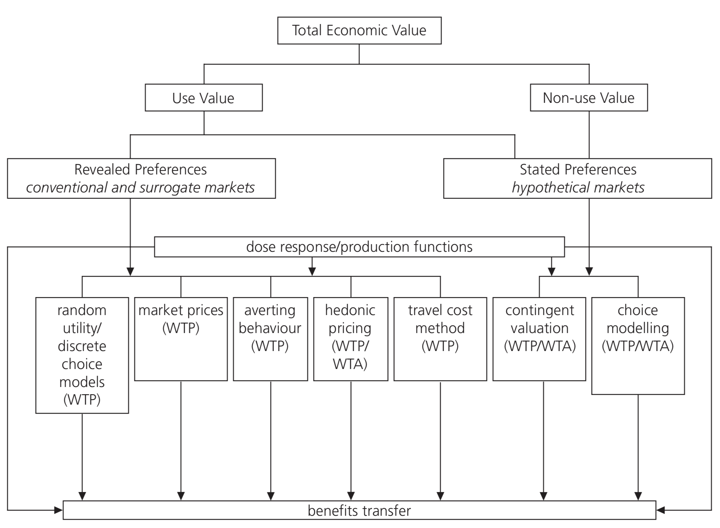
Understand valuation methods
DEFRA (2008) An introductory guide to valuing ecosystem services. DEFRA: London, UK

Slide 10
Types of Goods → Types of Valuation
Direct
Indirect
Option
Existence, Altruism, Bequest
VALUES
Consumptive
Non-Consumptive
Water regulation, climate mitigation, open space
Future use of known and unknown benefits
Satisfaction
- that some thing exists
- that someone else benefits
- to pass things on to the future
Crops, livestock, game
Recreation, research, education
Market
Market prices, replacement cost
VALUATION METHODS
Revealed Preferences
Charitable Donations?
Hedonic pricing, travel cost, defensive expenditures, health expenditures / value of statistical life
Stated Preferences
Contingent valuation, choice experiments, expert opinion, participatory deliberation
Confidence in validity

Slide 11
Questions
What environmental or social benefit(s) would you like to enhance with your policy solution?
How would you quantify the benefit(s)?
How would you value the benefit(s)?
What are your policy options?

Slide 12
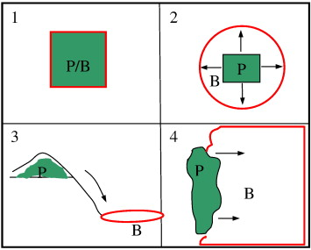
Spatial relationships between locations of actions vs. beneficiaries
Fisher et al. (2009) Defining and classifying ecosystem services for decision making. Ecological Economics

Slide 14
Soil Fertility
Carbon
Sequestration
& Storage
Water
Purification
Dry Season Flows
Biodiversity
Species Survival
Scenic Appeal
Recreation
Residence
How would you measure the value (to people) of a future change in that ecosystem service?
→ objective function
How will you predict the effect of (combinations of) location-specific actions on the ecosystem service?
→ social & ecological model
Can this approach be used to assign priorities to single actions and locations?
  How important are spatial dependencies?
Pollination
Food
Flood Regulation
Coastal Protection

Slide 15
Developing a Model: Common Steps
Start with a simple model
Consider real-life complexities (e.g., interactions)
Consider constraints (data, computation, complexity)
End up with a solvable model (usually simple)

Slide 16
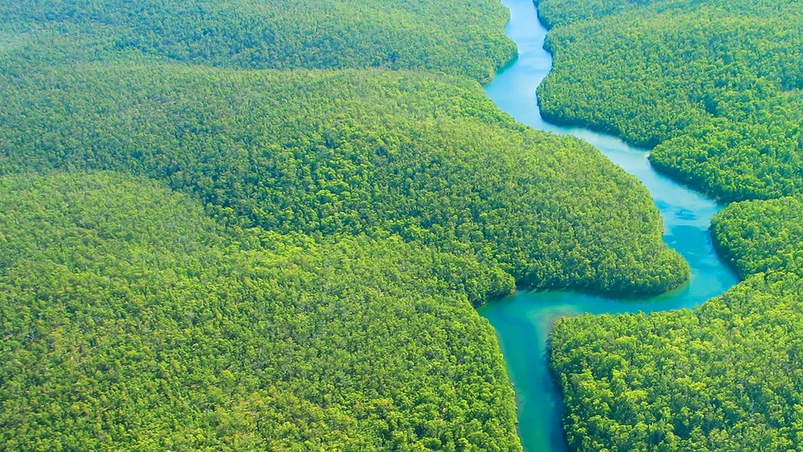
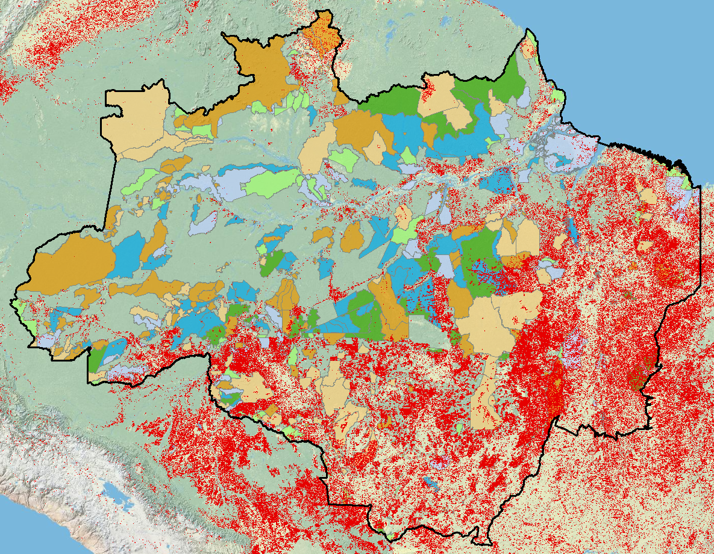
Carbon
Notes:
What would be a suitable objective function?
How would you value it?

Slide 17
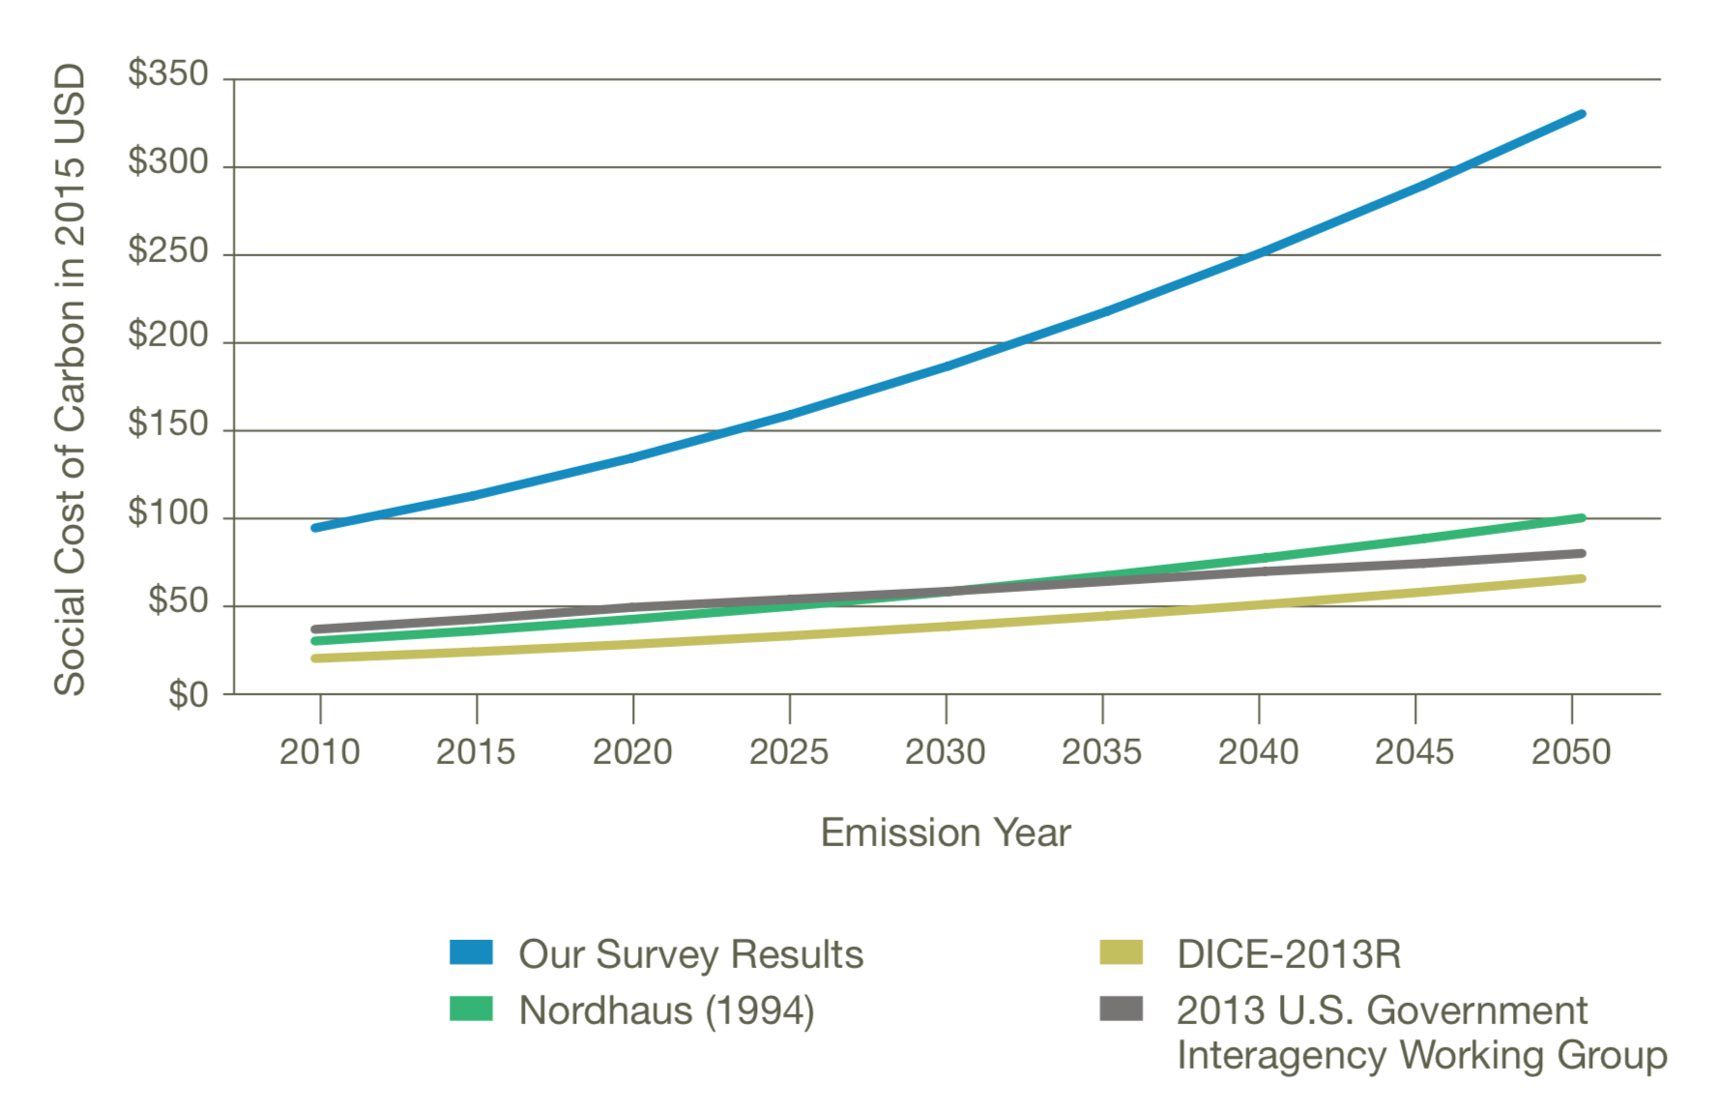
The Social Cost of Carbon
“ a maddeningly complex task” Plumer, NYT 2018
Obama EPA:
$50
Trump (1st) EPA:
$1-6
Biden EPA
$204
(2023)
Trump (2nd) EPA:
$0
Howard & Sylvan (2009) Expert Consensus on the Economics of Climate Change. Institute for Policy Integrity

Slide 18
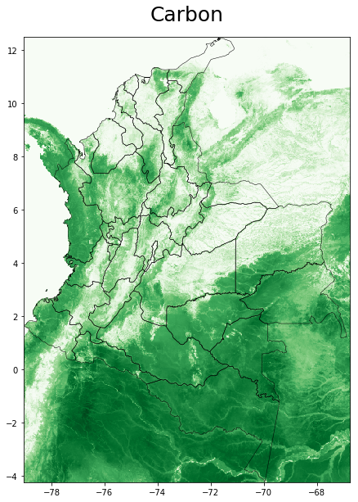
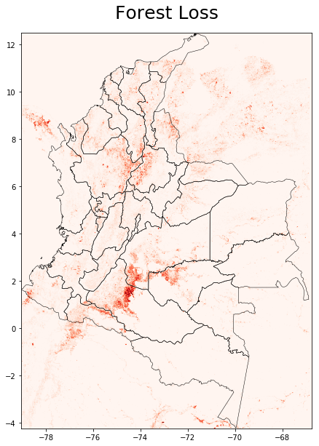
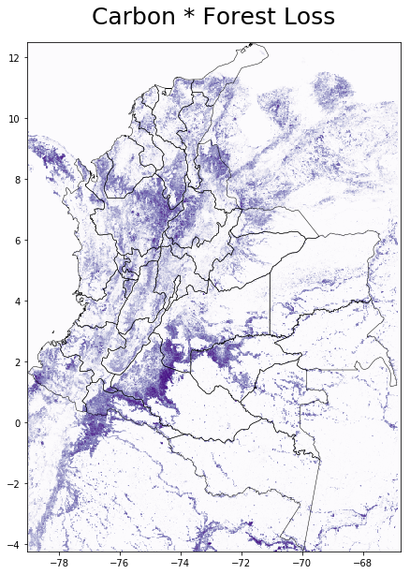
The Importance of Threat
Baccini et al. (2019)
Hansen et al. (2019)

Slide 19
The Simple Approach
(ignoring any dependencies between actions)
Calculate benefit / cost ratio for each action (or unit)
Sort options by benefit/cost ratio
Pick top options until budget is exhausted
Value Threat Cost
V | T | C | B/C
5 | 7.3 | 2.7 | 13.5
3.9 | 6.9 | 5.8 | 4.6
1.4 | 7.5 | 7.8 | 1.3
4.6 | 7.7 | 5.3 | 6.7
1.8 | 0.2 | 7.2 | 0.1
6 | 5.2 | 2.2 | 14.2
7.3 | 3.5 | 3.4 | 7.5
2 | 3.5 | 2.3 | 3
V | T | C | B/C
6 | 5.2 | 2.2 | 14.2
5 | 7.3 | 2.7 | 13.5
7.3 | 3.5 | 3.4 | 7.5
4.6 | 7.7 | 5.3 | 6.7
3.9 | 6.9 | 5.8 | 4.6
2 | 3.5 | 2.3 | 3
1.4 | 7.5 | 7.8 | 1.3
1.8 | 0.2 | 7.2 | 0.1
V | T | C | B/C
6 | 5.2 | 2.2 | 14.2
5 | 7.3 | 2.7 | 13.5
7.3 | 3.5 | 3.4 | 7.5
4.6 | 7.7 | 5.3 | 6.7
3.9 | 6.9 | 5.8 | 4.6
2 | 3.5 | 2.3 | 3
1.4 | 7.5 | 7.8 | 1.3
1.8 | 0.2 | 7.2 | 0.1
Example:
Budget = 15
Spent: 13.6, Benefit: 128.6

Slide 20
But are there really no spatial dependencies in carbon sequestration (ecological, threat, cost)?
Watch out for leakage…

Slide 21
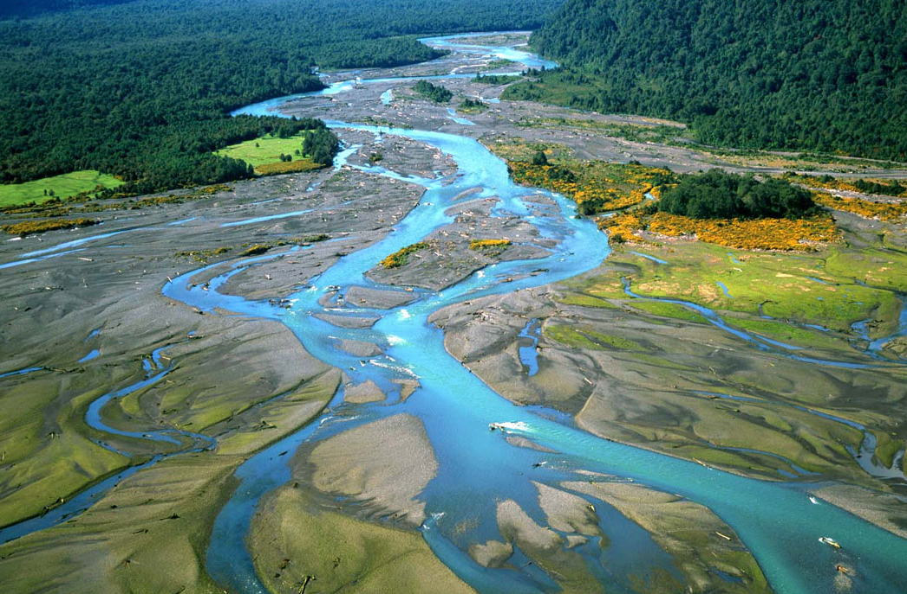
Water
Notes:
What would be a suitable objective function?
How would you value it?

Slide 22
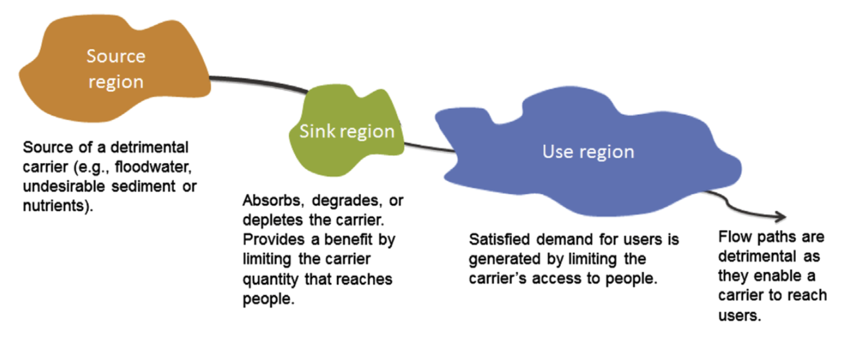
Spatial dependencies
… creating a sink region (e.g., a wetland) between the source and the use region will have benefits for people in the use region …
If a source region emits a ”carrier” (e.g. a toxic pollutant) that is bad for the people in the use region…
However: if we completely remove the source of the “bad”, the value of adding a sink region changes as well (its “sink function” is not needed anymore)
Therefore, the benefits of the two actions “clean up the source” and “create a new sink” are not independent.
Bagstad et al. (2013) Spatial dynamics of ecosystem service flows […] Ecosystem Services

Slide 23

Combinations of actions: “brute force” approach
(allowing for dependencies between the costs or benefits of actions)
Input scenario (a combination of locations & actions)
Model response of ecological system
Measure change in objective function
CO₂ Sequestration
Hydrological Flows
Species Persistence
Viewshed Modeling
Cost
Benefit
Repeat for all possible combinations
of locations and actions
Pick the solution with the highest
benefit for the given budget
n = $2^{n_{Locations}∗n_{Actions}}$
10 locations, 5 actions → 1,125,899,906,842,620 scenarios
(if actions are not
mutually exclusive)

Slide 24
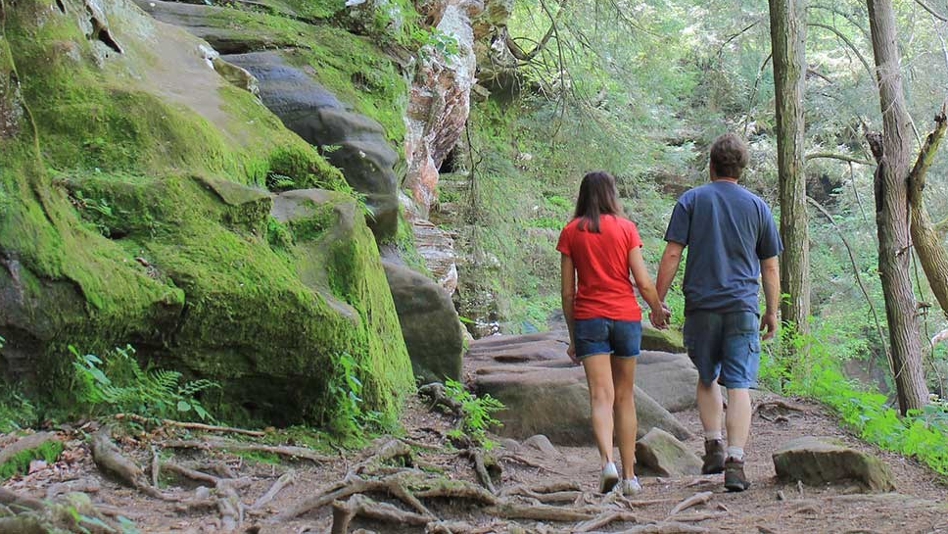
Recreation

Slide 25
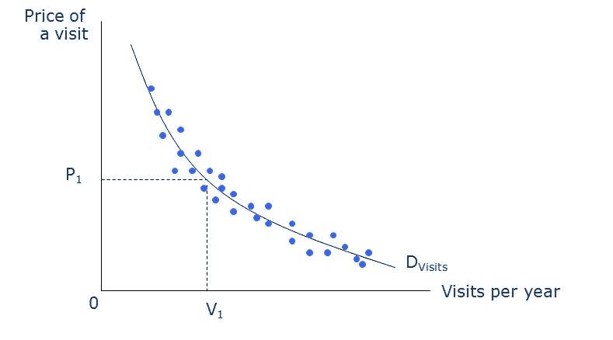
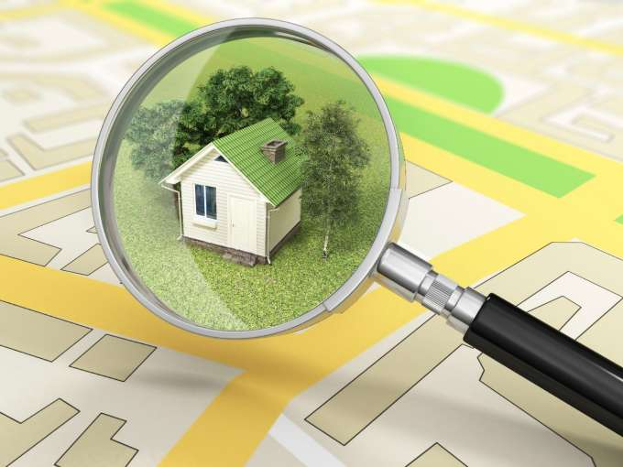
Valuation of amenities (recreation & other)
Travel cost method
  Estimates the willingness to pay per visit from the observed frequencies of visitation from individuals with different travel costs.
Hedonic valuation
  Estimates the effect of environmental attributes on the sales prices of properties.
  Allows for the estimation of very localized effects.
Notes:
Do we have spatial dependencies?
Yes: value of a park might depend on value of neighboring parks (diminishing returns)

Slide 26
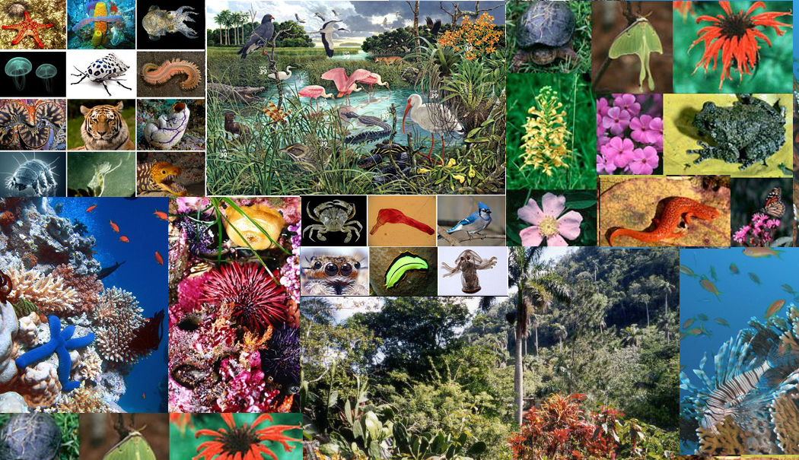
Biodiversity

Slide 27
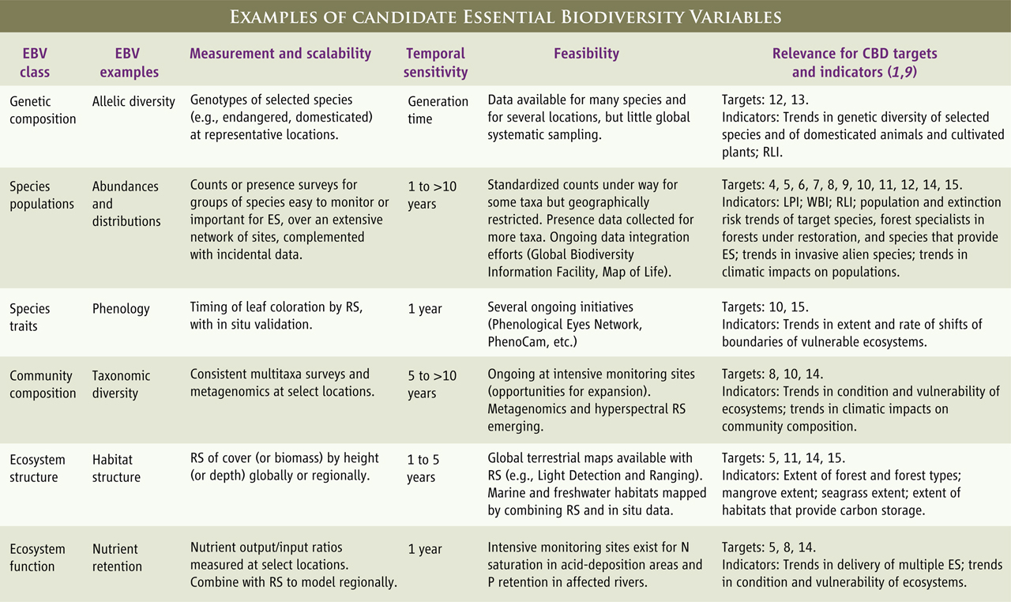
What scientists value might be opaque to others
Pereira et al. (2013) Essential Biodiversity Variables. Science

Slide 28
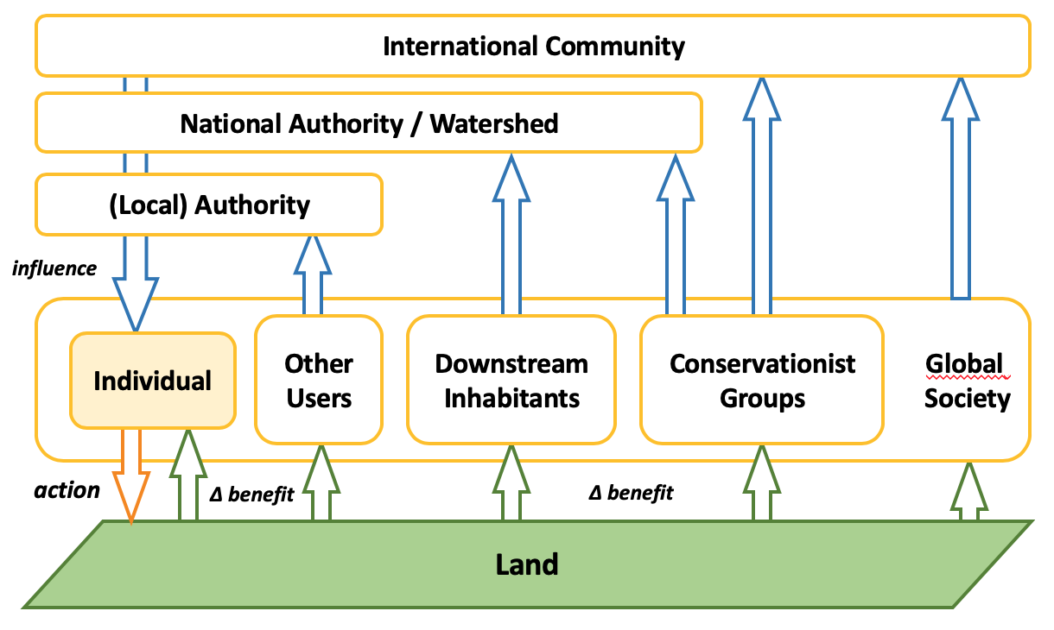
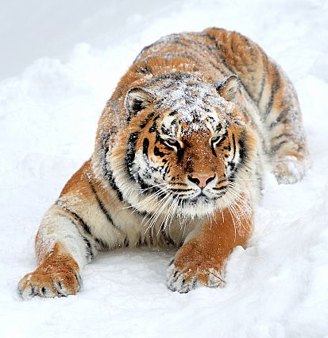
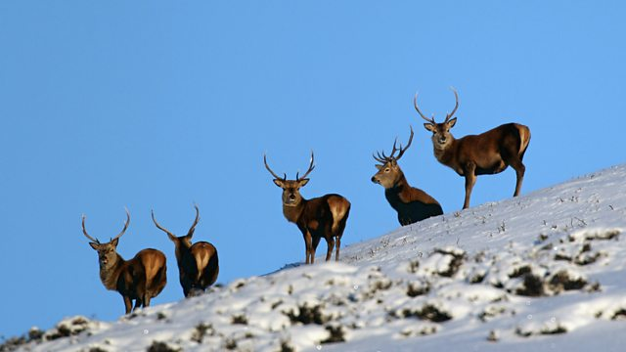
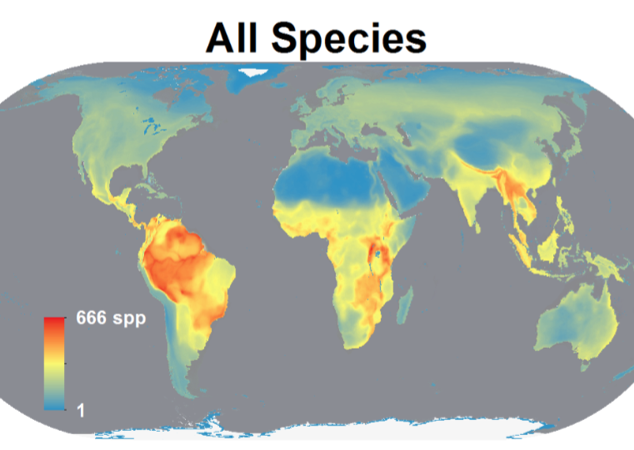
Scaling problems in valuation
Respondents might not be willing to pay for an action if they believe that action should be taken at a different level
Respondents’ willingness to pay to protect one species in one location vs. all species in all locations is surprisingly similar

Slide 29
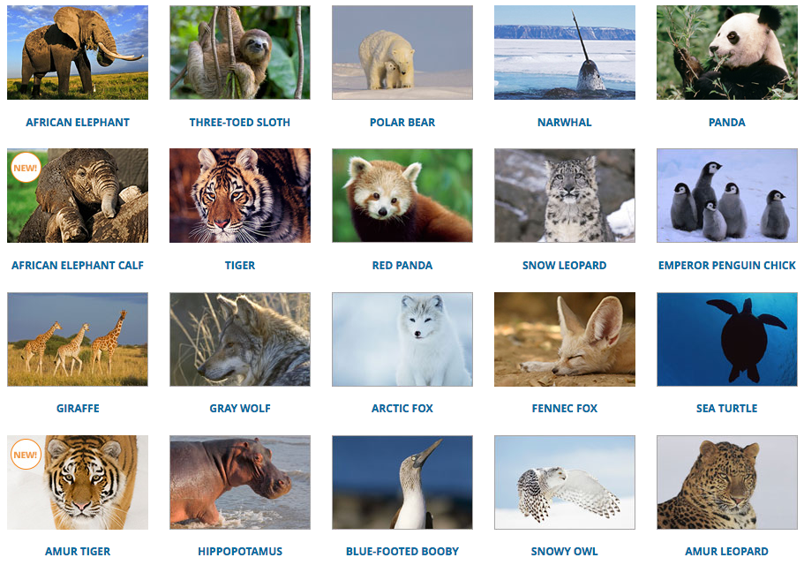
Flagship species = threatened by extinction?
2
VU
4
LC
VU
LC
VU
CR
EN
EN
VU
NT
VU
LC
LC
LC
7
CR
VU
sub
EN
VU
LC
VU
sub
CR

Slide 30
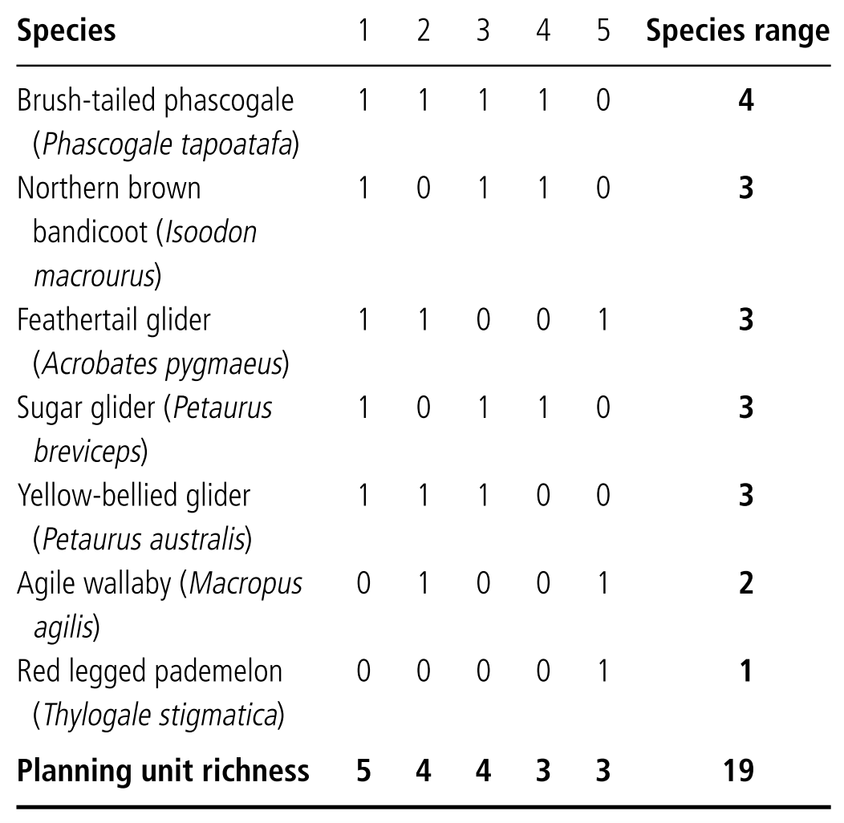
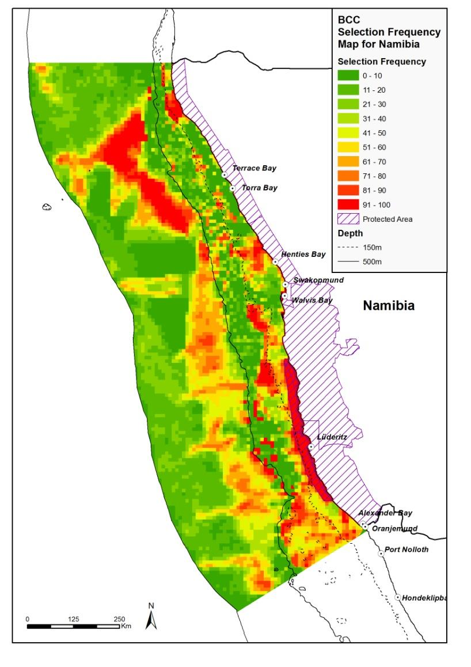
Complementarity
Marxan is an analytical tool that finds reserve
networks that achieve
predefined comple-
mentarity targets at
the lowest cost.
It uses an algorithm
called “simulated
annealing”

Slide 31
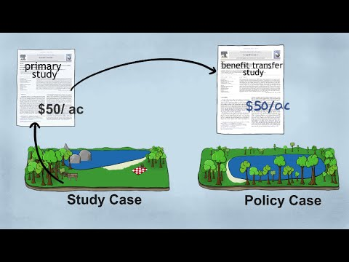
Benefit Transfer

Slide 32
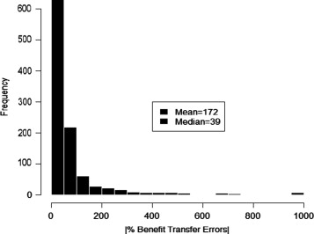
Be careful with benefit transfer
Benefit transfer: using values or functional relationships observed in other studies to infer values of current case.
  Cheaper, but extremely vulnerable to transfer errors
Median absolute error = 39%
Function transfers outperform value transfers
Transfers describing quantities outperform transfers describing quality changes
Geographic site similarity is important
Contingent valuation: lower transfer errors than other valuation methods
Combining data from multiple studies reduces transfer errors.
Kaul et al. (2013) What can we learn from benefit transfer errors? J Env Econ & Mgmt

Slide 33
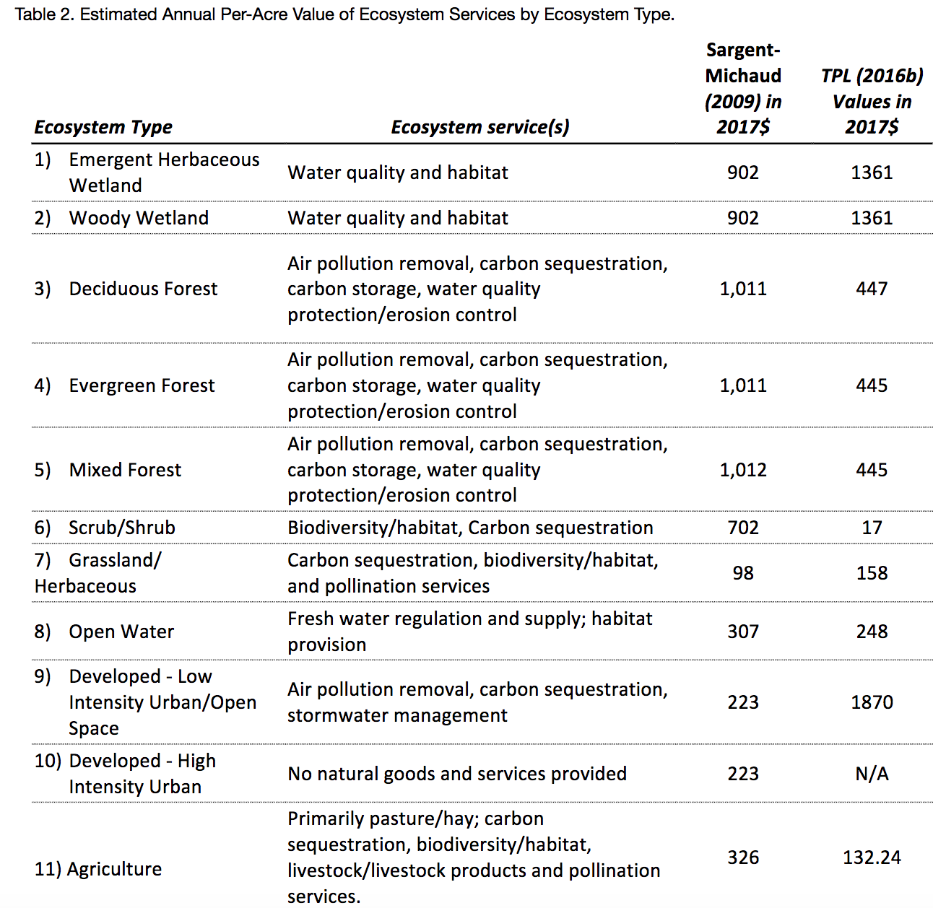

Benefit Transfer: Unit Value
Seidl et al. 2017

Slide 34
So what?

Slide 35
Objective function: alternatives / shortcuts
How can you specify an objective function for your project? Choose or combine any of the following:
  Adopt priorities defined by any given organization (government, international convention, company, NGO, etc.) or by any given program or intervention.
  Synthesize what is known about the preferences of your target group from the existing valuation literature.
  Refer to expert knowledge / scientific consensus.
  Model economic benefits to a specific actor group (e.g. water supply companies).
  Pick your personal priorities (and be explicit about that).

Slide 36
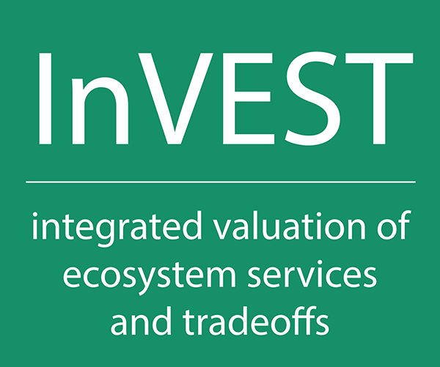
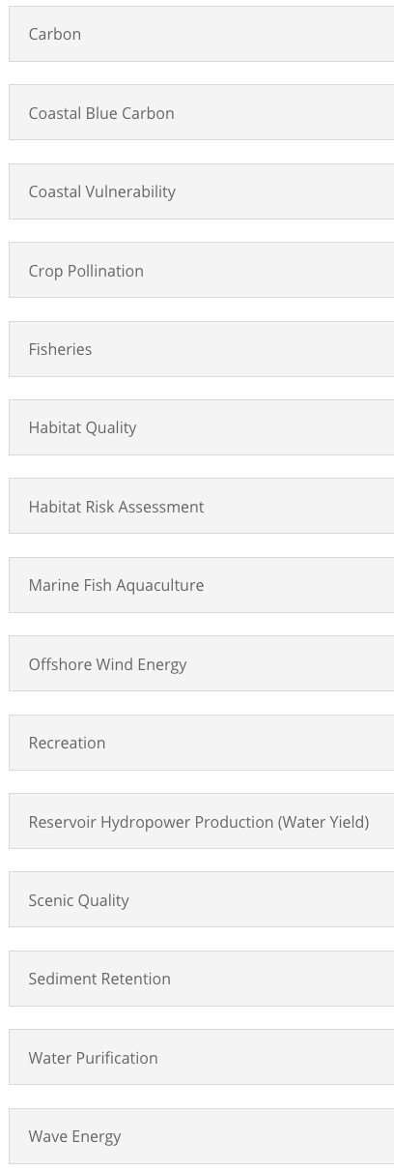
naturalcapitalproject.stanford.edu/software/invest
Homework: read the user guide of one of these models so you can explain to your classmates how the model works.

