Slide 1
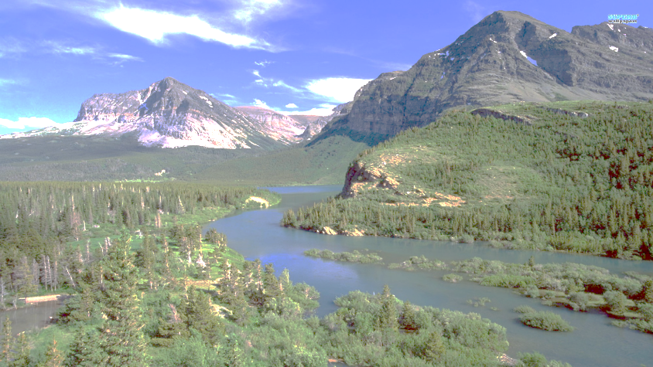

Impact Evaluation
Day 22

Slide 2
Ferraro 2009
What is impact evaluation?
Why does it matter? Why now?
What is counterfactual thinking?
Why does it matter?
What is selection bias?
Why does it matter?

Slide 3
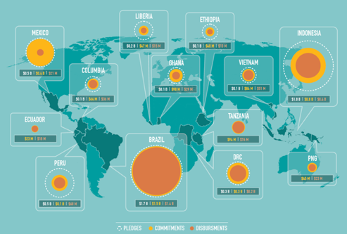

Policy
Impact
Δ Outcome

Slide 4
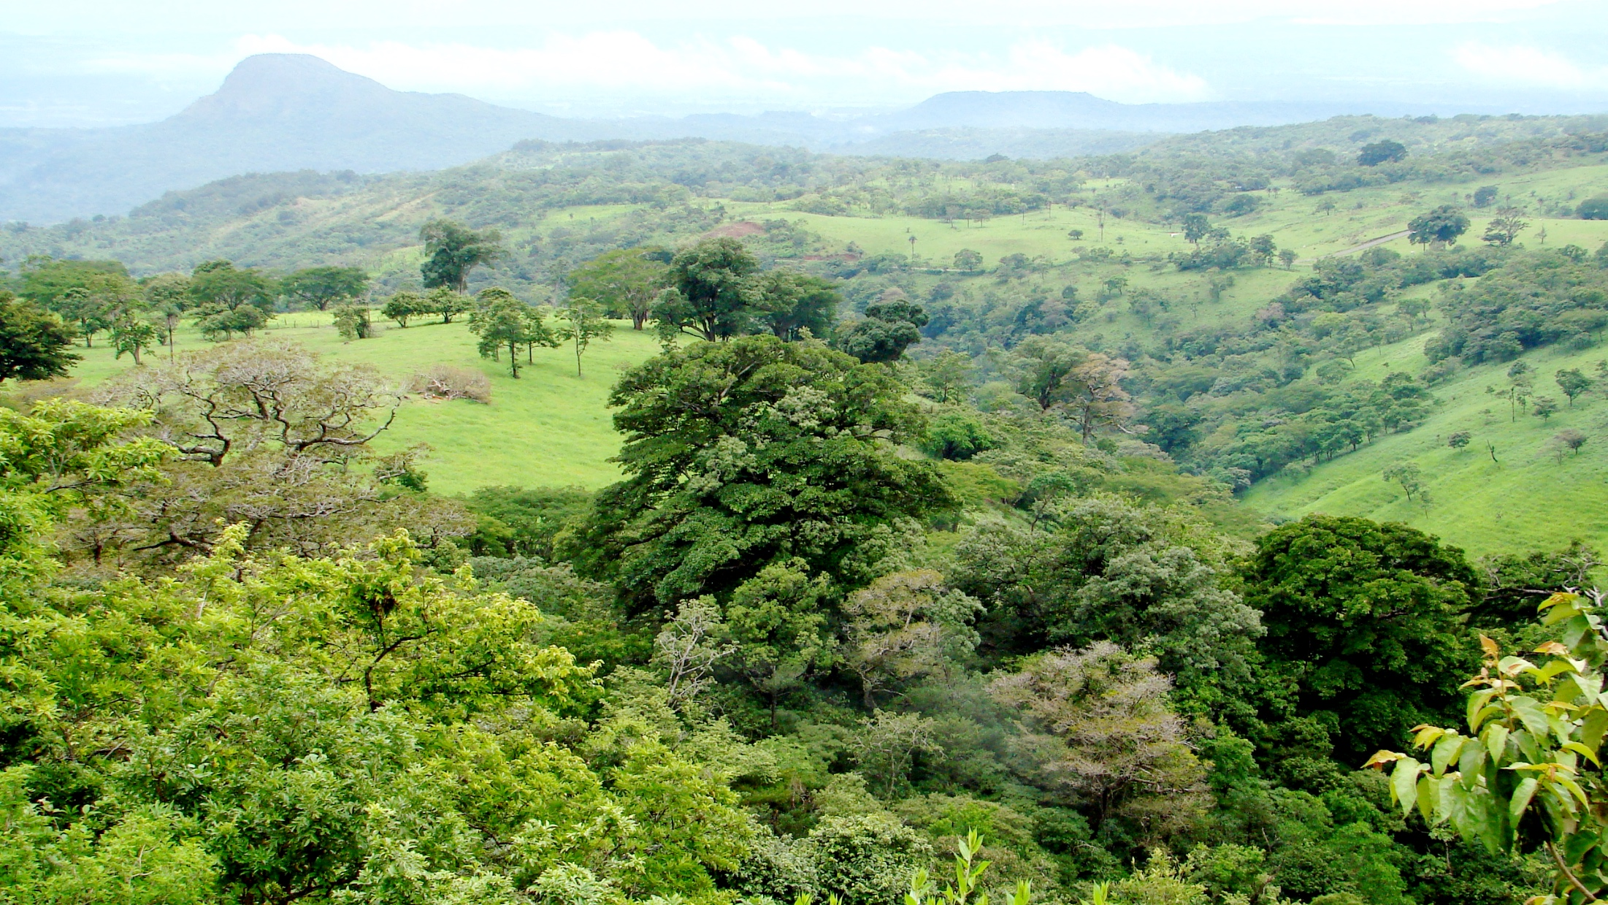
Example: What is the impact of Costa Rica’s payments for environmental services (PES) on deforestation?
Participating properties
Other
properties
During PES program period
0.5%
2%
Cotempo-raneous
confounding factors
Before PES program period
2%
8%
Selection Bias
Observed outcome variable: forest loss over 5-year period

Slide 5
Example: What is the impact of Costa Rica’s payments for environmental services (PES) on deforestation?
Participating properties
Other
properties
During PES program period
2%
8%
Cotempo-raneous
confounding factors
Before PES program period
0.5%
2%
Selection Bias
Observed outcome variable: forest loss over 5-year period

Slide 6
Success?
Failure?
Success?
Failure?
?
Nolte et al. 2013 PNAS

Slide 7
The Attribution Problem
Identification
Evaluation
Cotemporaneous Factors
Selection Bias
Observable or unobservable?
Time-variant or
time-invariant?
Confounding Factors
Treatment
Outcome

Slide 8
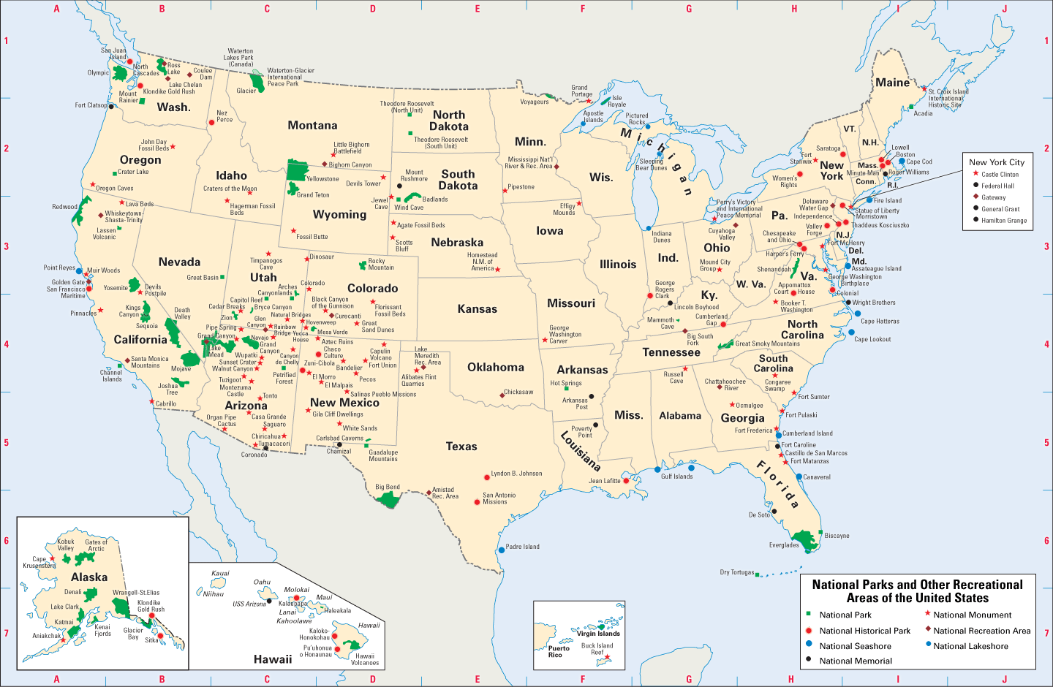

Slide 9
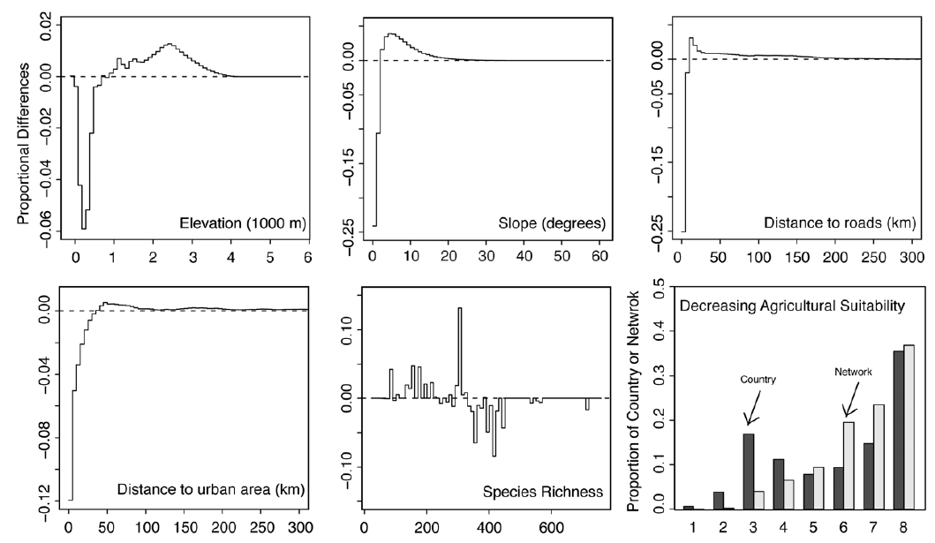
Selection Bias
Protected Areas in the U.S.
These variables are called Confounders.
Joppa & Pfaff (2009) PLoS One

Slide 10

Toolbox
Observational
“Quasi-Experimental”
Non-experimental
Comparative
Controlling for Confounders
“Natural” Experiments
Experimental
Before vs. After (BA)
Control vs. Intervention (CI)
Regressions
(Linear, Multiple, Logistic, Panel)
Instrumental Variables
Randomized Controlled Trial
(Experiment)
Difference-in-Differences (BACI)
Regression Discontinuity
Includes:
Randomized encouragement
Randomized phase-in
Matching
Panel Data Models
Synthetic Counterfactuals
Better ability to deal with selection bias

Slide 11

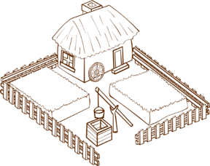
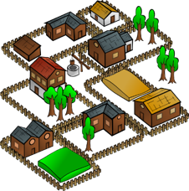
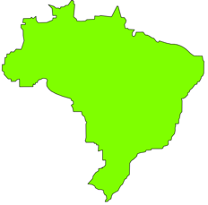
Units of Analysis
Should reflect the targeting of the policy
Can be hierarchical (e.g. village -> individuals)
Individuals
Households
Villages / Communities
Jurisdictions
Pixels
Plots
Protected Areas
Countries

Slide 12
“We have no shortage of good ideas to solve environmental problems, but we do have a glaring shortage of evidence to support these ideas”

Slide 13
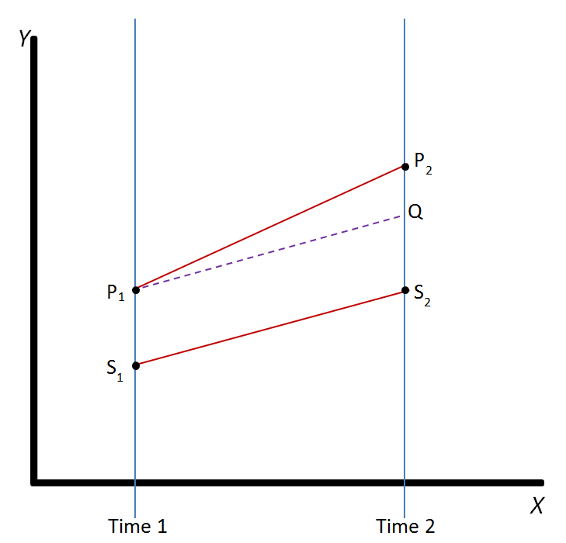
Difference-in-Differences (DID)
intervention
/ treated
Treatment Effect?
DID
Difference 1
control
Difference 2
Can control for time-invariant confounders (i.e. confounders that might affect one group more than the other, but with that difference not varying over time)

Slide 14
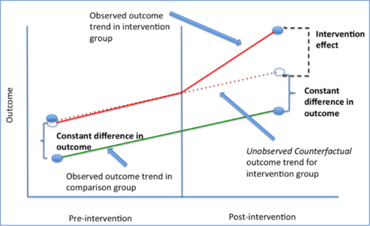
Difference-in-Differences (DID)
Argument for validity of DID is usually perceived as stronger if pre-intervention outcomes follow parallel time trends.

Slide 15
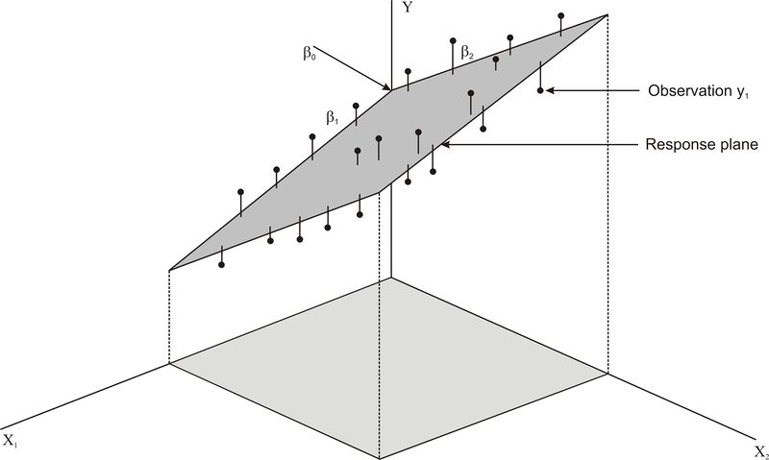
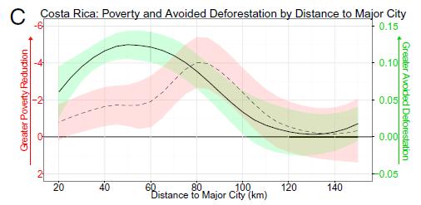
Regressions
with a treatment dummy
Problems occur if
  Treated and untreated units are very different from each other (occupy different areas in covariate space)
  → extrapolation
  Functional relationship between covariates and outcome is unknown and/or non-linear?
Ordinary Least Squares (OLS) / multiple linear regressions / generalized linear models
Logit / Probit models (for binary outcomes)
Interactions & more complex functional forms are possible
Ferraro et al. 2011

Slide 16
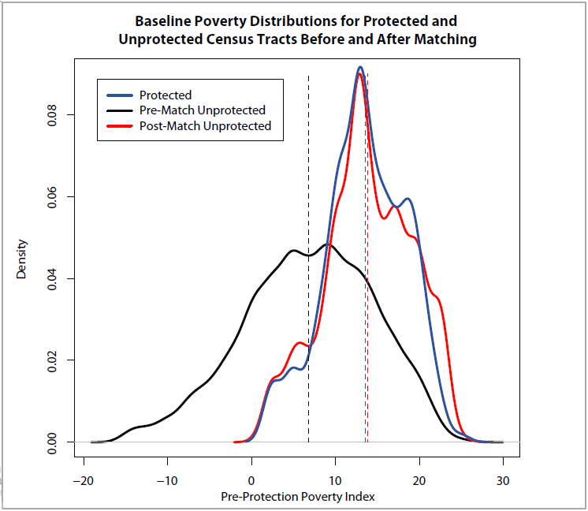
Matching
Matching treated units
to untreated units with similar observable characteristics
  Quasi-experimental: Mimics experiments by creating artificial control groups.
  Indicator of matching success: similarity in covariate distributions of treatment units vs. matched controls.
Treated units
All controls
Matched controls

Slide 17
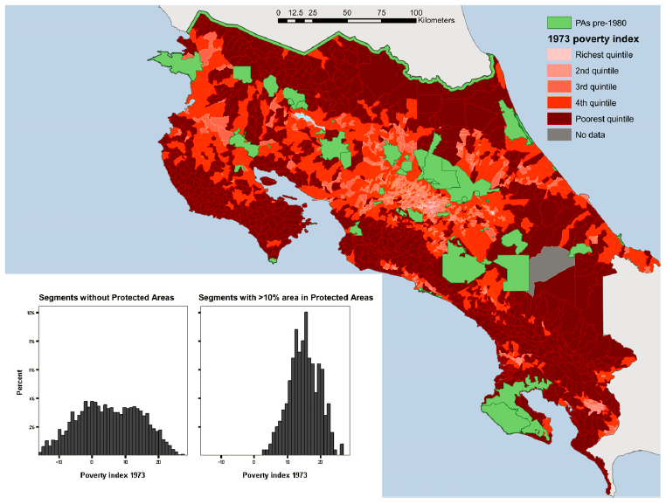
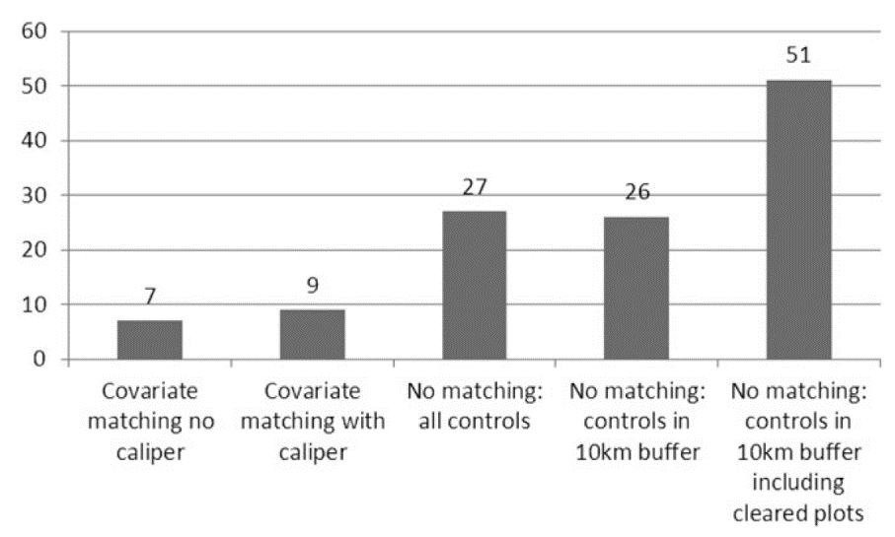
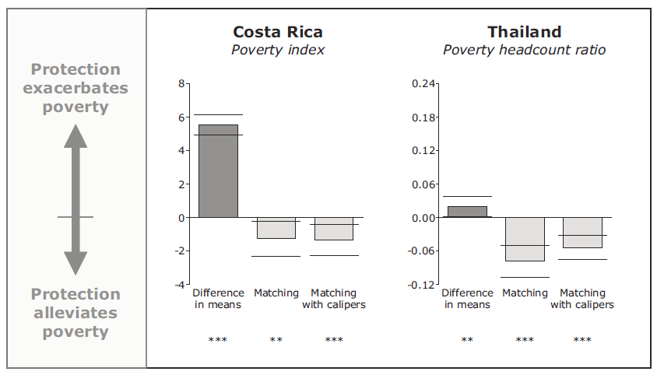
Matching: first applications
Poverty index in 1973, prior to the creation of the parks
Impacts of protected areas in Costa Rica
and Thailand on deforestation and poverty
Finding 1: Less deforestation was avoided than a simple inside-outside comparison suggests.
Finding 2: Protected areas reduced poverty
Avoided Deforestation Success
Poverty Impacts
census tracts with no parks (less poor in 1973)
census tracts with parks (poorer in 1973)
Andam et al. (2008) PNAS
Andam et al. (2010) PNAS

Slide 18
Matching
Outcome
(e.g. Deforestation)
Control (e.g. unprotected)
Treatment (e.g. protected)
“naive”
Covariate
(e.g. Distance to Markets)
(or Propensity Score)

Slide 19
Matching
Outcome
(e.g. Deforestation)
Control (e.g. unprotected)
Treatment (e.g. protected)
Linear regression with treatment dummy
Covariate
(e.g. Distance to Markets)
(or Propensity Score)

Slide 20
Matching
Outcome
(e.g. Deforestation)
Control (e.g. unprotected)
Treatment (e.g. protected)
“Common support”:
Extent of overlap of treatment and control groups in covariate space
Covariate
(e.g. Distance to Markets)
(or Propensity Score)

Slide 21
Matching
Outcome
(e.g. Deforestation)
Control (e.g. unprotected)
Treatment (e.g. protected)
1st nearest neighbor
2nd nearest neighbor
Kernel matching
Covariate
(e.g. Distance to Markets)
(or Propensity Score)

Slide 22
Matching
Outcome
(e.g. Deforestation)
Control (e.g. unprotected)
Treatment (e.g. protected)
Difference in Means
Covariate
(e.g. Distance to Markets)
(or Propensity Score)

Slide 23
Matching
Outcome
(e.g. Deforestation)
Control (e.g. unprotected)
Treatment (e.g. protected)
Matching can be used as a preprocessing step for your favorite statistical model
Post-matching linear regression with treatment dummy
Covariate
(e.g. Distance to Markets)
(or Propensity Score)

Slide 24
Matching
Outcome
(e.g. Deforestation)
Control (e.g. unprotected)
Treatment (e.g. protected)
Calipers:
No control unit within predefined distance
→ Treatment observation is dropped
Covariate
(e.g. Distance to Markets)
(or Propensity Score)

Slide 25
Matching: Choice of covariates
Ultimate goal: Achieve balance on all potential confounders, i.e. variables that influence both the outcome and the likelihood of treatment
  How do you identify confounders? Theory & knowledge of your case.
  Reality 1: Important confounders are often unobservable.
    Match on observable confounders and discuss implications of missing variables.
    Combine with DID to control for time-invariant unobservable confounders.
  Reality 2: Important confounders are unobserved at baseline (no data exists)
    Work with what you get …
Treatment
Evaluation
Covariates
Time

Slide 26

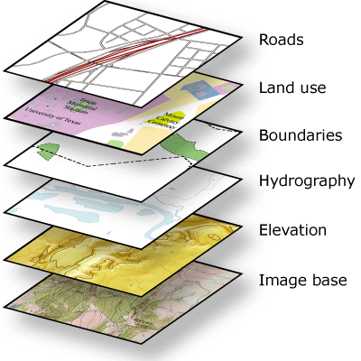

Matching: Process
Obtain spatial datasets (treatment, outcome, covariates)
Use GIS to create table that includes all variables for your sample of units of analysis
Evaluate matching quality (covariates, sample size)
Conduct matching in preferred stats program
Estimate impact (your model of choice)
improve
Robustness checks, placebo tests
Variables
R: Match, MatchIt
Stata: match, psmatch2
Decisions: Covariates, subgroups, matching method(s), distance, weighting, calipers, bias adjustment, …
Units

Slide 27

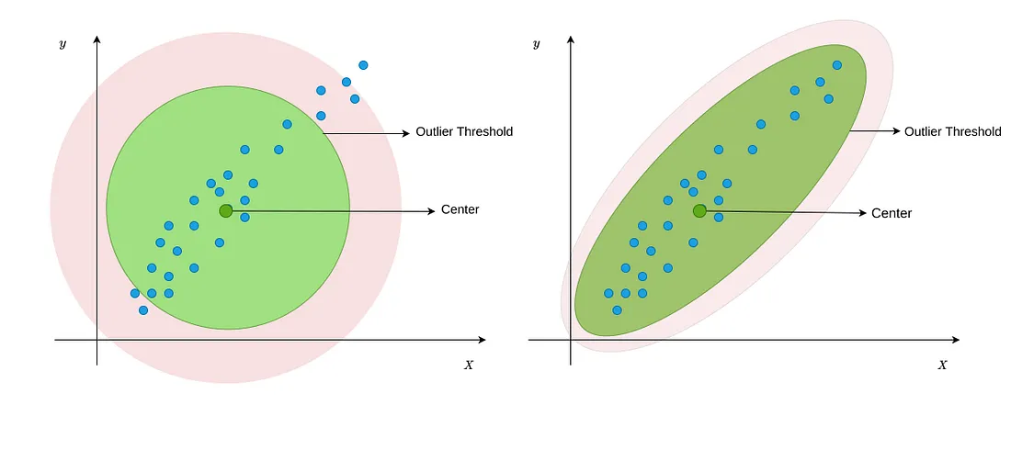
Mahalanobis distance
“a scale-free, correlation-aware distance.”
Euclidean distance
Mahalanobis distance
https://medium.com/data-science/multivariate-outlier-detection-in-python-e946cfc843b3

Slide 28
Matching advances & applications

Slide 29
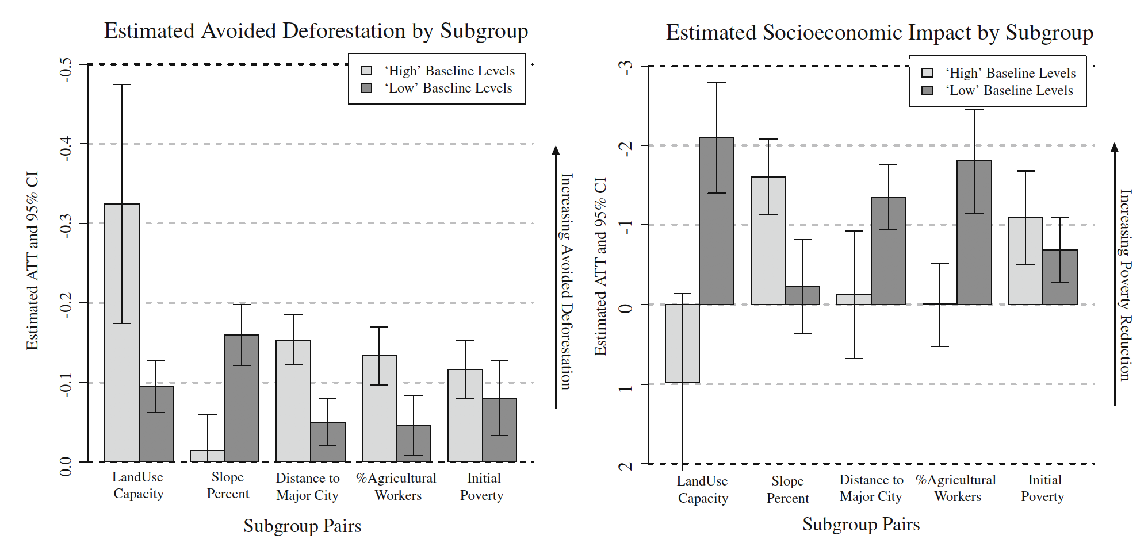
Parks in Costa Rica: Subgroup Analyses
Avoided Deforestation
Poverty Alleviation
Ferraro & Hanauer (2010) Protecting Ecosystems and Alleviating Poverty with Parks and Reserves: ‘Win-Win’ or Trade-Offs?

Slide 30
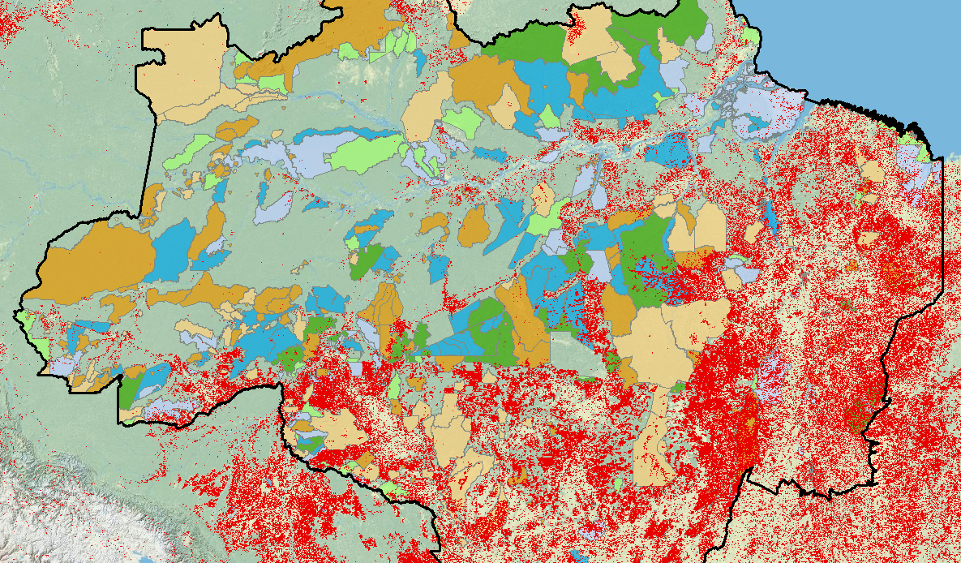
Protected Areas in the Brazilian Amazon
Nolte et al. (2013) Governance regime and location influences avoided deforestation success of protected areas in the Brazilian Amazon. PNAS

Slide 31
Protected Areas in the Brazilian Amazon
Nolte et al. (2013) Governance regime and location influences avoided deforestation success of protected areas in the Brazilian Amazon. PNAS

Slide 32
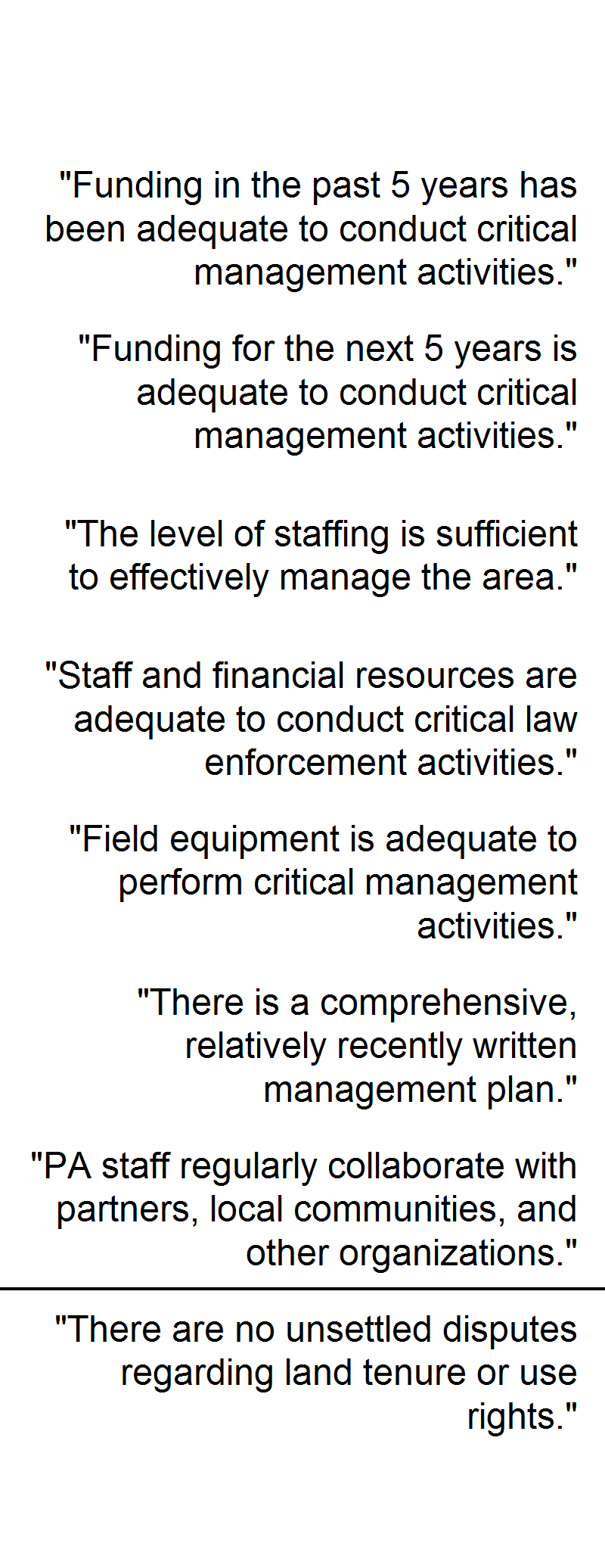
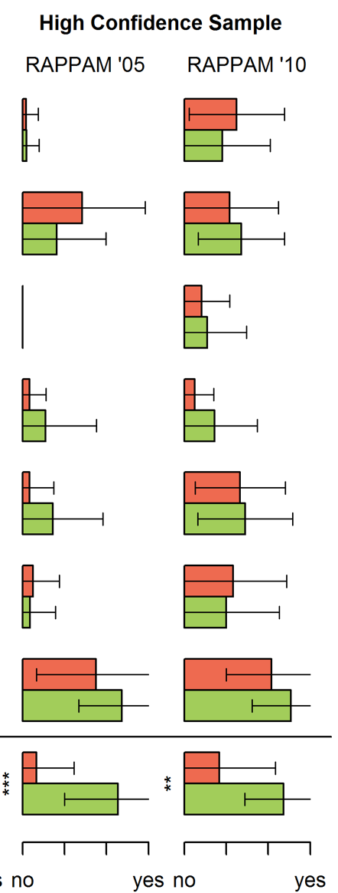
Strictly Protected
Sustainable Use
Nolte et al. (2013) Setting priorities to avoid deforestation in Amazon protected areas: are we choosing the right indicators?

Slide 33
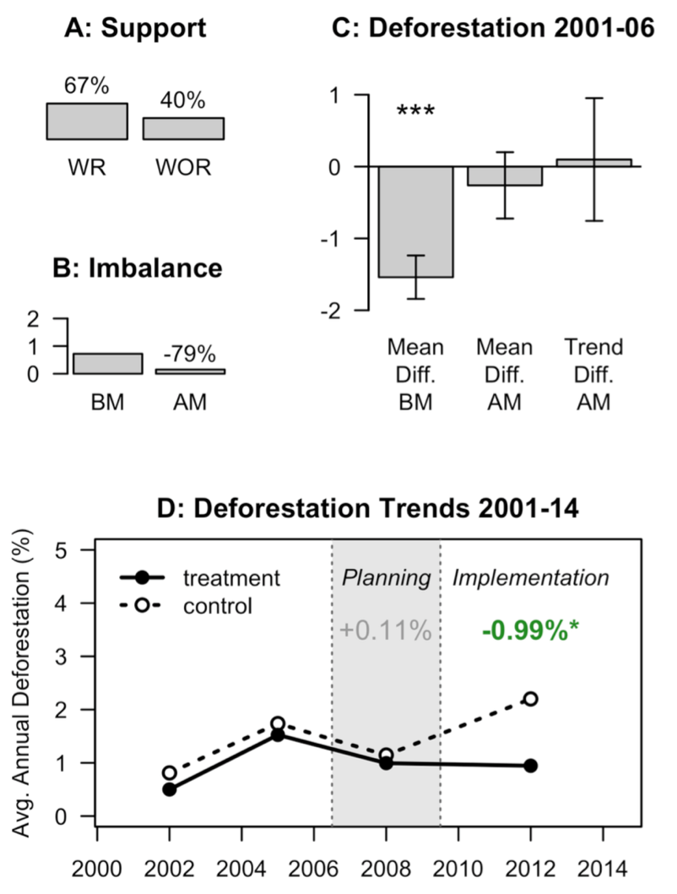
Matching + DID
A: % of matched treatment pixels with replacement (WR) and without replacement of control units (WOR)
C: Differences in pre-treatment deforestation before matching (BM) and after matching (AM), and difference in deforestation time trends after matching (AM)
Did Argentina’s 2007 Forest Law reduce deforestation in the Chaco forests?
B: Covariate balance (standardized difference) before matching (BM) and after matching (AM)
Impact of policy during planning process and implementation process (matched treatment and controls)
Nolte et al. (2017) Decentralized land use zoning reduces large-scale deforestation in a major agricultural frontier. Ecological Economics

Slide 34
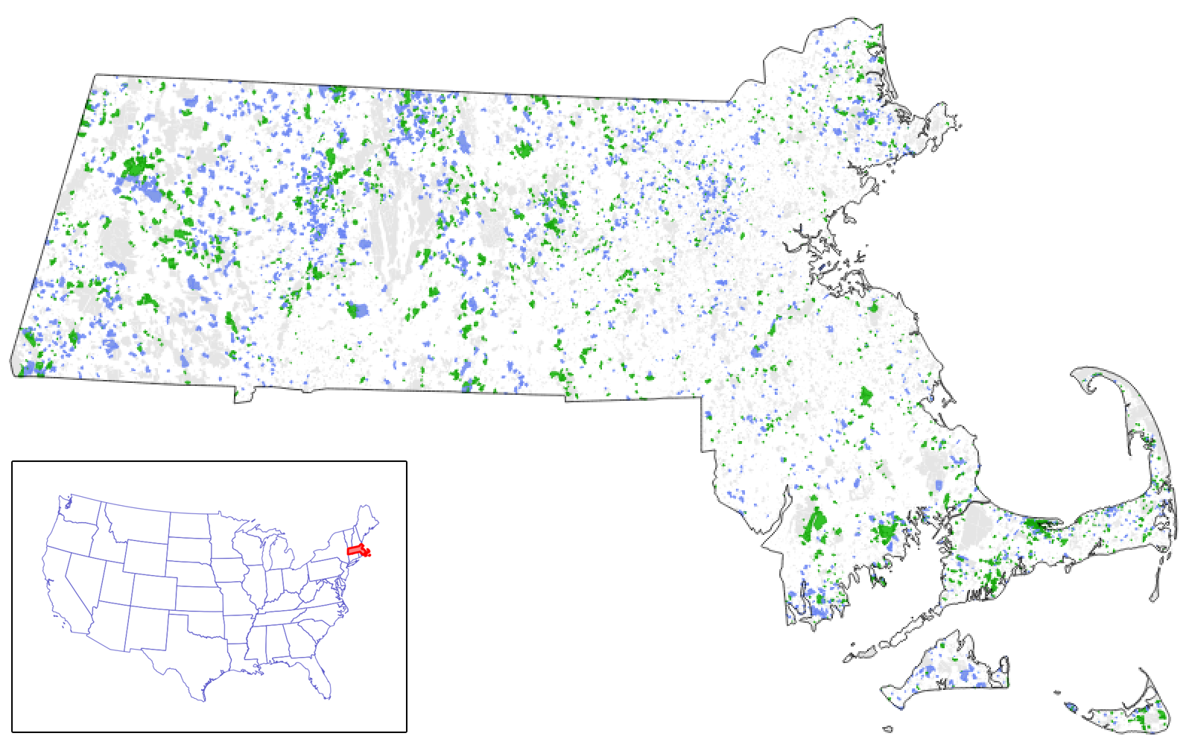
Private Land Protection in Massachusetts
Impacts: protected parcels vs.
unprotected parcels
Spillovers: unprotected parcels
next to recently protected
parcels vs. unprotected parcels
away from protected parcels
Required modifying the matching
algorithm to ensure that parcels
were matched at the time of treatment
(which varied between 1985 and 2006).
220,187 | parcels > 1ha (2.5ac)
6,676 | protected >80% 1985-2006
Nolte et al. (2019) Voluntary, permanent land protection reduces forest loss and development in a rural-urban landscape. Conservation Letters

Slide 35
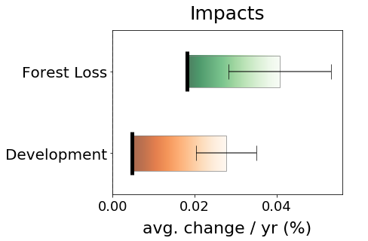
Did protection reduce land cover change?
with protection
without protection
Yes.

Slide 37
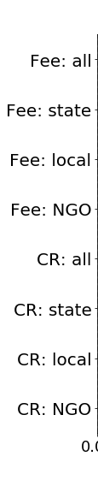
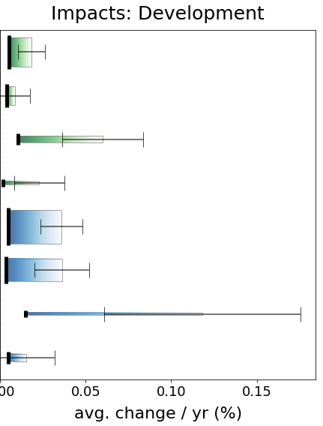
Land Acquisitions
Conservation Easements

Slide 38
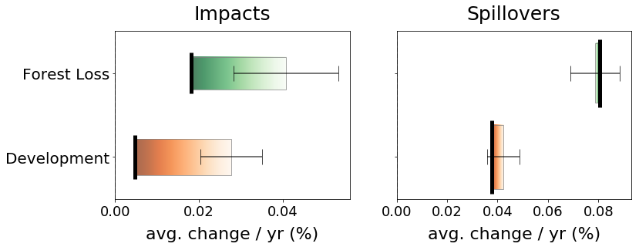
Did protection increase land cover change on adjacent parcels (spillovers)?
No.

Slide 40
Beyond matching more rigorous impact evaluation tools for observational data

Slide 41
Instrumental Variables
Confounding Factors
Treatment
Outcome
no direct influence
Instrument
Scope of Application: If there is a variable (instrument) that influences the outcome exclusively through its influence on the treatment (usually an external source of random variation)

Slide 42
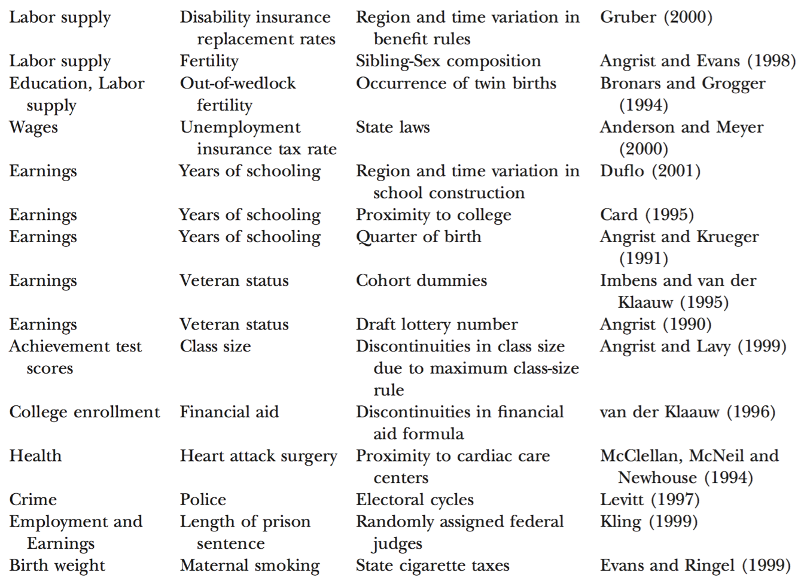
Instrumental Variables: examples
Outcome
Treatment
Instrument
Reference
Angrist & Krueger (2001) Instrumental Variables and the Search for Identification. J of Economic Perspectives

Slide 43
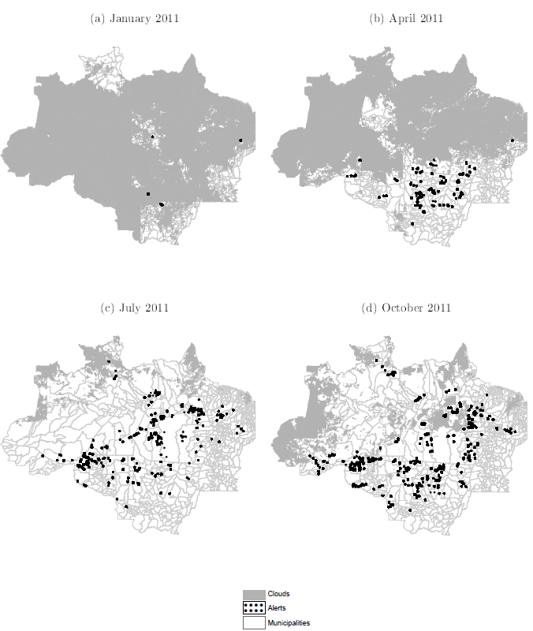
Instrumental Variables
Law enforcement against deforestation in Amazon
  Environmental police visits recent deforestation spots after receiving satellite alerts
  Daily cloud cover has random properties, influences alerts and thus enforcement.
  Cloud cover does not directly influence deforestation (except through its impact on enforcement)
  → used to estimate impact of enforcement on deforestation
Assunção et al. (2023) DETER-ing Deforestation in the Amazon: Environmental Monitoring and Law Enforcement. American Economic Journal: Applied Economics

Slide 44
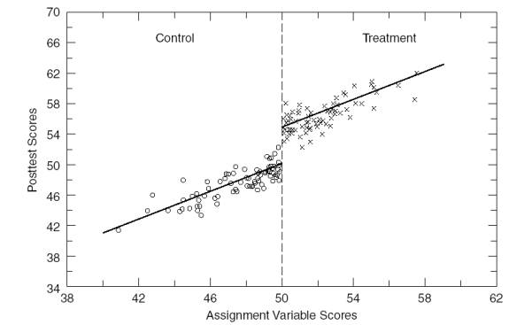
Regression discontinuity

Slide 45
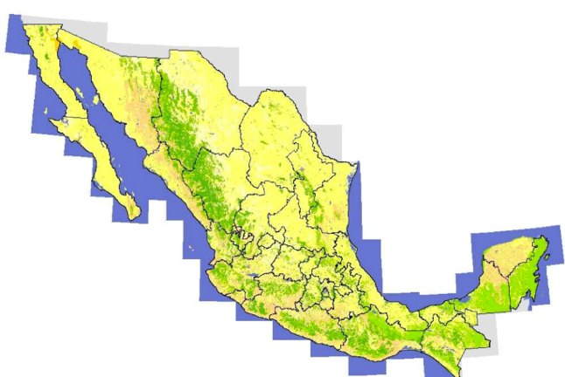
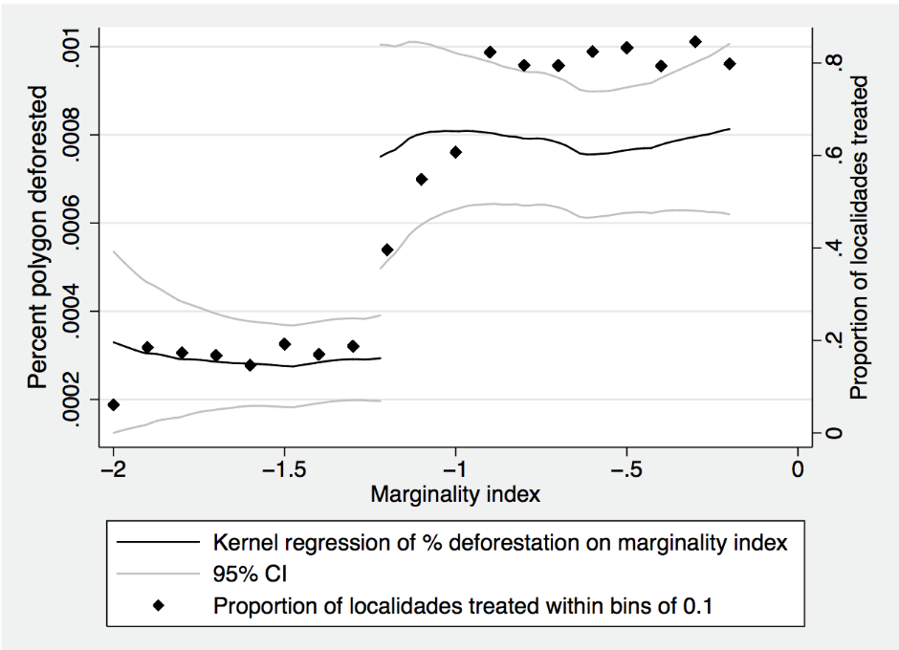
Regression discontinuity: example
Mexico’s “Oportunidades”
  Conditional cash transfers to poor villages (below a marginality index threshold)
  Cash transfers increased household income by a third
Finding: Conditional cash transfers increased deforestation
  Especially in villages with poor infrastructure
Alix-Garcia et al. (2013) The Ecological Footprint of Poverty Alleviation: Evidence from Mexico’s Oportunidades Program. Review of Economics and Statistics

Slide 46
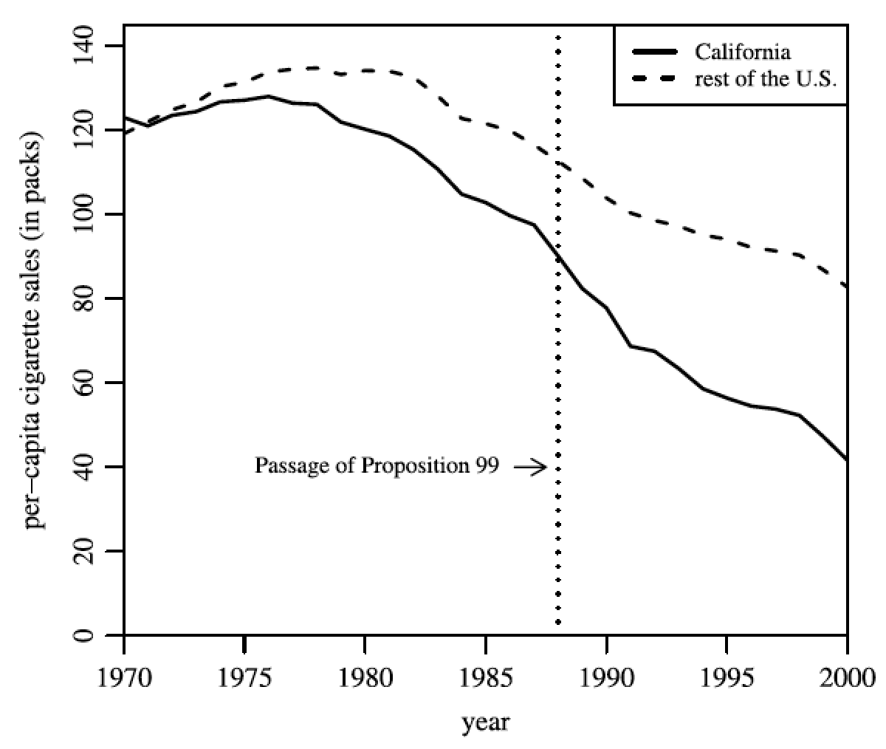
Synthetic counterfactuals
Context: One treated case, many possible controls, rich panel data (many time periods)
Method uses pre-treatment covariates and outcomes to construct “synthetic” control case
(1988)
Abadie et al. (2010)

Slide 47
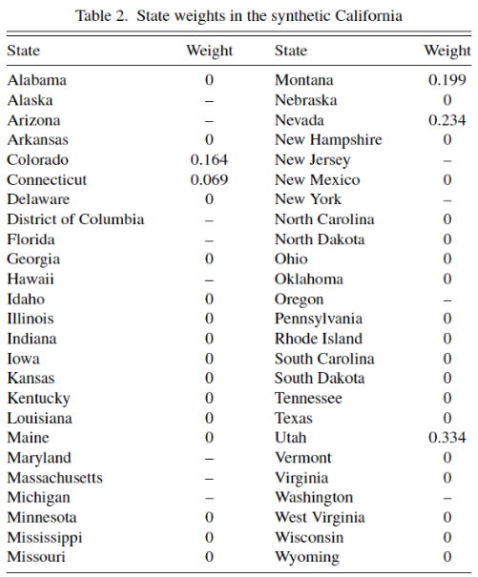
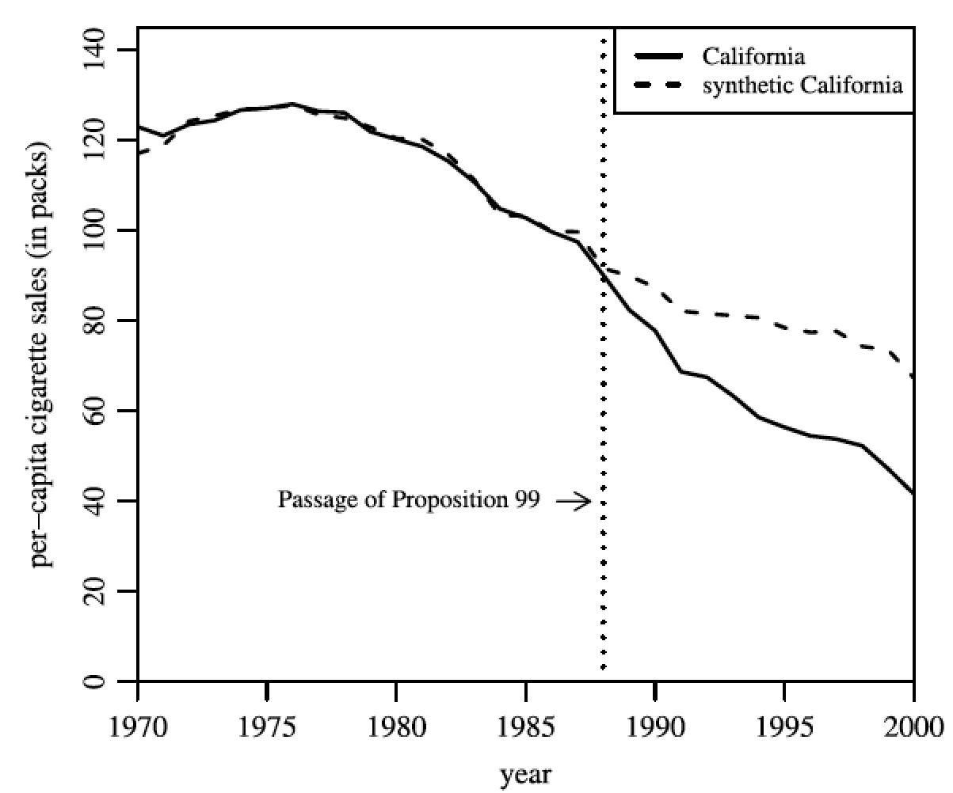
Synthetic counterfactuals

Slide 48
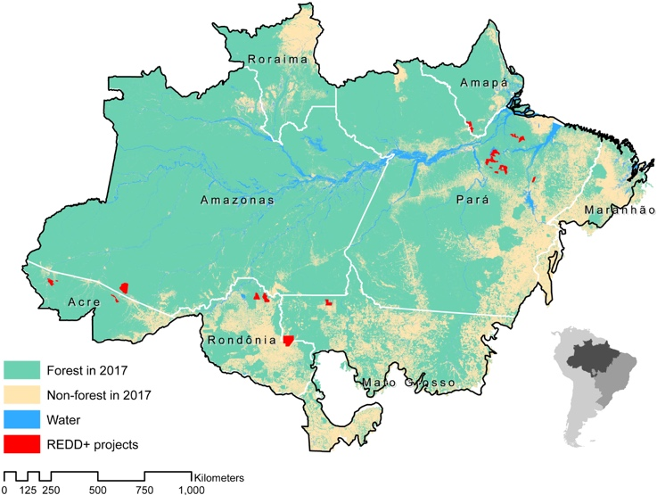
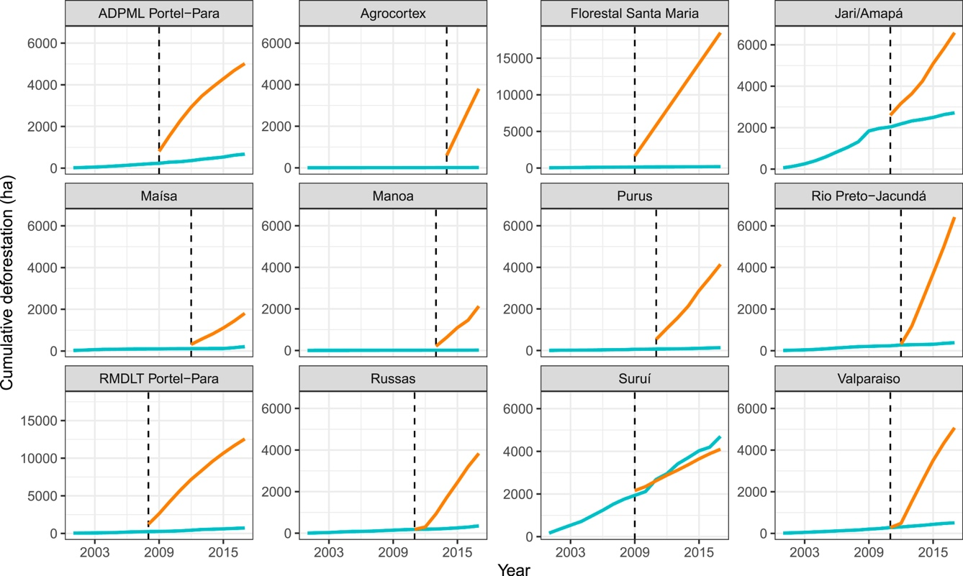
Synthetic counterfactuals for carbon credits
REDD projects in the Brazilian Amazon appear to have exaggerated their “business-as-usual” deforestation estimates
West et al. (2020) Overstated carbon emission reductions from voluntary REDD+ projects in the Brazilian Amazon. PNAS

Slide 49
Common real-life barriers to evaluation
Nonlinear response outcomes (e.g. thresholds)
High natural rate of outcome variability (noise >> signal)
Treatments that comprise multiple interventions
Infrequent data sampling, absent baseline, large measurement error
Long time lag between intervention and response
Complex spillover effects (e.g. leakage, migration)
Large spatial scales of ecological processes & environmental interventions
Unique treatment units without comparators
Small operations budgets

